Slide 1
A
PROJECT REPORT ON
“HVAC System for Cars and Automotive Vehicles ”
UNDERTAKEN AT
“MIT School of Distance Education”
IN PARTIAL FULFILMENT OF
“PGDBM PROJECT MANAGEMENT”
MIT SCHOOL OF DISTANCE EDUCATION, PUNE.
GUIDED BY
“Mr.Atul Sawant”
SUBMITTED BY
“Mr. Mahesh Bhosale”
STUDENT REGISTRATION NO.:
MIT202312345
MIT SCHOOL OF DISTANCE EDUCATION PUNE - 411 038
YEAR 2023-24
www.mitsde.com

Slide 2
Exempt Certificate - If you’re not able to provide the Project
Executed Certificate
To
The Director
MIT School of Distance Education,
Respected Sir,
This is to request you to kindly exempt me from submitting the certificate for Project Work due to the reason mentioned below:
Tick the right option
1. As per the Rules of the Organisation
2. Self Employed
Working in Public Sector
Full-time Student
Thanking you in anticipation of your approval to my request. Regards
Student Sign: - Student Name: Student ID:
www.mitsde.com

Slide 3
DECLARATION
I hereby declare that this project report entitled “HVAC System for Cars and Automotive Vehicles ” bonafide record of the project work carried out by me during the academic year 2023-2024, in fulfillment of the requirements for the award of “PGDBM Project Management” of MIT School of Distance Education.
This work has not been undertaken or submitted elsewhere in connection with any other academic course.
Sign:-
Name:-Mahesh Bhosale
Student ID: MIT2022D01920
www.mitsde.com

Slide 4
ACKNOWLEDGEMENT
I would like to take this opportunity to express my sincere thanks and gratitude to “ Mr.Atul Sawant”, Faculty of MIT School of Distance Education, for allowing me to do my project work in your esteemed organization. It has been a great learning and enjoyableexperience.
I would like to express my deep sense of gratitude and profound thanks to all staff members of MIT School of Distance Education for their kind support and cooperation which helped me in gaining lots of knowledge and experience to do my project work successfully.
At last but not least, I am thankful to my Family and Friends for their moral support, endurance and encouragement during the course of the project.
Sign:-
Name:-Mahesh Bhosale
Student ID: MIT2022D01920
www.mitsde.com

Slide 5
TABLE OF CONTENTS
1.0. | CHAPTER 1: BASIC PRINCIPLES OF AIR-CONDITIONING
1.1 | HVAC System
1.2 | Principles of Air Conditioning
1.3 | Classification of Heat
1.4 | Rules of Heat Transfer
1.5 | Factors Affecting Heat Transfer Efficiency
1.6 | Refrigeration System and Components
1.7 | Refrigeration Cycle
1.8 | Automobile Air-conditioning System
2.0. | CHAPTER 2: DESCRIPTION OF COMPONENTS
2.1 | Compressors
2.2 | Electromagnetic Clutch
2.3 | Compressor Designs
2.4 | Piston Type Compressor
2.5 | Through-Vane (TV) Compressor
2.6 | Swash-plate Compressor
2.7 | Variable Displacement Compressor (VDC)
2.8 | Scroll Compressor
2.9 | Electric Compressors
2.10 | Air conditioning Compressor Failures
2.11 | Receiver/Dryer
2.12 | Condensers
2.13 | Flow Control Devices
2.14 | Evaporator
2.15 | Air Distribution System
www.mitsde.com

Slide 6
 | HVAC System for Cars and Automotive Vehicles
2.16 | Evaporator Fan/Blower
2.17 | Cabin Filters
2.18 | Other Miscellaneous Components
2.19 | Heating
3.0. | CHAPTER 3: SYSTEMS OPERATION OVERVIEW & SAFETY DEVICES
3.1 | Controlling Refrigerant in A/C Systems
3.2 | Refrigerant Pressure Switch
3.3 | Pressure Control Valve
3.4 | Thermal protection switch
3.5 | Anti-frost Devices (Freeze protection of evaporator)
3.6 | Fusible plug (pressure relief valve)/High-Pressure Switch
3.7 | Relays
3.8 | Automatic Sensors
4.0. | CHAPTER 4: CLIMATE CONTROL SYSTEM
4.1 | Features of the Climate Control System
4.2 | How does Climate Control Work?
4.3 | Mechanics of Automated Climate Control
4.4 | Zone Control
5.0. | CHAPTER 5: REFRIGERANTS AND ENVIRONMENTAL REGULATIONS
5.1 | Refrigerants
5.2 | Refrigerant Leaks
5.3 | Environmental Regulations
5.4 | Ozone Layer
5.5 | Impact of Motor Vehicle Air Conditioners
6.0. | CHAPTER 6: EVALUATING AND DIAGNOSING CAR HVAC
6.1 | Problem: Air conditioning not cooling enough

Slide 7
HVAC System for Cars and Automotive Vehicles
Problem: Refrigerant Charging
Problem: Low Refrigerant Charge
Problem: Refrigerant Overcharge
Problem: Air in the Refrigerant Circuit
Problem: Moisture in the Refrigeration Circuit
Problem: Insufficient Air from the Vents
Problem: Smell and Odours
Problem: AC Makes Noise
Problem: Air Conditioning Goes from Cold to Hot
Common Problems with Compressors and Clutches
Common Problems with Condensers
Common Problems with Evaporators
Common Problems with Metering Devices
Common Problems with Receiver/Dryer or Accumulator/Dryer
www.mitsde.com

Slide 8
HVAC System for Cars and Automotive Vehicles
Chapter 1
1.0 Introduction:
Background and Context
In today's rapidly evolving business landscape, internships serve as a pivotal bridge between academic learning and practical application. This report documents my PGDBM internship experience at Sanden Vikas India Pvt Ltd in Sanaswadi, Pune, and a leading player in the automotive air-conditioning manufacturing industry during the summer of 2023. The project undertaken during my internship aimed to address critical challenges within the organization, offering insights into the strategic decisions that impact its growth trajectory.
This eight-week training is a part of our 2-year PGDBM course. Practical industrial training mainly aims at making one aware of the industrial environment, which means getting to know the limitations, constraints, and freedoms under which a manager works. One also gets an opportunity to observe management relations from up close. This training mainly involves gaining industrial and comprehensive knowledge about management strategies, relationship management, teamwork, the PDCA approach, industrial operations, design, and control of activities within the organization. Excellence is an attitude that the entire human race is born with. It is the environment that determines whether the results of this attitude are visible or not. A well-planned, properly executed, and evaluated industrial training goes a long way in inculcating a professional attitude. It provides a linkage between the student and the industry to develop an awareness of an industrial approach to problem-solving, based on a broad understanding of the processes and modes of operation of the organization. During this period, students gain real experience working in the actual environment. Most of the theoretical knowledge acquired during the course of their studies is put to the test here.
Apart from this, students have the opportunity to learn the latest technology, which immensely helps them in building their careers. I had the opportunity to gain real experience on many ventures, which significantly expanded my sphere of knowledge. I had the chance to learn many new technologies and was introduced to various new instruments, and all the credit goes to Sanden Vikas (India) Pvt. Ltd., Pune.Research Objectives
Primary Objectives:
HVAC System for Cars and Automotive Vehicles.
Company Overview:
Sanden Vikas India Ltd is the flagship company of the Vikas Group and a pioneer and industry leader in automotive air-conditioning. Globally recognized for its leading-edge technology and innovative thermal management systems, SVL is India’s only company manufacturing 3 types of compressors under one roof. Sanden Vikas India Pvt. Ltd. is a leading player in India's automotive air conditioning manufacturing industry. It is recognized
for its commitment to producing high-quality air conditioning systems and components for vehicles. With a history dating back to its establishment in 1991, the company has solidified its position as a trusted partner for the Indian automotive industry.
www.mitsde.com

Slide 9
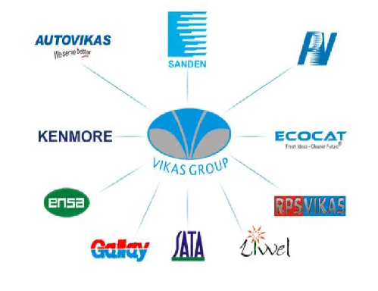
HVAC System for Cars and Automotive Vehicles
History and Founding:
In 1982, before the widespread use of air-conditioning systems in India, Vikas Group saw the potential for automotive air conditioning and entered into a joint venture with Sanden Corporation of Japan to establish manufacturing facilities for world-class Sanden Car Air-Conditioning Systems in India. The company had the distinction of being the pioneer OE supplier of A/C systems to Maruti Udyog Ltd. for their M800 car and Omni Van.
Over the last 42 years, Sanden Vikas has established a very strong R&D team. The company has a fully functional Design Centre with fully-fledged CAD/CAM facilities supported by the latest software. It has the capabilities to design and develop any type of automotive air-conditioning requirements to meet the diverse needs of the customers as per local climatic conditions. All quality control and training functions are conducted under the strict and vigilant eyes of expert Japanese Engineers.
Over the last some decades, SVL and the Group companies have established and further enhanced their production facilities to manufacture air-conditioning parts like compressors, HVACs, blowers, receiver driers, hoses & pipes, high-precision machined parts, and injection-molded parts. They have a strong and fully trained workforce at all their manufacturing locations. The Company and the Group companies have a very strong focus on quality and customer satisfaction. Most group companies are accredited with ISO/TS16949 certifications. SVL is on its way to challenging the Deming Award, which it hopes to accomplish by 2009. In order to deliver quality products to its customers, the company has set a minimum criterion of ISO9001 certification for all its vendors as well.
Group of the company
The company was founded as a joint venture between Sanden Corporation, a renowned Japanese multinational with decades of experience in automotive air conditioning, and Vikas Group, a well-established Indian industrial conglomerate. This partnership brought together the best of both worlds, combining Japanese precision and innovation with Indian market insights.
www.mitsde.com

Slide 10
HVAC System for Cars and Automotive Vehicles
Mission, Vision and Values:
Sanden Vikas India Pvt. Ltd.'s mission is to lead in providing eco-friendly and energy-efficient automotive air conditioning solutions in India. The company values innovation, quality, sustainability, and customer satisfaction as core pillars of its corporate philosophy. Their aim is to contribute to cleaner and more comfortable driving experiences while minimizing environmental impact.
Company's Mission
- To be India's leading automotive air conditioning company.
- To be globally competitive.
- To benchmark with best and be at the top of the class in technology, design, manufacturing and quality.
- To delight and exceed customer expectations.
Company's Vision
- Let us develop with wisdom and prosper in harmony.
- Create value through challenge and innovation.
- Sustain growth and gain for all stakeholders.
Management Principles
- Challenge and innovation.
- Customer is king.
- Benchmark with the best and be top-of-the-class.
- Decision-making: Transparency, employee participation, and consensus building.
- Implementation of decisions and adherence to targets.
- Discipline.
- Cost consciousness.
1Organizational Structure:
The company's organizational structure typically includes various departments, such as manufacturing, research and development, sales, marketing, and support functions. At the helm is an executive team responsible for overseeing day-to-day operations and making strategic decisions.
Financial Performance:
An analysis of the company's financial performance reveals a track record of financial stability and growth, which is often closely linked to the performance of the Indian
www.mitsde.com

Slide 11
HVAC System for Cars and Automotive Vehicles
automotive industry. The company's ability to maintain profitability in varying economic conditions underscores its resilience and market presence.
Revenue and Profit Trends:
Revenue and profit trends can vary from year to year and are influenced by factors such as the overall performance of the automotive sector in India, consumer demands, and economic conditions. Variations are common in industries closely tied to the automotive sector.
Corporate Culture:
Sanden Vikas India Pvt. Ltd. fosters a corporate culture that emphasizes innovation, quality, and a customer-centric approach. They prioritize the development of innovative solutions and maintaining a strong commitment to customer satisfaction. Their culture embodies a forward-thinking and adaptable spirit.
Employee Values and Culture:
The company values qualities like integrity, teamwork, and a commitment to excellence among its employees. Staff members are encouraged to contribute to the company's mission and embrace a culture of innovation and continuous improvement.
Social Responsibility Initiatives:
As part of its corporate social responsibility (CSR) efforts, Sanden Vikas India Pvt. Ltd. may engage in activities related to environmental sustainability, community development, and other initiatives aimed at giving back to society. These initiatives align with the company's mission to provide eco-friendly air conditioning solutions.
Awards & Recognitions:
Over the years, the company may have received several awards and recognitions within the automotive industry. These accolades acknowledge Sanden Vikas India Pvt. Ltd.'s innovation, product quality, and commitment to environmental sustainability. They serve as testimony to the company's dedication to excellence.
www.mitsde.com

Slide 12
SWOT ANALYSIS of Company
A SWOT analysis (Strengths, Weaknesses, Opportunities, and Threats) of Sanden Vikas India Pvt Ltd can provide insights into its internal and external factors.
1. Strengths:
1. Established Brand: Sanden Vikas India Pvt Ltd is associated with the Sanden Group, a global leader in automotive air conditioning systems, providing credibility and trust.
2. Product Quality: Known for producing high-quality automotive air conditioning systems and components, meeting international standards.
3. Diverse Product Portfolio: Offers a wide range of products, including compressors, condensers, and heat exchangers, serving various segments of the automotive industry.
4. Innovation: Continuously invests in R&D, leading to the development of innovative and energy-efficient solutions.
5. Strong Industry Relationships: Maintains long-standing relationships with key players in the automotive industry, fostering strategic partnerships.
6. Global Presence: Part of a global network, allowing for international reach and access to new markets.
www.mitsde.com

Slide 13
2. Weaknesses:
1. Dependence on the Automotive Industry: Vulnerable to fluctuations in the automotive market, which can impact revenues.
2. Competitive Market: Faces competition from other major players in the automotive air conditioning sector.
3. Environmental Regulations: Stringent environmental regulations require constant adaptation and investment in eco-friendly technologies.
4. Supply Chain Challenges: Susceptible to supply chain disruptions, impacting manufacturing and deliveries.
5. Labor Intensive: Manufacturing processes are labor-intensive, potentially increasing production costs.
3. Opportunities:
1. Electric Vehicles (EVs): The shift towards EVs creates opportunities for Sanden Vikas to develop air conditioning solutions for electric vehicles.
2. Energy Efficiency: Growing focus on energy-efficient systems presents opportunities to develop and market more eco-friendly products.
3. Emerging Markets: Expansion into emerging markets, where the automotive industry is growing, can lead to increased sales.
4. Aftermarket Sales: Expansion into the aftermarket segment by providing replacement parts and servicing can generate additional revenue.
5. Technological Advancements: Leveraging IoT and smart technology for advanced air conditioning systems can create a competitive advantage.
4. Threats:
1. Economic Downturn: Economic recessions can lead to reduced demand for automobiles and related products.
2. Competition: Intense competition from established and new players in the automotive air conditioning industry.
3. Regulatory Changes: Evolving emission and environmental regulations can increase compliance costs.
4. Supply Chain Disruptions: Global events like pandemics or geopolitical conflicts can disrupt the supply chain and impact production.
5. Changing Customer Preferences: Rapid changes in consumer preferences and trends may require quick adaptation of product offerings.
6. Trade Barriers: Trade disputes and tariffs can affect global operations and increase costs.
www.mitsde.com

Slide 14
Customers
www.mitsde.com

Slide 15
HVAC System for Cars and Automotive Vehicles
1.0. CHAPTER 1: BASIC PRINCIPLES OF AIR-CONDITIONING
The basic purpose of a heating, ventilation, and air conditioning (HVAC) system in vehicle air conditioning is not only to add heat or remove unwanted heat from the passenger cabin, but also to purify and circulate air throughout the vehicle.
The operation of the HVAC system may be controlled either automatically or manually by the driver. In some high-end luxury vehicles, conditioned air distribution can be “Zone” controlled for each seating position. The objective here is to provide a thermally comfortable environment for every passenger as per his or her requirements.
1.1 HVAC System
The acronym HVAC stands for Heating, Ventilation and Air conditioning. The automobile HVAC system can be thought of as a climate control system having three subsystems:
H | Heating
V | Ventilation
AC | Air conditioning
Heating
The purpose of the heating system is to add heat in the winters. Heating the passenger compartment is a comparatively easy task, since there is such an abundant supply of waste heat produced in the engine. This waste heat is expelled into the exhaust system and absorbed into the engine parts and oil. The heat that is absorbed by the engine parts must be removed, or the engine would fail in minutes. This is the job of the engine cooling system. We can tap into this heat source to provide heat to the passenger compartment.
Ventilation
The purpose of ventilation air is to keep the car interior fresh, replace stale air, prevent carbon monoxide from the exhaust, and create positive cabin pressure. The air ducts allow outside air into the interior via cabin filter to clean the air by trapping dust and pollen particles before they enter the passenger compartment.
Air Conditioning and Dehumidification
Air conditioning cooling is provided by a vapour compression refrigeration system. The automotive air conditioner combines the refrigeration system with an air-distribution system and a temperature-control system to cool, clean, and dehumidify air.
www.mitsde.com

Slide 16
HVAC System for Cars and Automotive Vehicles
The automobile compartment is heated due to several factors such as:
Higher temperature of outside air
Solar radiation
Engine/exhaust heat
The amount of heat absorbed is dependent upon:
Automobile insulation
Position of sun and intensity of solar radiation
Variation of light and shadow
Vehicle color
Tinted glass
Vehicle speed
Wind direction and velocity
The cabin passengers also contribute to heat.
The automobile air conditioner must be capable of removing all the heat inputs. Heat load on the air conditioner for customary units is expected to be as high as 18000 Btu/hr, which is equivalent to 1.5 tons of air conditioning. About half of this heat is conducted through the body metal and glass and the remaining comes from air leaks and warm parts within the compartment. The air conditioner can transfer about one-third of this heat at engine idle and hence full air conditioning is attained only at raised engine speeds.
Besides temperature, humidity is also one of the comfort factors and in many cases, it is even a more important factor. Therefore, removal of excess humidity is also one of the requirements of air conditioning. Water vapour condenses on the cold evaporator fins just as it would on a glass holding a cold drink. This condensed water then drops off the evaporator and runs out the drain at the bottom of the evaporator case. This feature is especially useful if it rains outside.
The two main sources of humidity are:
Outside air
Breathing of passengers
Humidity control is important for safety and defroster operation. In-vehicle humidity is reduced to about 40% to 45% even on the most humid days if the air conditioning is operated long enough. A good example of this dehumidification process occurs when a vehicle's A/C is operated on cold
www.mitsde.com

Slide 17
HVAC System for Cars and Automotive Vehicles
days when the windows are fogged up. It usually takes only a short time to dry the air and remove the fog from the windows.
Principles of Air Conditioning
The basic principle behind the operation of an HVAC unit is conduction and convection. Heat is transferred from a low-temperature region to a high-temperature region in the vehicle, due to the pressure difference. This process of heat transfer is called Refrigeration.
In order to understand how air conditioning works, you must first understand the principles of thermodynamics. Air conditioners use a fluid, called refrigerant, that absorbs heat when in a liquid state and in the process becomes a gas (evaporate). For example, when alcohol is rubbed on the skin, it feels cool. This is because the alcohol absorbs heat from the area of contact and evaporates. It is well known that heat is necessary to change a liquid to a gas. Heat is absorbed from the area in contact with the liquid, thereby cooling it.
The fluids boil at different temperatures depending on the pressure that it is under. To increase or decrease the boiling point of a substance, we must alter the pressure on the substance. Increasing the pressure increases the boiling point. To decrease the boiling point, decrease the pressure. This extremely simple principle is the basis of all air conditioning and refrigeration systems, from home refrigerators and window A/C units to the largest industrial applications.
Thermodynamics deals with heat and heat transfer, and the refrigeration systems work using the principles of evaporation, condensation, and heat transfer. To understand just how an air conditioning system works, we must first understand the nature of heat.
Heat and Heat Transfer
Heat is the amount of energy transferred due to the temperature difference between two bodies (flowing from the high-temperature system to the low-temperature system). It is a boundary phenomenon and depends on the path followed in the process. Heat is typically measured in Btu, calories, or joules.
Heat Transfer is the term used for the movement of heat across the border of the system due to the difference in temperature between the system and its surroundings at any instant (which is given as the amount of heat transferred per unit time). This transfer of heat can happen in three ways: conduction, convection, and radiation.
Conduction is the mode by which heat is transferred in solid materials from one molecule to another. The rate at which each specific material can transfer heat depends on the
www.mitsde.com

Slide 18
HVAC System for Cars and Automotive Vehicles
thermal conductivity of each specific material. A heat exchanger in an HVAC system (evaporator and condenser) or home furnace uses conduction to transfer heat. In general, the heat exchangers are constructed from materials, which are good thermal conductors.
Convection is the second mode of heat transfer and is defined as the transfer of heat through the movement of fluids. An HVAC system uses convection in the form of air, water, steam, and refrigerants in ducts and piping to convey heat energy to various parts of the system. In an automobile engine, the engine coolant flows around the cylinders, carrying away the heat of combustion.
Radiation carries heat through waves. Heat transferred by radiation travels through space without heating the space. Radiation or radiant heat does not transfer the actual temperature value. The first solid object that the heat rays encounter absorbs the radiant heat.
In an automobile air conditioning system, heat is removed from the air entering the passenger compartment and released from the condenser in front of the radiator, into the atmosphere. Heat transfer occurs in two main places in an air conditioning system, in the evaporator in the passenger compartment and in the condenser.
Heat versus Temperature
Heat and temperature are not the same.
Temperature is the measure of heat intensity (levels of energy). Hot objects have relatively high heat intensity, while cold objects have relatively low heat intensity. Temperature is measured in degrees Celsius (°C) or in degrees Fahrenheit (°F).
Heat is measured in the metric unit called calorie and expresses the amount of heat needed to raise the temperature of one gram of water one degree Celsius. Heat is also measured in British Thermal Units (BTU). One BTU is the heat required to raise the temperature of one pound of water 1°F at sea level. One BTU equals 252 calories.
A temperature reading gives us the heat intensity of a substance and not the actual quantity of heat. To understand the difference, think of two containers of water—one containing 10 gallons and one containing 1 gallon. The water in both containers is 50°F. Although they are the same temperature, the larger container holds 10 times more heat than the smaller one. The larger container has more thermal mass and therefore has more heat capacity.
Important Fact: Air conditioning is a method of controlling heat. The control of temperature means the control of comfort.
www.mitsde.com

Slide 19
HVAC System for Cars and Automotive Vehicles
Classification of Heat
There are two kinds of heat:
Sensible Heat
Sensible heat is the energy that causes a change in the temperature of an object with no phase change. When an object is heated, its temperature rises, and this increase in heat is called sensible heat. Similarly, when the heat is removed from an object and its temperature falls, the heat removed is also called sensible heat.
Latent Heat
All pure substances in nature are able to change their state. Solids can become liquids (ice to water) and liquids can become gases (water to vapour), but changes such as these require the addition or removal of heat. Latent heat is the “extra” heat that is needed to transform a substance from one state to another. It does not affect the temperature of a substance - for example, water remains at 100°C while boiling. The heat added to keep the water boiling is latent heat. The heat that causes a change of state with no change in temperature is called latent heat.
Latent heat is important in the operation of an air-conditioning system because the cooling effect is derived from changing the state of liquid refrigerant to vapor. The liquid refrigerant absorbs the latent heat of vaporization, making the air cooler. The cooler air is then blown into the passenger compartment. It also explains why the terms 'total capacity' (sensible & latent heat) and 'sensible capacity' are used to define a unit's cooling capacity. During the cooling cycling, condensation forms within the unit due to the removal of latent heat from the air.
www.mitsde.com

Slide 20
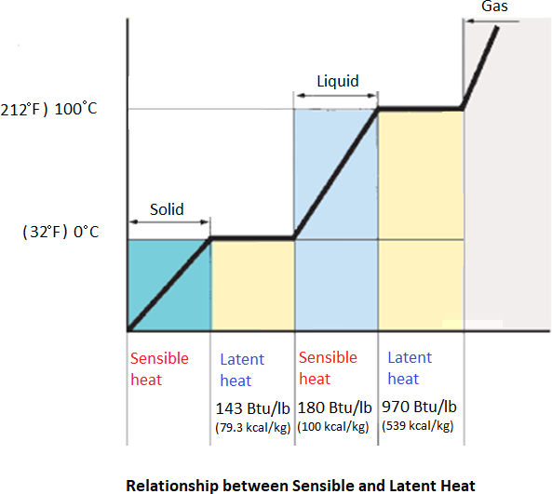
HVAC System for Cars and Automotive Vehicles
Key Fact: Sensible capacity is the capacity required to lower the temperature and latent capacity is the capacity to remove the moisture from the air.
Rules of Heat Transfer
Heating and air conditioning must follow the basic rules of heat transfer. An understanding of these rules helps greatly in understanding the systems.
Heat always moves from warmer areas to colder areas. Whenever there is a transfer difference between two areas/objects, the heat energy will be transferred from the warmer object to the cooler one until both objects stabilize at the same temperature. This is known as the law of heat transfer. In winter, we heat the interior of a car, so the direction of heat flow is from inside to outside. In summer when it’s hotter outdoors, the direction is reversed.
The greater the temperature difference, the faster the heat flows. If it’s 70°F inside and 75°F outside, there’s not much energy moving through the enclosure, and the difference is not very noticeable. But, if it’s 70°F inside and 0°F outside, there is a lot of heat flow,
and the difference is immediately noticeable. (Note: Heat flow has a big impact on comfort; that is, how we feel about the heat or the lack of it.)
Air contains moisture vapor. The warmer the air is, the more moisture it can hold. If the air cools sufficiently, the moisture in the air condenses on a surface. A large amount of heat
is released when a vapor changes state to a liquid. Similarly, a large amount of heat is absorbed when a liquid changes state to vapor.
www.mitsde.com

Slide 21
HVAC System for Cars and Automotive Vehicles
d. Compressing a gas (refrigerant) concentrates the heat and increases the temperature.
Factors Affecting Heat Transfer Efficiency
The heat transfer efficiency of automotive air conditioning systems is greatly affected by the heating or cooling load.
Cooling Load
The cooling load refers to the amount of heat that must be extracted from the passenger cabin. The factors affecting cooling load include:
High ambient temperatures
Very high outside temperatures will cause higher inside temperatures. The heat load to be removed from an enclosure will increase in direct proportion to the heat intensity. As that heat increases, achieving a temperature that is much lower than the outside temperature will take longer than achieving one that is only slightly lower.
High humidity
Humidity is the term used to describe the wetness or dryness of the air. The air around us contains a percentage of water vapour and the humidity refers to the moisture content (water vapor) present in the air. There are generally two ways to measure humidity, relative humidity, and absolute humidity.
Absolute humidity is the measure of the amount (by weight) of moisture in the air regardless of the temperature.
Relative humidity (RH) is the percentage of how much moisture is present in the air compared to how much moisture the air is capable of holding at that temperature. As an
example, if the relative humidity is 50%, the air could hold twice as much vapour as it does at that given temperature. The amount of vapour that the air can hold changes with its temperature. If the air warms up, then it can hold more vapour which would reduce the relative humidity because it could hold more vapour than what it was actually carrying. If the air cools, then its relative humidity reduces because it can now hold less.
When the air becomes saturated the relative humidity becomes 100%. When the air is cooled further, the vapour in the air will condense and this point is called the ‘dew point’ temperature of the air.
The Relative humidity is the most common measurement for the control of the humidity within the A/C system. Physically, in an air conditioner unit, the humidity is controlled by the surface area of
www.mitsde.com

Slide 22
HVAC System for Cars and Automotive Vehicles
the evaporator and the volume and flow of air traveling through it. The cold surface of the evaporator causes the moisture in the air to condense and cover the surface in water droplets. This reduces the moisture content, thus drying the air and improving comfort. Relative humidity for comfort levels is generally about 60%.
It is important to note that the heat energy does not transfer as readily or efficiently from humid, moisture-laden air and the air conditioning system does not cool air as much when humidity is high.
Solar Radiation
The intensity of long wave heat rays from the sun is called sun load. Ambient temperatures, together with the vehicle’s type and the colour of interior/exterior materials, may increase the effects of sun load and the amount of heat the system must absorb and transfer outside.
Heating Load
The heating load refers to the amount of heat loss from the vehicle during winters and the heat that must be added to the passenger cabin to compensate for the heat loss. The primary factors affecting heat loss include low ambient temperatures and outdoor air infiltration.
Very low outside temperatures will cause lower inside temperatures. The heat to be added to the enclosure will increase in direct proportion to the heat intensity. In most vehicles, the heat is provided by the heated coolant from the engine cooling system. This coolant is typically at a temperature of 190°F to 205°F (88°C to 98°C) when the engine reaches its normal operating temperature.
The heated coolant is circulated through a heat exchanger, called a heater core. Air is circulated through the heater core, where it absorbs heat. Then it is blown into the passenger compartment, where the heat travels on to warm the car interior and occupants.
www.mitsde.com

Slide 23
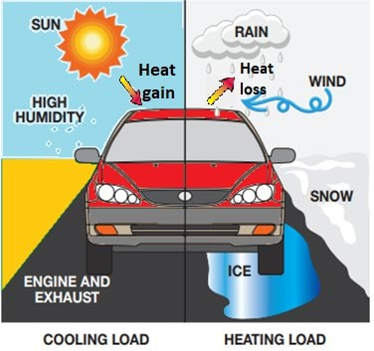
HVAC System for Cars and Automotive Vehicles
Note the heat sources and heat transfer components in the illustration.
Refrigeration System and Components
The refrigeration system works on vapour compression cycle, where four distinct activities such as compression, condensation, expansion (throttling), and evaporation of the refrigerant takes place.
The five major components of the refrigeration system responsible for the above four functions are respectively compressor, condenser, expansion valve, receiver/dryer and evaporator.
The individual components of the refrigerant circuit are connected by tubes and/or aluminium pipes and thus form a closed system. Refrigerant and refrigerant oil circulates in the closed-loop system, driven by the compressor. At some points, the refrigerant is a liquid, and at others, it is a gas (vapor). Heat transfer occurs primarily through a change of state of the refrigerant.
Compressor
The compressor is a mechanical device that circulates the refrigerant gas and compresses it increasing its temperature and pressure. This ensures efficient heat removal at the condenser. Usually, three to four pounds of refrigerant is used to fill the system in most vehicles.
Condenser
The condenser’s job is to cool the refrigerant so that it turns from a gas into a liquid or condenses. This happens when warm outdoor air is blown across the condenser coil that is filled with hot, gaseous refrigerant. This allows heat to transfer from the refrigerant to the cooler outdoor air, where the excess heat is rejected to the atmosphere.
www.mitsde.com

Slide 24
HVAC System for Cars and Automotive Vehicles
Expansion device
The expansion device is responsible for quickly driving the pressure of the refrigerant down so it can boil (evaporate) more easily in the evaporator. The expansion device has one sole purpose: to reduce refrigerant pressure. Because the pressure drops so rapidly at the expansion device, the refrigerant turns into a combination of a cold liquid and vapor. The energy content of the refrigerant does not change as it passes through the valve. An orifice tube or thermostatic expansion valves are the types of expansion devices.
Evaporator
The evaporator absorbs heat (and moisture) from the passenger compartment. This happens when warm cabin air is blown across the evaporator and as cold refrigerant moves through the evaporator coil. Heat transfers from the air to the refrigerant, which cools the air directly before it is vented to the cabin. The refrigerant enters the evaporator in a liquid state and as it absorbs the heat, it leaves into vapour. The evaporator has a constant temperature and pressure.
Receiver/Dryer
A receiver/dryer or an accumulator/dryer stores refrigerant and removes any moisture. This ensures system effectiveness and protects the components from damage caused by contaminants.
Refrigerant
Refrigerant is a working fluid that carries out the "transfer of heat process" by cycling through the air conditioning system and absorbing heat when becoming a gas, and giving off heat when becoming a liquid. Refrigerant has a low boiling point and at low temperatures, the refrigerant converts into gaseous form, while it stays liquid at a high temperature.
An ideal refrigerant would have the following properties:
Zero ozone-depleting potential (ODP) and zero global warming potential.
Low boiling point.
High critical pressure and temperature point.
Miscible with oil and remain chemically stable.
Non-toxic, non-flammable.
Non-corrosive to metal, rubber, plastics.
Cheap to produce, use, and dispose.
www.mitsde.com

Slide 25
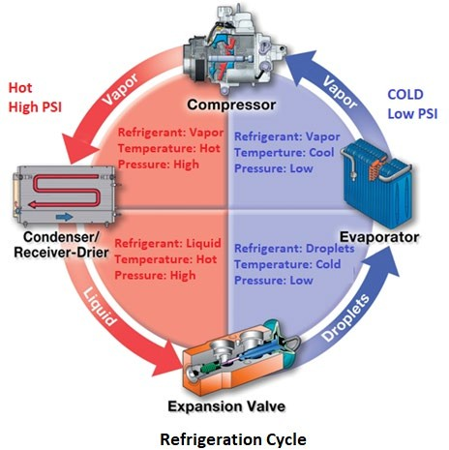
HVAC System for Cars and Automotive Vehicles
* HFC-134a (R134a) is currently used in air conditioners because it evaporates and liquefies easily, chemically stable, and non-degenerative properties. Because the refrigerant has no chlorine it has ZERO ODP. But it does contribute to global warming.
1.7 Refrigeration Cycle
Now that you know about the main components of the refrigeration, we can move forward towards its process. The Figure below shows a basic refrigeration system with all major components sealed with tubes and hoses containing the refrigerant. Refrigerant has the ability to change its physical properties during compression, which is crucial to the operation of refrigeration system.
In the figure above, note that the high-pressure side of the system extends from the outlet of the compressor to the metering device (expansion valve). The low-pressure side extends from the expansion valve back to the inlet of the compressor.
The process of removing heat from air involves four stages of the refrigeration cycle: compression, condensation, expansion, and evaporation.
a. Compression - The gaseous refrigerant is compressed by the compressor thereby significantly increasing its pressure and temperature. When the refrigerant gas is compressed and the pressure is increased, it becomes comparatively easier for a refrigerant gas to give off heat and liquefy (condense).
www.mitsde.com

Slide 26
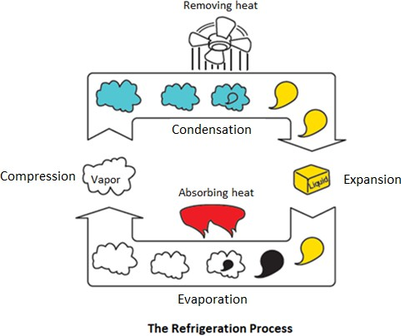
HVAC System for Cars and Automotive Vehicles
Condensation - The pressurized refrigerant vapour is pumped from compressor to condenser where it removes heat from the refrigerant. This causes the refrigerant to change from high-pressure hot vapour into the warm liquid. The heat is given off to outside air. Condensation occurs at constant pressure.
Expansion - The liquid refrigerant then passes through a metering device (an expansion valve) where it losses pressure and changes its state to wet droplets. Expansion occurs with no change in enthalpy.
Evaporation - The wet droplets pass through the evaporator where it absorbs heat from the air. This causes the refrigerant to change from a low-pressure cold liquid into a cold vapor (the latent heat of evaporation). The evaporation occurs at constant pressure. The cycle continues.
To summarize — heat is absorbed by the refrigerant (cooling the air) in the evaporator and expelled from the refrigerant to the outdoor air in the condenser. Simultaneously, the expansion device and compressor help us manipulate the pressure of the refrigerant to make the cycle possible.
Keep in mind these core principles of the refrigeration cycle will always remain the same, even when we get into more complex centralized HVAC systems like chillers. The operating characteristics of any refrigeration system are determined by the refrigerant used. Many refrigerants are available, and the characteristics of each are presented in a diagram called a "pressure-enthalpy diagram". Energy flow through a refrigeration system can be examined by
www.mitsde.com

Slide 27
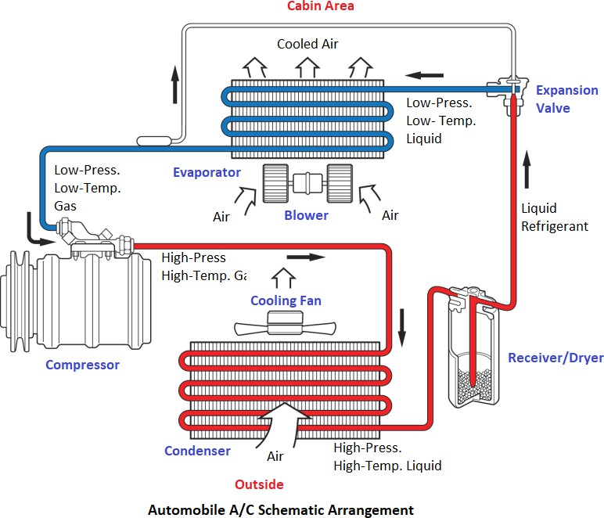
HVAC System for Cars and Automotive Vehicles
drawing a diagram of the refrigeration cycle on the pressure-enthalpy diagram of the refrigerant used in the system.
1.8 Automobile Air-conditioning System
Now that we know the heat transfer and refrigeration principles, let’s take a more detailed look at the automobile air conditioning system.
In an air-conditioning system, the refrigerant picks up heat from the passenger compartment and is pumped to the condenser where it gives up its heat to the outside air and then flows back through the system to pick up more heat. The system is shown schematically in the figure below. Refrigerant is recycled in a closed system. Refrigerant R-134a is currently the most commonly used heat transfer medium in an automatic air-conditioner refrigeration system. This refrigerant has a good heat transfer property in the required temperature range, has zero ozone depletion potential, and does not corrode system components.
The heat from the passenger compartment evaporates the refrigerant in the evaporator thereby changes its phase from liquid to vapour and cools the air. The vapour is then pumped from the evaporator by the compressor, which compresses the vapour to increase its pressure. This high pressure, high-temperature vapour passes through the condenser where it is cooled with outside air and condensed into high-pressure liquid. This liquid is throttled down to lower pressure in the
www.mitsde.com

Slide 28
HVAC System for Cars and Automotive Vehicles
expansion valve before passing to the evaporator. This constitutes a continuous cycle in which heat is carried from the evaporator placed in the passenger compartment to the condenser where it is given up to outside air. During operation, the refrigerant continuously changes its phase from liquid to gas and then back to liquid again.
The Automotive Air Conditioning v/s Room Air Conditioning
The automotive application places very special demands on the air conditioning system. A typical vehicle system has a similar cooling capacity to that required for the air conditioning of a small house despite the vast difference in volumes to be cooled. The reasons for this are twofold.
Firstly, cooling duty per unit volume is much higher for the vehicle because heat transfer coefficients between hot ambient air and the outside surfaces are much higher due to the movement of the vehicle through the air.
Secondly, the proportion of the enclosure consisting of glass is very high for the vehicle –
a factor that makes the effect of direct solar radiation heating very high. On top of this, a particularly demanding requirement is to cool the cabin very rapidly after the vehicle has been soaked in an ambient temperature of 40°C or higher. At the start of the cool down, temperatures in the cabin can be as high as 60 or 70°C.
Another significant way in which automotive air conditioning differs from domestic or air conditioners is the compressor drive. The engine-driven compressor has numerous constraints. The major implications are:
In the vehicle, the compressor is belt-driven by the engine so that independent control over the compressor speed is not possible. This obviously has significant implications for system control, and means that there can be calls for high system performance at times when the compressor speed is very low. Also, the hermetic compressors are not possible, and very effective shaft seals must be used.
The second implication of the external drive is that the compressor must be engine
mounted so that lengths of the flexible hose must be introduced to accommodate relative movement between engine and chassis mounted components.
And finally, there are stringent constraints on size, weight, and cost. There are lots of constraints to arrange air conditioning components to fit in a compact space and allow for the serviceability.
Because of these constraints, an electrically driven system could be thought of to provide a better solution. But it is also not feasible on current vehicles due to insufficient electrical power. The
www.mitsde.com

Slide 29
HVAC System for Cars and Automotive Vehicles
applications in which an electrical compressor would make real sense, however, would be the electric, hybrid, or fuel cell vehicles where sufficient electrical power is readily available.
This should give you a general idea of the function of automobile air conditioning, its components, and how they contribute to the air conditioning process. We will study in more detail, each piece of the air conditioning system in the following chapters.
www.mitsde.com

Slide 30
HVAC System for Cars and Automotive Vehicles
CHAPTER 2: COMPONENTS OF THE AIR CONDITIONING SYSTEM
The car air conditioning system has almost the same components as a room’s air conditioner, but since the space is very compact, there are a lot of modifications made in the design of air conditioning components so that it provides convenient installation in the vehicle as well as to service and repair system components.
2.0. DESCRIPTION OF COMPONENTS
2.1 Compressors
The compressor is the heart of the vehicle air-conditioning system and is driven by the engine.Its key tasks are to generate the required flow of refrigerant around the system and at the same time to compress it sufficiently to raise its temperature above the ambient in order that heat can be rejected from the system. These demands must be met efficiently over very wide ranges of compressor speed and ambient conditions. At the same time, a very serious consideration is its intrinsic noise generation - modern vehicle noise requirements mean that the compressor must be very quiet and vibration-free.
As the refrigerant flows across the compressor, it also removes the heat of compression, motor winding heat, mechanical friction, and other heat absorbed in the suction line. This heat is 20 to 25% higher than the heat extracted from the evaporator and therefore the size of the condenser is always bigger than the evaporator.
www.mitsde.com

Slide 31
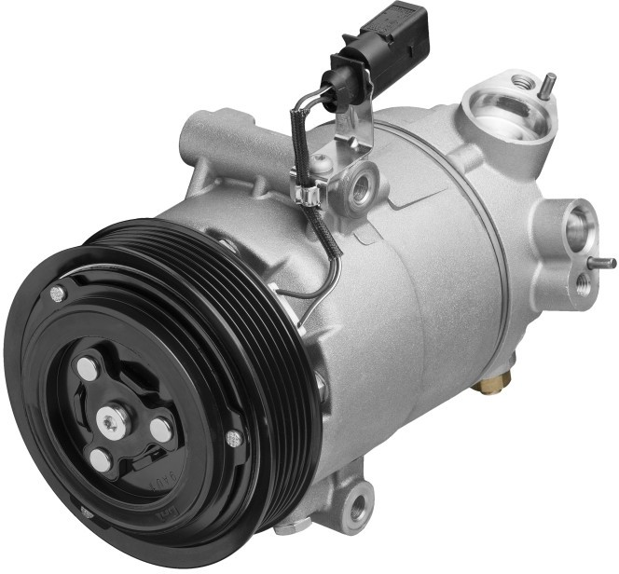
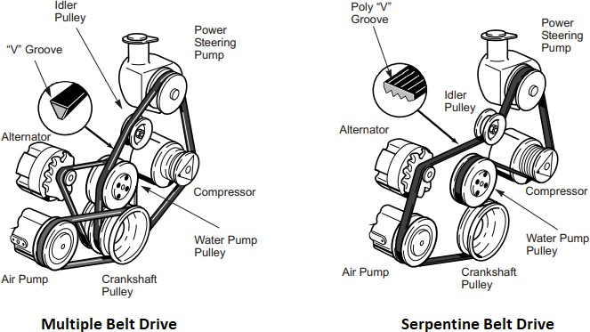
HVAC System for Cars and Automotive Vehicles
2.1.1. How do they work?
Compressors are driven by a multi-belt or a single serpentine belt drive from the engine crankshaft. A small idler pulley is normally used in conjunction with a belt adjusting mechanism to absorb belt vibrations when a belt has a long distance between pulleys.
2.2 Electromagnetic Clutch
A clutch is used to transmit the power from the engine crankshaft to the compressor by means of a drive belt. The clutch has an electromagnetic pressure plate designed to connect the rotor pulley to the compressor shaft when the field coil is energized. When the clutch is not engaged to the compressor, the shaft does not rotate and there is no refrigerant flow and the compressor pulley spins freely.
www.mitsde.com

Slide 32
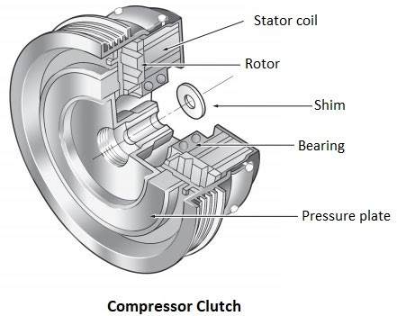
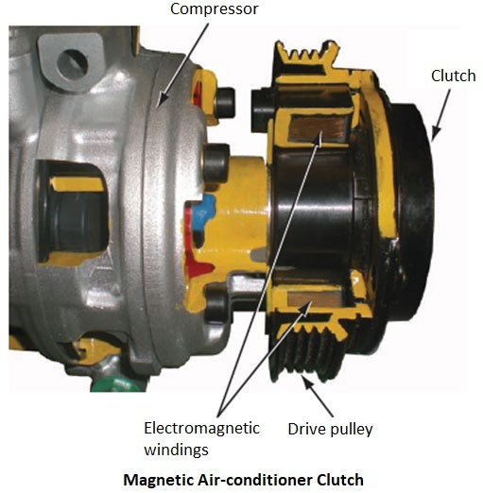
HVAC System for Cars and Automotive Vehicles
The electromagnet allows the compressor operation to be controlled by an electric circuit. The compressor clutch relay is also controlled by a temperature signal from the evaporator and a pressure switch in the refrigerant line. In most systems, the compressor clutch cycles ON and OFF periodically to allow the evaporator to warm up (defrost) during periods of high cooling demand.
www.mitsde.com

Slide 33
HVAC System for Cars and Automotive Vehicles
2.2.1. Clutch Free Compressors
Fixed compressors have electromagnetically operated clutches to allow system control by switching the compressor drive ON and OFF as required. Such ON-OFF control causes abrupt changes to the engine torque, affecting drivability and fuel energy consumption. A slight increase and decrease of engine speed and power are noticeable under some vehicle operating conditions. This is normal and indicates that the system is cycling to maintain full cooling capacity while preventing evaporator freeze-up.
As consideration was given to the application of air conditioning to smaller vehicles with smaller engines, it was found that the significant and sudden increase in engine load that resulted from compressor switching caused problems for the small engine with resultant issues of drivability. A compressor with variable displacement offered the solution to this problem.
Variable compressors have also traditionally retained the clutch to turn the system off when not required or should system conditions approach unsafe operating levels for any reason.
A more recent innovation is the introduction of clutch-less compressors. It is made possible by the implementation of external compressor control. Here the compressor can be de-stroked to such an extent that it no longer pumps, and can be permanently driven without dissipation of significant energy. Externally controlled means that the displacement volume of the compressor is determined using an integrated control valve depending on parameters such as exterior temperature, requested temperature, high pressure, low pressure, RPM speed, and engine load. These are essentially externally controllable, variable compressors.
Compressor Designs
The compressor can be dimensioned depending on the size of the system. There are different designs available:
Piston
Through-Vane
Swash-plate (fixed or variable capacity)
Scroll-type
Piston Type Compressor
The piston type reciprocating compressors are very similar to a four-stroke cycle lawn mower engine. It has valves to control the flow of intake and discharge refrigerant vapours.
www.mitsde.com

Slide 34
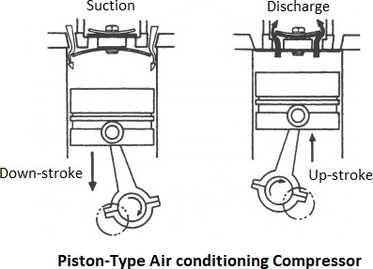
HVAC System for Cars and Automotive Vehicles
The compressor has the task of inducing gas at a low suction pressure and delivering it at higher discharge pressure. This is achieved by using spring-tensioned stainless steel “Reed valves” which allow gas flow in one direction, and only when a significant pressure difference exists between the chamber of the compressor and the intake or outlet passages. Lubrication is provided by a splash from a sump in the compressor base.
The Reed valves operate automatically to control the fluid flow into and out of the cylinders.
2.5 Through-Vane (TV) Compressor
Through-Vane (TV) rotary compressors reduce the rotating mass by eliminating pistons in favour of sliding vanes which seal against the compressor housing at both ends.
The through vane type has two vanes mounted at right angles to each other in slots in a carefully shaped rotor housing. As the compressor rotor rotates, the vanes and housing form chambers. The vanes are sealed against the rotor housing by centrifugal force and lubricating oil. The oil sump and oil pump are located on the discharge side so that the high-pressure forces oil through the oil pump and then onto the base of the vanes, keeping them sealed against the rotor housing.
www.mitsde.com

Slide 35
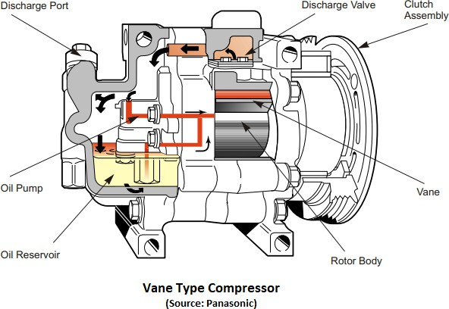
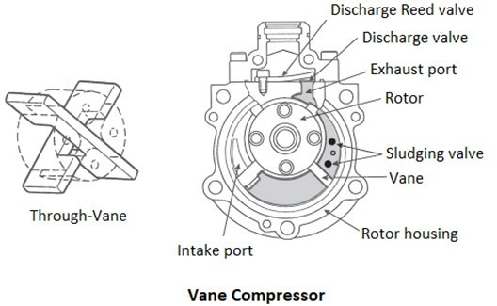
HVAC System for Cars and Automotive Vehicles
These provide four pulses per revolution, which ensures high efficiency and minimal vibration. However, unlike conventional compressors that build pressure against a ‘Reed Valve’ until it opens, TV compressors perform compression internally. Because of this, they tend to run hotter than conventional compressor designs. In addition, for this reason, they are equipped with an internal pressure release called a “Sludging Valve”. This valve prevents damaging the through- vanes by allowing liquid oil to escape from the compression area into an oil chamber.
2.6 Swash-plate Compressor
The swash-plate (also called “wobble plate”) type compressors are the most popular compressors for engine-driven mobile air conditioning systems. These convert the rotary motion of the shaft into smooth back and forth motions of the pistons. This design provides reduced vibration and
www.mitsde.com

Slide 36
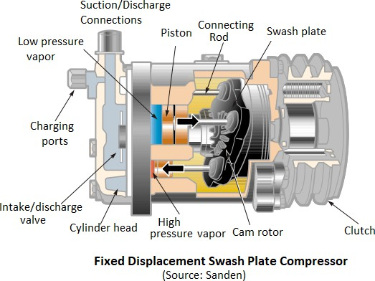
HVAC System for Cars and Automotive Vehicles
allows more pulses per revolution than a two-piston reciprocating compressor. These are two types:
Fixed swash plate
Variable swash plate
Fixed swash plate type compressor maintains the constant compression ratio and the discharge rate of refrigerant in accordance with the engine rotation.
Variable swash plate type compressor can vary its duty cycle and change the amount of displaced refrigerant. It maintains the variable compression ratio, and the discharge rate of refrigerant varies in relation to the exterior temperature, requested temperature, high pressure, low pressure, RPM speed, and engine load.
2.6.1. Fixed Swash Plate
In the fixed displacement swash plate compressor, a rotating device called the swash plate causes the pistons to move. The swash plate is an elliptical disc that is mounted at an angle to the compressor drive shaft. The rotation of the swash plate moves the pistons parallel to the drive shaft.
The swash plate is held at a fixed angle by anti-rotation gears, and a cam rotates behind the swash plate. The combination of the rotating cam and the stationary swash plate causes the pistons to move in a plane parallel to the compressor drive shaft. These compressors usually contain six or ten pistons. The pistons in an opposed axial compressor are connected together by a solid piece that keeps them at a fixed distance from each other.
www.mitsde.com

Slide 37
HVAC System for Cars and Automotive Vehicles
For compressors with fixed inclination swash plate angle, piston stroke is also fixed and the cooling capacity of the compressors changes only with the engine operating speed. The cooling load for the compartment can only be controlled by ON-OFF control of compressor clutch attachment to the engine shaft.
Variable Displacement Compressor (VDC)
Variable displacement compressors (VDC) provide continuous modulation of the cooling capacity by changing the inclination angle of swash plate. The swash plate has a linkage mechanism that allows it to rotate thus changing its angle and with it, the piston displacement. The linkage is designed so that the clearance volume remains as constant and small as possible over the full swash-plate angle range from full stroke to minimum stroke.
The variable swash plate compressor uses a solenoid control valve that opens and closes to adjust the low-pressure inlet to the compressor. Controlling the suction side of the compressor changes the volume capacity according to the cooling load of the A/C system. This change in pressure affects the swash-plate angle. It also changes the piston stroke and thus the amount of refrigerant discharged to the condenser. Controlling the compressor volume in this manner improves the driving comfort, A/C performance, and energy savings.
With a variable displacement compressor, there is no jerking of the engine brought about by the switching ON and OFF the compressor clutch. In fact, some variable displacement compressors have no clutch at all. This results in a very smooth operation and improvement in fuel consumption.
There are two commonly used types of variable displacement compressors:
The internally controlled variable displacement compressor (ICVDC)
The externally controlled VDC (ECVDC)
Both have basically the same internal structure. They differ only on the manner the displacement control valve is actuated.
In an internally controlled VDC, a control valve senses the intake (suction) pressure of the refrigerant gas by means of a bellows or diaphragm, which varies with the temperature in the vehicle's cabin, to maintain an optimum compressor displacement. This system makes possible a smoother driving experience as well as comfortable temperature control.
In an externally controlled VDC, actuation of the control valve is done by means of a solenoid actuator. This type of compressor sends an electronic signal originating outside the compressor
www.mitsde.com

Slide 38
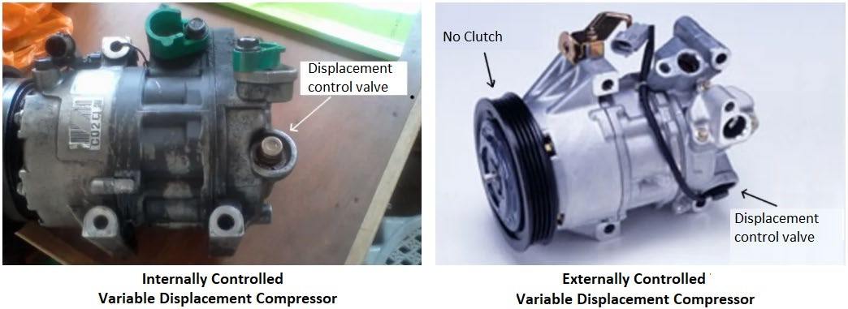
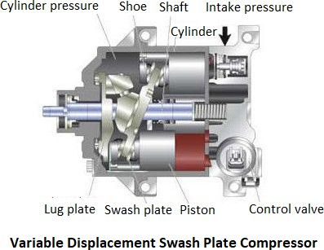
HVAC System for Cars and Automotive Vehicles
to the control valve to make possible precise voluntary control so that the compressor can operate at optimum displacement. This system allows for significant energy savings.
The figure below shows the construction of the variable displacement compressor. Refrigerant intake and compression methods are almost the same as those for the fixed displacement swash plate compressor. Unlike the fixed displacement type, however, there is only one cylinder. The required amount of refrigerant gas is sucked in and compressed by changing the pressure balance within the compressor. The swash plate angle can be adjusted, which forces the piston to make larger or smaller strokes. This enables stable temperature control and improved driving feel. Displacement control can be achieved by either internally controlled variable displacement or externally controlled variable displacement methods.
2.8 Scroll Compressor
A Scroll Compressor is a spirally wound, fixed scroll and movable scroll that form a pair. The fixed scroll is integrated with the housing. The movable spiral is able to orbit or oscillate without actually fully rotating. The movable scroll is connected to the input shaft via a concentric bearing. As the
www.mitsde.com

Slide 39
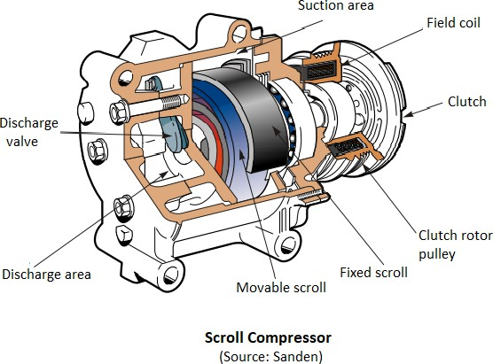
HVAC System for Cars and Automotive Vehicles
movable spiral oscillates within the fixed spiral, a number of pockets are formed between the spiral. As these pockets decrease in size, the refrigerant is squeezed, the pressure increases, and is discharged through a reed valve at the discharge port in the rear section of the compressor.
Some hybrid models use an electric motor drive scroll-type compressor to continue the operation even when the engine stops.
All these compressors have a “bolt-on” fitting block to provide connections to the low-pressure side of the system (suction side) and high-pressure side of the system (discharge port). There may also be fittings on or near the compressor to connect pressure gauges.
Electric Compressors
For traditional internal combustion vehicles, the air conditioning compressor is driven by a belt connected to the engine; therefore, it can only operate when the engine is running. Electric and hybrid vehicles operate under different conditions and include an efficient scroll compressor controlled by on-board electric motor and integrated power electronics. The electric compressor operates independently, enabling the cabin to be cooled even when the engine is OFF.
Air Conditioning Compressor Failures
Compressor failures are usually the result of the loss of lubrication, which in turn may be due to low refrigerant in the system, a blockage (such as a plugged orifice tube which prevents refrigerant and oil from circulating to the compressor), loss of lubricant due to leaks or improper service procedures (not adding oil to the system to compensate for the oil lost through leakage or component replacement), or use of the wrong type of lubricant.
www.mitsde.com

Slide 40
HVAC System for Cars and Automotive Vehicles
There are a number of possible causes of failure:
Bearing damage caused by a defective tensioner or by wear
Loss of sealing of the compressor shaft or of the housing
Mechanical damage to the compressor housing
Electrical connections
Lack of refrigerant oil/refrigerant (30-35% more or 70-75% less)
Expansion valve stuck shut or blocked.
Compressor displacement regular valve defective (for variable-displacement compressors only)
Clogging in the A/C system circuit
Filter saturated with moisture
Humidity (corrosion etc.)
Effects of Failure
A damaged or failed compressor can manifest itself as follows:
Loss of sealing
Development of noise
Insufficient or no cooling performance
Fault code is stored (automatic air conditioning)
Troubleshooting
When making diagnostics on the compressor, the first item to verify is A/C compressor engagement. Whether or not the compressor clutch is activated when A/C is requested at the control panel is a crucial item. When diagnosing a vehicle equipped with an electric cooling fan, make sure that the fan comes ON whenever the compressor clutch is engaged.
If the compressor does not engage when commanded, connect a manifold gauge set to see if there is any pressure in the refrigeration system. If no pressure exists, look for signs of a large, obvious refrigerant leak. Visual clues that indicate the presence of a large leak may include broken, physically damaged, or oil-stained hoses, pipes, or components. Broken or damaged components will obviously need to be repaired or replaced. The A/C system will then need to be made to operate before any other diagnostics can be performed.
www.mitsde.com

Slide 41
HVAC System for Cars and Automotive Vehicles
2.10.3. Noise Diagnostics
The noise heard when the A/C system is first turned on is not due to a defect. In the event of persistent noise, check for the presence of one of the following malfunction causes and apply the corresponding solution.
Cause | Solution
Belt worn or slipped | Check the wear and tension of the belt.
Belt idler pulley is noisy | Replace it.
Electric clutch plate slipping | Make sure that the distance between the compressor pulley and electric clutch is 0.3- 0.5mm.
Vibration and resonance of the compressor support plate. | Make sure the bolts are tight and the plate is properly positioned.
Expansion valve “whistles”. | If the noise persists, replace the valve.
Function test and pressure measurement of the system:
Does the compressor switch on, is the connector plug securely in place, and is there a voltage?
Check that the drive belt is positioned correctly, undamaged, and that there is tension.
Check visually for loss of sealing.
Check that refrigerant tubes are securely in place.
Compare the pressures on the high and low pressure sides.
Read out the fault memory
2.11 Receiver/Dryer
The amount of refrigerant flowing through the system varies depending on heat load and ambient (outside) temperature. Because of this, the extra refrigerant must be available for these different conditions. The receiver acts as a storage tank for the extra refrigerant. It also contains a filter and a desiccant material in an internal sack to help remove impurities and moisture in the refrigerant system.
The function of the receiver/dryer is as follows:
www.mitsde.com

Slide 42
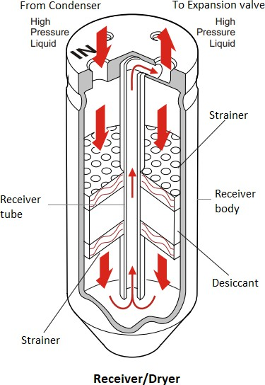
HVAC System for Cars and Automotive Vehicles
To ensure the system is free from dirt preventing any excessive wear or premature failure of components.
To remove moisture from the refrigerant ensuring no ice can form on any components
within the system which may cause a blockage. Also, the moisture and refrigerant (R134a) cause hydrofluoric and hydrochloric acid. The silica gel beads (desiccant) located in the receiver/dryer absorbs small quantities of moisture thus preventing acid and ensures no internal corrosion can form.
To act as a temporary reservoir to supply the system under varying load conditions.
To allow only liquid refrigerant to flow to the expansion valve.
The dryer is located in the high-side of the system between the condenser and evaporator, ahead of the expansion valve. It stores liquid refrigerant until needed by the evaporator.
2.11.1. How does the Receiver/Dryer Combination Work?
The liquid refrigerant enters the filter dryer, flows through a hygroscopic drying medium and leaves the filter dryer again as a liquid. The upper part of the filter dryer serves as a compensation chamber; at the same time, the lower part serves as refrigerant storage in order to compensate for fluctuations in pressure in the system.
The outlet of the receiver/dryer connects to a siphon tube that goes to the bottom of the container. This acts as a liquid/vapor separator and ensures only liquid refrigerant is supplied to the
www.mitsde.com

Slide 43
HVAC System for Cars and Automotive Vehicles
expansion valve. In addition, the end of the siphon tube has a very fine mesh screen to filter debris from the refrigerant and oil. This protects the expansion valve and the compressor from mechanical damage.
To protect the expansion valve from being blocked by ice, any moisture in the refrigerant is removed as it passes through a desiccant in the receiver/dryer. A desiccant is a chemical that bonds water (H2O) with other molecules to form a different molecule. There is a limit to the amount of moisture the desiccant can hold. After the desiccant becomes saturated, any additional moisture will pass through the system. A receiver/dryer left open (fittings removed) on the shelf or in the vehicle for about 10 minutes (80% humidity) will become fully saturated and unusable.
In some systems, the receiver/dryer contains a sight glass that allows you to visually confirm that only liquid refrigerant is passing on to the expansion valve. This may be useful during preliminary diagnosis, but it is not accurate in determining if the system has the proper amount of refrigerant.
2.11.2. Effects of Failure
A failure of the filter dryer may exhibit the following symptoms:
Poor cooling capacity
Failure of the air conditioning system
Causes for the failure of the filter dryer can be:
Aging defective filter pad inside
Leaks at the connections or caused by damage
2.11.3. Troubleshooting
The following steps are to be considered during troubleshooting:
Verify maintenance intervals (every 2 years) Leak test/correct fit of the connections/damage
Pressure test of the high and low-pressure sides
Important
The receiver/dryer is a service part and should be replaced any time the system has leaked, or been left open (even for a short time), or when a component such as a compressor or reed valve has failed.
www.mitsde.com

Slide 44
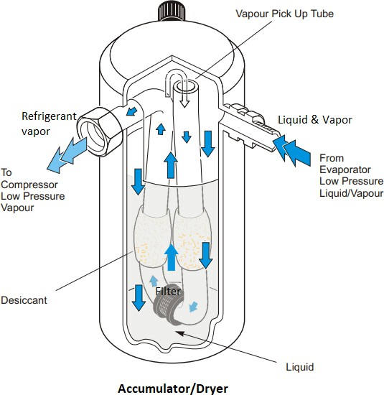
HVAC System for Cars and Automotive Vehicles
2.11.4. Accumulator System
The accumulator is the component that keeps liquid refrigerant from entering the compressor. These are used in systems with orifice tubes, not expansion valves.
The functions of the accumulator are:
To separate vapor from the liquid refrigerant. This is to ensure that the refrigerant leaves the accumulator as a vapour and not a liquid state in the compressor.
To filter particulates and ensure that the refrigerant is free from dirt to stop any excessive wear or premature failure of the compressor.
To absorb moisture ensuring no ice can form on any components within the system which
may cause a blockage and to ensure no internal corrosion can form.
To act as a temporary reservoir to supply the system under varying load conditions.
To add lubricating oil for system components like the compressor.
Often to house the low-pressure switch/sensor.
The accumulator is located on the low-pressure side, downstream of the evaporator before the compressor. When the refrigerant leaves the evaporator coil as a mixture of vapour and liquid, this liquid enters the accumulator and falls to the bottom. The vapour rises to the top and continues onto the compressor. The liquid refrigerant in the bottom of the accumulator gradually vaporizes off. This vapour rises and then pulls into the compressor.
www.mitsde.com

Slide 45
HVAC System for Cars and Automotive Vehicles
Condensers
The condenser is a heat exchanger designed to cool the hot refrigerant that is heated up by the compression in the compressor.
The hot refrigerant gas flows into the condenser and transfers heat to the cooler outside air. As it cools down, the state of the refrigerant changes again from gaseous to liquid.
Since the refrigerant is at a much higher temperature than the ambient temperature, it cools down as it passes through the coil. By the time the superheat refrigerant reaches the lower third of the coil, it cools down enough to change back into a liquid. This process is known as sub-cooling.
Condenser Construction and Design Types
There are several designs of the condenser.
Condensers are typically made of aluminium and have a single flow or serpentine path which increases the time available for heat transfer.
Serpentine
This type of condenser consists of one long tube which is coiled over and back on itself with cooling fins in between the tubes.
Parallel Flow Design (Recommended for R-134a)
This design is very similar to a cross-flow radiator. Instead of the refrigerant travelling through one passage (like serpentine type), it can now travel across numerous passages. This will give a larger surface area for the cooler ambient air to contact.
As R-134a operates on higher pressures, less internal flow, restrictive and improved heat rejection condensers are required.
Most manufacturers select the parallel flow design for this version. They are approximately 25% more efficient than the serpentine condensers.
www.mitsde.com

Slide 46
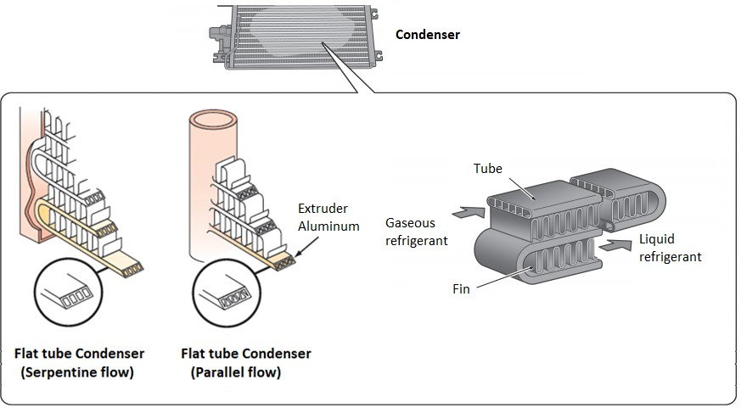
HVAC System for Cars and Automotive Vehicles
Some systems use multiple-path condensers with two or three shorter serpentine sections connected in parallel. This maximizes the time the refrigerant stays in the condenser for increased heat transfer.
How do they Work?
The hot refrigerant gas flows on top into the condenser and transfers heat to the surroundings via the tube and fins. Due to cooling down, the refrigerant exits the condenser at the lower connection in a liquid state. Note that the refrigerant flows from the top to the bottom of the coil.
In some designs, a sub-cool condenser is used. This condenser redirects gaseous refrigerant to the top for further cooling (gas-to-liquid) while the liquid refrigerant exits from the bottom. This ensures all refrigerant discharged from the condenser is in a liquid state.
Location of Condenser
The placement of the condenser is also important for better efficiency.
As the condenser is very hot, the maximum surface area of the condenser needs to be exposed to ensure cooling at a faster rate.
The condenser is typically located in front of the radiator in the air stream so the maximum temperature differential exists to transfer the heat.
www.mitsde.com

Slide 47
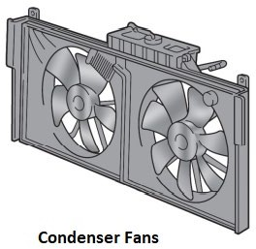
HVAC System for Cars and Automotive Vehicles
2.12.6. Condenser Fan
The effectiveness of the HVAC system depends on removing heat as the hot refrigerant flows through the condenser. The condenser fan helps to ensure the optimal liquefaction of the refrigerant by either pushing or pulling the air through the condenser, depending on which side of the condenser the fan is placed.
The condenser fans are driven either manually from the engine or electrically. Most vehicles use electric fans. The condenser fan is operated with A/C engaged in various ways: - Medium pressure switch; - Indirect connection to the compressor clutch - Via the Electronic Control Module (ECM); - Signal from the A/C switch activation.
2.12.7. Foam Seals
These seals are fitted in between the condenser and radiator to prevent the heated ambient air from exiting above, below, or to the sides of the space in between (normally 25mm) the radiator and condenser. As ambient air is drawn through the condenser by the condenser or radiator fan, its temperature increases - if gaps are present between the condenser and radiator, this heated air can be circulated back through the condenser. This results in increased condenser temperature and causes a reduction in the performances of the A/C system.
www.mitsde.com

Slide 48
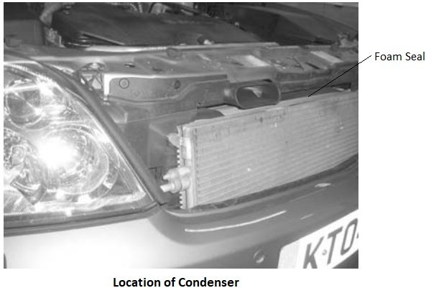
HVAC System for Cars and Automotive Vehicles
2.12.8. Effects of Failure
A defective condenser doesn’t dissipate enough heat. Possible causes and solutions may be:
Cause | Solution
Air flow blocked by dirt accumulated on the heat exchangers; water radiator, condenser. | Clean the radiator and condenser thoroughly.
The pressure switch or water temperature bulb are not tripped at the correct pressure and temperature levels. | Cut out the controls using the appropriate electrical connection. Replace the defective part if necessary.
The electric fan does not work | Power the electric fan directly. Replace if it still does not work.
Incorrect functioning by the electric fan (incorrect rotation direction). | The fan must be “suction” type when placed between the heat exchangers and the engine, and “blowing” type if placed between the heat exchangers and outside air intake.
Engine water overheated | Make sure the original engine cooling system is working properly.
Condenser not positioned correctly. | Make sure that the distance between the radiator and condenser is 15-20mm; if present the air ducts must be correctly positioned.
www.mitsde.com

Slide 49
HVAC System for Cars and Automotive Vehicles
2.13 Flow Control Devices
Refrigerant flow to the evaporator must be controlled to obtain maximum cooling while ensuring that complete evaporation of the liquid refrigerant takes place. This is accomplished by the flow control devices such as thermal expansion valve (TXV) or orifice tubes.
The flow control device is required to generate the pressure difference for liquid refrigerant to boil off into gas. It creates a pressure drop by restricting the flow of refrigerant around the system. Slowing down the flow of refrigerant causes the compressor to partially evacuate one side of the system. This low-pressure void is called the “suction side” or the “low side” of the system. There are two commonly used type of refrigerant control restriction used:
Thermostatic Expansion Valve (TXV) and Receiver/dryer System
Orifice Tube and Accumulator System
Both function in a similar manner but the placement of refrigerant storage/system protection components is different.
Thermostatic Expansion Valve (TXV) and Receiver/dryer System
Thermostatic Expansion Valve (TXV) is used with the receiver/dryer system and is positioned between the evaporator and the receiver/dryer.
The receiver/dryer works like the accumulator, but it is located on the high-pressure side rather than the low-pressure side. The desiccant in this system absorbs the moisture.
Orifice Tube and Accumulator System
At the orifice tube, the refrigerant is forced to flow through a fine restriction (orifice). This causes a pressure drop and temperature drop in the refrigerant entering the evaporator. The rate of flow depends on the pressure difference across the restriction. A fine gauze filter is located at the inlet and outlet sides of the orifice tube to filter any contaminants from passing onto the evaporator. Orifice tubes have different size restrictions depending on the A/C system. The normal process of the orifice tube system works as an accumulator, which is located on the low side before the compressor. The accumulator holds the refrigerant and removes moisture from it to control the damage.
www.mitsde.com

Slide 50
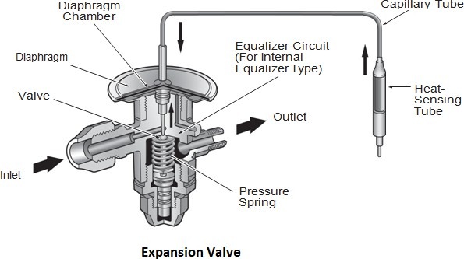
HVAC System for Cars and Automotive Vehicles
2.13.3. How do Expansion Valves Work?
Expansion valves are usually spring-loaded devices with a diaphragm that is linked to a plunger. Without any pressure against the diaphragm from the gas in the capillary tube, the spring inside the expansion valve would cause the valve to stick closed.
Here is the sequence of events:
Warm, high-pressure liquid refrigerant flows to the expansion valve.
A low-pressure spray of cold refrigerant droplets passes through the expansion valve into the evaporator.
As the cold spray contacts with the relatively warm tubing of the evaporator, the refrigerant
vaporizes (becomes a gas) and absorbs heat from the evaporator and the air surrounding the evaporator.
The refrigerant flow is controlled by the expansion valve depending on the refrigerant temperature.
•
If the refrigerant temperature increases at the end of the evaporator, it expands in the expansion valve. This results in an increase of the refrigerant flow (injection quantity) to the evaporator.
If the refrigerant temperature lowers at the end of the evaporator, the volume in the expansion valve decreases. As a result, the expansion valve reduces the refrigerant flow to the evaporator.
•
2.13.4. Expansion Valve/Evaporator Interaction
As the evaporator temperature increases, the expansion valve allows greater flow of refrigerant to the evaporator. For example, if there is a high heat load in the vehicle, the evaporator temperature will be relatively high (more heat transfer). The refrigerant in the sensing tube will
www.mitsde.com

Slide 51
HVAC System for Cars and Automotive Vehicles
therefore expand and the increased pressure will tend to open the expansion valve more. This increases refrigerant flow and heat transfer in the evaporator. When the system stabilizes, the evaporator surface temperature should remain constant at about 32°F (0°C) in order to provide the greatest heat-removing capacity.
Since the evaporator surface temperature can be close to 32°F (0°C), there could be the problem of freezing and icing in high humidity conditions. This frozen water forms an insulating layer that prevents air from reaching the evaporator to exchange heat. To prevent icing, the expansion valve can change the size of the spray orifice (opening). The size of the orifice is controlled by a spring- loaded diaphragm that moves according to a heat-sensing tube (bulb). This bulb, called the capillary tube is located at the outlet of the evaporator. A thin, hollow tube connects the sensing tube to the diaphragm chamber. The sensing tube contains refrigerant and senses the evaporator temperature which changes the pressure inside the tube. The capillary tube transfers this pressure to the diaphragm to push against the spring and open the expansion valve to control refrigerant flow to the evaporator.
Less flow = less heat transfer More flow = more heat transfer
The traditional expansion valve has external equalization. The block-type expansion valve is internally vented. This helps prevent flooding the evaporator during operation with a high heat load.
2.13.5. Effects of Failure
A defective expansion valve can manifest itself as follows:
Poor cooling capacity
Failure of the air conditioning system
There are several possible causes of failure:
Temperature problems due to overheating or icing
Contaminations in the system leaks at the component or the connection pipes
Troubleshooting (TXV)
The following test steps should be followed in the case of a malfunction:
www.mitsde.com

Slide 52
HVAC System for Cars and Automotive Vehicles
High pressure | Low pressure | Possible cause
High | High | Engine overheating; expansion valve open continuously; temperature in evaporator housing too high; coolant shut-off valve not closing correctly
High | Normal to high | Air in refrigerant circuit
High | Normal | Too much refrigerant (system overfilled)
Normal to high | High | Line from compressor to condenser constricted/blocked
Normal to high | Normal to high | Too much refrigerant oil; air humidity well above the normal value
Fluctuating | Fluctuating | Temperature sensor of expansion valve faulty
Normal to low | Normal to low | Evaporator blocked; air throughput insufficient
Low | High | Suction line constricted; valves in compressor damaged, hence poor performance
Low | Low | Suction line or receiver/dryer constricted; evaporator iced; condenser blocked; compressor clutch no longer disengaging; de-ice switch remaining closed; refrigerant leak or under filling;
www.mitsde.com

Slide 53
HVAC System for Cars and Automotive Vehicles
 |  | temperature sensor of expansion valve faulty; blockage in high pressure line
2.14 Evaporator
The evaporator is a heat exchanger used to extract heat from the cabin air (car interior) or incoming fresh air that is blown through the evaporator coil. The evaporator is usually located inside the passenger compartment.
The tasks performed by the evaporator can be summarized as follows:
Absorption of heat
Boiling of all the refrigerant to vapors
Since air conditioning evaporator provides the cooling by absorbing the heat from the surrounding medium, it could serve a dual purpose when placed very close to the dashboard of the vehicle. It absorbs the heat from the air that is passed through it and also absorbs heat from inside the vehicle to maintain the required temperature.
How do they Work?
The expansion valve and/or orifice tube injects the highly pressurized liquid refrigerant into the evaporator. The refrigerant absorbs the heat and gets converted to low temperature, low-pressure vapour.
As the warmer air blows across the evaporator fins, moisture contained in that air (humidity) will condense on the cooler evaporator fins. Condensed moisture then runs off through the drain tubes located at the underside of the evaporator case.
Evaporator Construction and Design
The evaporator is very similar in construction to a condenser. An evaporator will have a serpentine, tube and fin or parallel type construction. Since the surface fins or plates of the evaporator are usually colder than the air flowing past them, any moisture (water vapor) in the air tends to condense and form liquid droplets on the fins. The moisture eventually drains from underneath the vehicle. This process is called dehumidification and only occurs when the air conditioner is operating.
www.mitsde.com

Slide 54
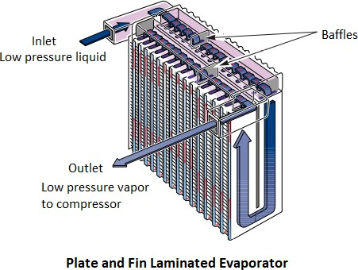
HVAC System for Cars and Automotive Vehicles
This process of dehumidifying is not only important to passenger comfort but can also be used in cold or humid climates to reduce windshield fogging. However, a large amount of heat must be removed from water vapor in order to condense it, so extreme humidity reduces the ability of the evaporator to lower the temperature of the incoming air.
2.14.3. Effects of Failure
A defective evaporator exhibits the following symptoms:
Poor cooling performance
Failure of the air conditioning system
Poor ventilation performance
Causes for the failure of the evaporator can be:
Pipes blocked in the evaporator
Evaporator leaking (at the connection, caused by damage)
Evaporator contaminated (air passage disturbed)
2.14.4. Troubleshooting Ice on the Evaporator Core
Cause | Solution
1. Malfunction by the thermostat or “no- frost” probe (if present) | 1. Make sure the electrical connection of the thermostat or of “no-frost” probe is in good condition, and that the sensor is properly
www.mitsde.com

Slide 55
HVAC System for Cars and Automotive Vehicles
 | positioned. Replace any defective parts as needed.
2. Malfunction by the blower fan | 2. With the A/C system running, at least the first ventilation speed must work. Otherwise, make sure the electrical system is properly connected.
3. Compressor displacement regulator valve is defective (only for variable displacement compressors) | 3. Check the operation of the compressor displacement regulator valve.
The following test steps should be considered during troubleshooting:
Check evaporator for contamination Inspect evaporator for damage
Check connection pipes for correct fit
Leak test
Pressure measurement with the compressor switched on and the engine running
Temperature measurement on the input and output line
2.15 Air Distribution System
The air distribution system is basically a mechanical system and consists of blower fans to remove air, ducts to carry air, and valves to control the airflow. The fans are driven by electric motors and air valves are adjusted by the vacuum adjusters or by mechanical means. Air distribution system differs among automobile manufactures, models, and types of air conditioner. However, they fall into three basic types of air-conditioning systems.
In the simplest type, the air conditioner is self-contained, and its air distribution system is completely separated from the automobile heater system. In this case, airflow is controlled by the fan speed and louvers control the airflow direction.
In the second type, factory-installed air conditioners are manufactured to combine the air distribution system with the heater air distribution system. A combination of cooling, which removes moisture and dirt, followed by desired reheating, provides ideal air-conditioning.
Reheating takes place if the air is cooled more in the evaporator, by directing some or all of the cool air across the heater core.
www.mitsde.com

Slide 56
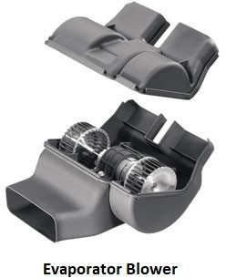
HVAC System for Cars and Automotive Vehicles
c. The third type of air conditioning system is quite complex and is factory installed having a fully automatic air distribution system. Once the desired temperature is set by the driver, the controls maintain the temperature within maximum cooling to maximum heating limits with a proper balance between cooling, heating, and blower speed. The Electronic Control Unit (ECU) operates the recirculation function based on the readings from the sensor and a pre-set value. In recirculation mode, high-end HVAC systems monitor several cabin air parameters, recirculate the air through the air conditioning unit back into the cabin, and limit the fresh air inlet to the minimum, while fulfilling the air parameters set by the driver and/or the system’s specifications. The frequency of operation of the recirculation flap is determined by the maximum allowed number of occupants, the minimum volume of air in the car interior, and the maximum allowed deviation from the desired CO2 level. It is easily calculated that five people in a 3m³ interior will increase the CO2 concentration by 100 ppm within 30 seconds.
2.16 Evaporator Fan/Blower
The blower is used to ventilate and cool the passenger cabin. The conditioned air is supplied to the cabin in various modes – direct on the face, on legs, windshield, both face and the legs, or other combinations. A multispeed fan motor in the air conditioning ductwork circulates cabin (interior) air or fresh exterior air through the evaporator.
2.16.1. Speed Control
Electric cooling fan is electrically powered. Various sensors control the fan operation.
In standard low-cost vehicles, a multi-position speed regulator, and resistor assembly is connected in series, which changes the source voltage to the fan motor. The resistor block
www.mitsde.com

Slide 57
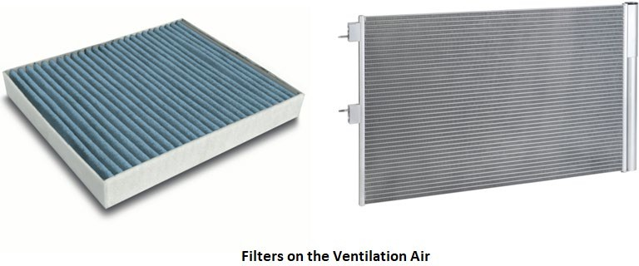
HVAC System for Cars and Automotive Vehicles
contains multiple outlet terminals to introduce different resistance values into the circuit to create multiple speeds.
In modern climate-controlled vehicles, the blower speed is controlled electronically by the air conditioning controller. The function of the electronic controller is to convert low current signals from the electronic control module (ECM) to a higher current, varying the voltage to the blower motor. Blower speeds may be infinitely variable and can usually use up to 13 speeds.
2.17 Cabin Filters
The filters are required to keep the cabin fresh by capturing dust and soot particulates. Evaporator blower fans pull passenger compartment air through a filter, which removes particulate matter, then passes the cleaned air through the evaporator coil.
The efficient filter media is distinguished by high particulate arrestance, high retention efficiency, low-pressure loss, and long service life. The filter media used offer a large effective surface and filter even smallest particles such as soot particles.
The filters are installed upstream of the evaporator coil in recirculation and outside air intake.
Other Miscellaneous Components
The other components include the refrigerant hoses and tubes, cooling fans, pressure control devices, control sensors, the air intake and air-delivery system that directs the conditioned air back into the passenger compartment, controlling the path, temperature, and volume. It has ductwork, air doors/valves, controls, and a blower fan.
Lines and Hoses
Refrigerant flows through the system in rigid metal lines and flexible rubber hoses. The volume of refrigerant is always the same at any point in the system (since it is a closed system). However,
www.mitsde.com

Slide 58
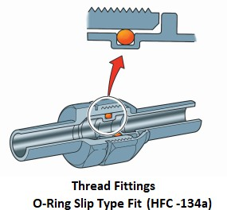
HVAC System for Cars and Automotive Vehicles
since the high-pressure side has a high-density liquid, it uses much smaller diameter lines than the low side. As a rule:
The high-pressure lines are the smallest in diameter
The low-pressure lines have the largest diameter
Unlike stationary refrigeration systems (appliance or building), mobile air conditioning systems must operate under high levels of vibration and motion. For this reason, all joint fittings use a gasket or O-ring to help seal the system. O-rings are made of various materials; each selected to deal with the particular refrigerant and lubricating oil used.
Fittings are typically one of three types: threaded tube-type, block-type or quick-disconnect.
Threaded fittings are used between hoses and lines. The more rigid block fittings are used at the system component. With threaded fittings, the correct tightening torque is important for a proper seal. Too little torque will not provide enough pressure on the O-ring to seal and may allow the fitting to move. Too much torque may distort the fitting and make it difficult to disassemble later. Torque Specifications for the different types and sizes of fittings are normally described in the Vehicle Repair Manual.
Block fittings provide more accurate positioning of the sealing surfaces, and they reduce the risk of tearing an O-ring due to rotation during assembly.
A quick-disconnect type fitting uses a plastic clamp lock to connect the tube endings. This type of fitting has no threads. One tube end has an O-ring that fits into a mating tube end.
The plastic clamp keeps the tube ends together to create a leak-free seal. To service the system (e.g., evacuating the system — the system must be empty), a special remover tool is used to release the clamp.
www.mitsde.com

Slide 59
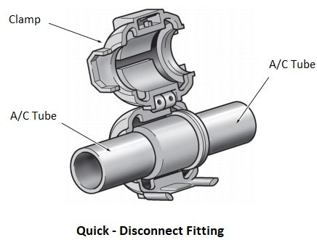
HVAC System for Cars and Automotive Vehicles
With threaded or thread-less tube fittings, in order to ensure the proper seal under high system pressures and temperatures, air conditioning O-rings rest within a machined area instead of just being compressed between two surfaces like a common gasket. In order to ensure a correct seal, the O-ring must be the correct one. An O-ring that looks about right may make a joint impossible to assemble without damage or may result in a leak. O-rings should be lubricated with the correct system refrigerant oil to prevent nicks or scratches during assembly.
Hoses
Owing to the smaller molecular size and higher operating pressure of R134a refrigerant, it is recommended to use a hose with a nylon inner lining. This is to reduce the normal refrigerant leakage that would naturally occur through the porosity of rubber hoses. Most R134a hoses have a smaller outside diameter and thinner hose walls to improve flexibility and reduce noise levels within the A/C system.
“O” Ring Components
The "O" ring rubber compound used for tube joints, fittings and components working on refrigerant R134a is a hydrogenated nitrile butadiene rubber (HNBR) and identified by the colour green.
"O" ring lubrication can be carried out using mineral oil. All hoses tubes and components included in an air conditioning kit are pre-lubricated, as are the "O" rings supplied as a spare part. Other manufacturers could use "O" rings of a different colour and size. Always use only the approved "O" ring suitable for the refrigerant and as recommended in your air conditioning manual.
Charging Ports
Charging ports are fitted onto components such as hoses, tubes, and filter dryer receivers. These charge ports enable the A/C system to be serviced and tested whilst under pressure. Different
www.mitsde.com

Slide 60
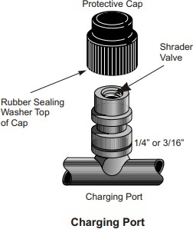
HVAC System for Cars and Automotive Vehicles
size ports identify the high and low sides of the A/C system. A plastic cap with a rubber seal is used to close the charge port opening and avoid leaking.
A dedicated design of the charging valve has also been developed to suit the R134a charging ports.
Most Schrader valves will leak slightly. Ensure that the plastic protection cap is fitted. Schrader valves designed for R134a must only be used in R134a systems. This is because of the seal material used.
2.19 Heating
The vehicle heating system transfers the engine’s heat to the vehicle’s interior. The heating system components include the heater fan, water pump, control valve, thermostat, blower motor, heater core, and heater hoses. These components work together to regulate temperatures in the engine and cabin compartment.
Excess engine heat is absorbed by coolant, a mixture of water and antifreeze. Coolant is carried by the heater hoses from the engine to the radiator, which expels some of the heat into the atmosphere. The water pump pushes the coolant through the engine, cooling system, and heating system. The coolant travels to the heater core, located in your vehicle’s dashboard. There, the heater fan directs the rest of the warm air into the vehicle’s cabin. Once the coolant transfers heat into the vehicle, the coolant returns to the water pump where it continues to circulate through the system. There, the heater fan directs the rest of the warm air into the vehicle’s cabin. Once the coolant transfers heat into the vehicle, the coolant returns to the water pump where it continues to circulate through the system.
www.mitsde.com

Slide 61
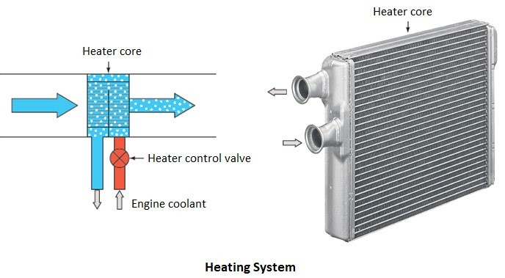
HVAC System for Cars and Automotive Vehicles
2.19.1. Auxiliary Heaters
Today’s fuel-efficient engines do not always deliver sufficient waste heat to enable rapid heating of the vehicle cabin, particularly for cold starts and in certain driving conditions. In order for the car interior to heat faster and ensure optimum thermal comfort in these situations, additional auxiliary heaters independent of engine heat are often provided that run on energy from the vehicle electronics. Other common issues that plague heating system components include a vacuum leak, heater valve failure; fan motor failure, heater core failure, stuck thermostat or overheating.
www.mitsde.com

Slide 62
HVAC System for Cars and Automotive Vehicles
3.0. CHAPTER 3: SYSTEMS OPERATION OVERVIEW & SAFETY DEVICES
Regardless of system design, all automotive A/C systems depend on the continuous interaction of the compressor with a flow control device, such as an orifice tube or thermal expansion valve (TXV). Flow volume may be adjusted based on pressure-temperature load, monitored at a key location. Locate the high- and low-pressure sides and note the state of the refrigerant as we follow the flow in the animation. In an operating A/C system, this process continuously repeats.
Controlling Refrigerant in A/C Systems
Pressure and Flow
A/C systems require some method of controlling refrigerant pressure and flow. Unless the compressor has something to push against, it cannot build-up system pressure and maintain the conditions needed for refrigeration.
System pressures are critical. Low side pressures keep the refrigerant boiling point at the correct level for absorbing heat through vaporization. Higher pressures would slow vaporization and heat absorption. Likewise, high side pressures allow the refrigerant to condense at normal ambient temperatures. Lower pressures would slow condensation and heat release.
A metering device helps the compressor build pressure and maintain the refrigeration cycle. Depending on the system, an orifice tube with a fixed diameter opening for metering refrigerant flow, or a thermal expansion valve that varies flow based on evaporator outlet temperatures is used.
High and Low-Pressure Areas
We have said that the refrigeration system is divided into a high-pressure area (high side) and a low-pressure area (low side). The high side extends from the compressor outlet, through the condenser, to the metering device inlet. In operation, it is also the high-temperature side. The low side starts at the metering device outlet, includes the evaporator and accumulator, and continues to the compressor inlet. During operation, the low-pressure side is also the low-temperature side.
The high-pressure and low-pressure sides of an operating A/C refrigeration subsystem can be identified in several ways:
Tube diameter - High side tubing is often smaller than low side tubing.
Feel - High side tubing is always hotter than low side tubing.
Sight - Low side tubing is often cool enough to collect frost or water droplets on high humidity days.
www.mitsde.com

Slide 63
HVAC System for Cars and Automotive Vehicles
Pressure - A/C system pressures can be measured with a gauge set.
Refrigerant temperature - Refrigerant temperatures can be measured with various methods on either the low or the high-pressure sides.
Refrigerant Pressure Switch
Pressure switches are responsible for protecting the air conditioning system against damage caused by too high or too low pressures. Possible causes of excessive pressure are:
Restriction in the high side of the system
Overheating condenser due to restricted airflow or fan failure
System overcharged with refrigerant
Abnormal heat source (e.g. steam cleaner)
A possible cause of low pressure is the refrigerant leak.
There is a low-pressure switch, high-pressure switch and multi-pressure switches, which contain two or even three pressure-sensing circuits. Current models use a multi-pressure switch that is located in the high-pressure line of the system (between the compressor and expansion valve).
There may be one or more pressure switches in the refrigerant lines.
Low pressure – The low-pressure sensing circuit switches the compressor OFF. This reacts to the pressure in the low side (suction side) of the system, generally the accumulator and disengages the compressor clutch if the pressure drops below approximately 1.5 bar. It prevents system damage due to the reduced amount of lubricant as a result of low system pressure.
Two pressure-sensitive switches are contained in the high-pressure switch. One of these
switches acts as a safety switch to prevent excessive system pressure. The second switch monitors pressures to control the operation of the high-speed condenser fan. This switching process improves the performance of the system in cases of excessive heat.
High pressure – Excessively high system pressure indicates a malfunction. In event of
sensing the high pressure approximately 30–35 bar, the pressure switch de-energizes the compressor via compressor clutch. The switch is normally positioned on the high side of the system.
The pressure switch is connected in series with the compressor clutch.
www.mitsde.com

Slide 64
HVAC System for Cars and Automotive Vehicles
Some vehicles using the Cycling Clutch Orifice Tube (CCOT) system utilize a pressure switch located in the low side of the air conditioning system between the evaporator and compressor for compressor control.
Pressure Control Valve
A/C Demand High
During periods of moderate to high A/C demand, system suction pressure will be greater than the control valve set point. During these periods, the control valve maintains a bleed from the crankcase to suction. Crankcase pressure is therefore equal to suction pressure. The wobble plate angle and therefore compressor displacement is at its maximum.
A/C Demand low
During periods of low to moderate A/C demand, system suction pressure will decrease to the control valve set point. The control valve maintains a bleed from discharge to the crankcase and prevents a bleed from the crankcase to suction. The wobble plate angle and therefore compressor displacement is reduced or minimized. During these periods, displacement is infinitely variable between approximately 5 and 100% of its maximum displacement.
Thermal Protection Switch
The thermal protection switch is normally located on the compressor housing. This protection switch is used to prevent compressor damage through internal friction. This switch senses the compressor case temperature and once this case temperature reaches a predetermined figure, the electrical circuit to the compressor clutch is interrupted. As the thermal protection switch is connected in series with the compressor clutch once the compressor case temperature lowers to a predetermined figure, the compressor clutch is then re-energized.
Anti-frost Devices (Freeze protection of evaporator)
The evaporator pressure regulator is mounted between the outlet of the evaporator and the compressor inlet (suction side). The valve regulates the pressure inside the evaporator to prevent icing. If the pressure drops below a certain threshold (196 kPa (28.4 psi)) then the valve closes to restrict the flow of refrigerant and increase the pressure inside the evaporator. This is to stop the evaporator temperature from reaching 0°C due to the relationship between temperature and pressure.
When the cooling load is high the vapour pressure of the refrigerant in the evaporator is high. The valve fully opens and the refrigerant flows unobstructed to the compressor. The valve operation
www.mitsde.com

Slide 65
HVAC System for Cars and Automotive Vehicles
is based on a spring bellows which expands and contracts with changes in refrigerant pressure. This device virtually eliminates the need for the compressor to cycle on and off to regulate the temperature of the evaporator.
Another device “Thermistor” (a temperature sensor) senses the air temperature coming off the evaporator coil. The temperature sensor is fitted to the evaporator’s fins and measures the temperature of the evaporator surface. This sensor sends the information to the relay in the form of a voltage drop and when approaching the freezing point of water (0°C), the current to the compressor clutch is interrupted to increase the pressure in the evaporator and avoid the surface water freezing. With a system threshold of 1°C at the surface, the relay will turn the compressor off. Once the surface increases to 2.5°C, the compressor, via the relay, will be switched on again.
Generally, a Thermistor is an NTC type sensor which means it has a negative temperature coefficient. This means that with an increase in temperature, the resistance of the sensor will reduce. This will affect the current flowing through the sensor and the voltage across the sensor. An amplifier is typically used along with the Thermistor, which amplifies the resistance to control or switch the A/C clutch on or off.
Fusible Plug/ Pressure Relief Valve/High-Pressure Switch
The earlier car models before 1995 relied on the fusible plug to release the excessive pressure in the closed-loop system. If adequate cooling of the condenser is not provided or the cooling load becomes excessive, a fusible plug melts at approximately 100–110°C and relieves the refrigerant to the atmosphere to reduce the possibility of a burst pipe. The problem with a fusible plug is that once the metal melts you lose the full contents of the refrigerant. This is harmful to the environment and can cause damage to vehicle components.
The new generation vehicles use the high-pressure relief valve to keep the system pressures from reaching a point that may cause compressor lockup or other component damage due to high pressures. A high-pressure relief valve discharges refrigerant at approximately 475 psi (3,275 kPa). Due to stricter EPA 609 regulations, the refrigerant must be properly reclaimed and recycled. The main safety device in the current generation of vehicles for high-pressure control is the high- pressure switch.
Relays
Relays are normally used in the A/C electrical circuit to protect switches that have a low current carrying capacity (i.e. a small contact area/weak pressure contact point) or for current draw
www.mitsde.com

Slide 66
HVAC System for Cars and Automotive Vehicles
differences between components. Shown below is an example of the difference in a circuit with and without a relay.
Automatic Sensors
Automatic sensors maximize system performance. The requirement is largely based on the interior and exterior conditions, HVAC system parameters, cabin volume, and number of passengers.
Sun-load Sensor
The sun-load sensor is a photochemical diode (PCD) located on top of the dashboard. This sensor sends a signal to the climate control module (CCM) to increase cooling needs when the cabin is being heated by direct sunlight.
Sun-load sensor opens blend door and spins the blower faster in response to sunlight intensity. Likewise, if the sun-load is low (cloud cover), the CCM will reduce the blower fan speed and the system will not operate at maximum cooling.
Outdoor Air Temperature Sensor
The outdoor air temperature (OAT) sensor allows a person inside the vehicle to know the temperature outside of the vehicle on a visual display in the instrument panel. It is often located around the front bumper area.
In automatic climate control systems, the OAT sensor senses ambient outside temperature and as the ambient or interior temperatures stray, the sensors pick up the deviation and the system adjusts the outlet duct temperature accordingly to compensate for the temperature changes.
The other function of OAT switch is to keep the compressor clutch from operating when outside temperature is cold below 50°F. This function protects the compressor from poor or no lubrication which could be the result of cold refrigerant oil.
The OAT sensor is a negative coefficient resistor (NTC) or thermistor with low voltage input. The sensor alters resistance depending on the ambient air temperature surrounding it.
Interior Temperature Control Sensor
The cabin temperature sensor is usually found around or within the steering column. It measures the temperature within the vehicle, which will signal to the HVAC system to either increase or decrease the temperature to fit a desired temperature range.
www.mitsde.com

Slide 67
HVAC System for Cars and Automotive Vehicles
Some systems have additional temperature sensors located on the evaporator and/or compressor to prevent evaporator icing and to regulate the operation of the compressor.
Most air temperature sensors have a “negative temperature coefficient,” which means they lose resistance as the temperature goes up. A simple way to check this type of sensor is to use a blow dryer to heat the sensor. The resistance should drop as the sensor warms up.
Humidity Sensors
Humidity sensors are capacitance sensors that measure the amount of moisture in the air. The information from the sensor both regulates the volume of air projected onto the windows to reduce misting and manages the humidity levels inside the car to enhance climate comfort. These sensors are typically mounted at the base of the rear-view mirror.
Air Quality Sensors
Air quality sensors can prevent harmful gases and unpleasant odors that can get into the cabin when the vehicle is sitting in heavy traffic, passing through congested areas or driving through tunnels. The sensor signals the fresh air inlet door/ventilation flap to close when undesirable substances are detected. This sensor is typically mounted behind the grill.
CO₂ Sensor
Carbon dioxide (CO₂) emitted just by the vehicle occupants can build up the CO2 concentration levels inside a modern, sealed vehicle with the HVAC system in the recirculation position. These high levels of carbon dioxide can cause drowsiness.
The adaptive air recirculation system continuously monitors the quality of the cabin air in terms of O2 and the CO2 concentration. When the level of carbon dioxide (CO₂) in the cabin exceeds the threshold limits, it signals the HVAC to introduce fresh air.
Windscreen Fogging Sensors
Fog can inhibit the driver's vision and has been among the highest HVAC complaint among the users. An automatic fog control system uses integrated humidity and temperature sensor, which uses a controller to calculate the dewpoint temperature of the air. The control unit adjusts the dry air and heating on the windshield on sensing the moisture and condensation based on dewpoint temperature.
www.mitsde.com

Slide 68
HVAC System for Cars and Automotive Vehicles
Some systems use an infrared sensor that remotely measures the windshield and side window temperatures as well. These sensors have a limitation that fogging can only be measured on a particular spot of the windshield and a dirty windshield can lead to false triggers.
The other reliable means is a current based fog sensor. This type of sensor detects fog formation at the time the amount of fog is small, and fog is not seen by the human eye. The control device of the sensor easily measures the current corresponding to the level of moisture on the interior windshield independent of temperature and humidity.
3.8.8. Rain Sensors
A rain sensor in a car detects any rainfall or moisture that contacts the windscreen and automatically adjusts their wiper movement accordingly. The rain sensors assist in the ongoing battle against driver distraction. The rain sensor appears to be attached to the car glass behind the windscreen and behind the rear-view mirror.
www.mitsde.com

Slide 69
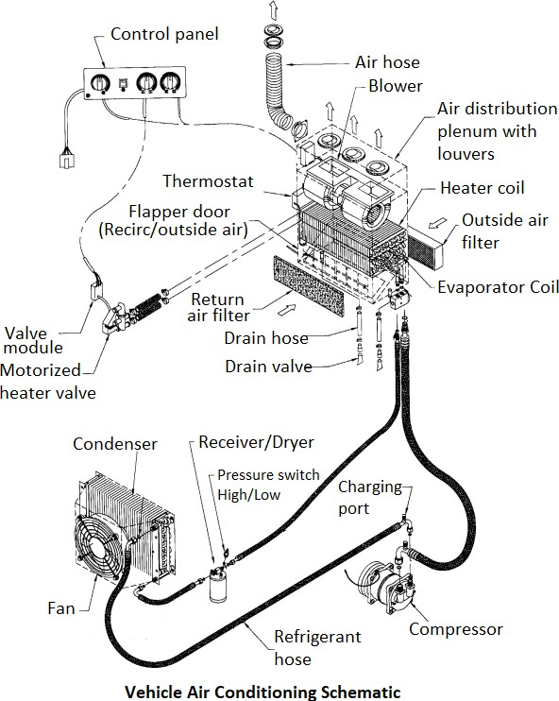
HVAC System for Cars and Automotive Vehicles
3.8.9. Overall Schematic of Air-conditioning Components and Controls
www.mitsde.com

Slide 70
HVAC System for Cars and Automotive Vehicles
4.0. CHAPTER 4: CLIMATE CONTROL SYSTEM
A standard air conditioning system either heats or cools the cabin depending on the position of the regulator. It is essentially a manual control of the temperature of the air pumped into the cabin, as well as the speed of the fan.
The climate control systems operate with the same basic composition as in the manually controlled systems, such as the condenser, compressor, evaporator, and heater. The major difference is that it maintains a pre-set level of cooling or heating selected by the vehicle operator without manual intervention.
Features of the Climate Control System
The automatic climate control system allows the vehicle passengers to set the desired temperature and humidity and set the system in AUTO mode. These values are taken as inputs by the climate control system and it then electronically controls the temperature and humidity and maintains them at user-specified values. This eliminates the human effort to regulate the cabin temperature by switching on/off the AC or by sliding warmer or cooler control.
Climate control is essentially a more advanced computerized system, which basically automates everything and keeps the interiors of the car at the same temperature, irrespective of weather conditions outside. The system-integrated controllers work in tandem with the sensors to gauge the comfort and quality of the cabin air. The system regulates temperature by factoring in outdoor heat and humidity, inside heat and humidity, quality of outdoor air as well as the non-weather aspects such as the car’s speed and its direction. This is accomplished by regulating the:
Blower fan speed
Air mode positions
Air conditioner activation
Heater tap activation
Air mix door movement
Fresh/Recirculation door position
Some advanced climate control systems adjust some other aspects such as sunlight, dewpoint or rain detection in advanced systems. For example, when the sun load sensor detects bright light and high heat intensity, the fan speed increases to allow for a higher rate of cooling.
www.mitsde.com

Slide 71
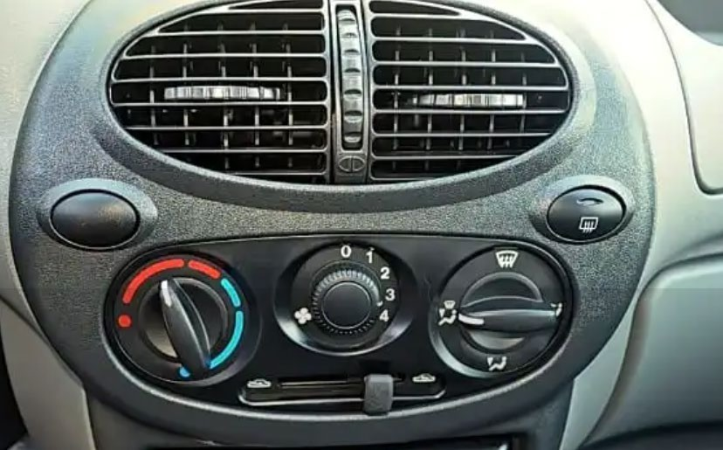
HVAC System for Cars and Automotive Vehicles
Most climatic control systems have a maximum setting also, which will automatically put the heater on full blast, usually so that the car's windscreen and windows can be cleared as quickly as possible in the event of fogging.
The advantages of the climate control system are that the driver does not need to constantly be distracted from driving a car to adjust the climate equipment. The electronics themselves take measurements and depending on the initial setting, turn on or off the necessary system (heating/cooling). An additional benefit of the climate control system is a self-diagnostic function which when used will greatly reduce the time spent locating system faults.
Whilst the system’s main benefits are attained on the AUTOMATIC mode, the option for manual override exists. But once manual mode has been selected by pushing the fan speed, A/C or mode switch, it takes away a function normally controlled by the processor in the climate control module making the processor adjust an alternative component to attain the pre-selected temperature.
4.1.1. Does your Car have Climate Control System?
To determine, whether your car is equipped with the climate control system, the panel will have a separate unit with a small screen on which the temperature level will be displayed.
The usual system of blowing and heating the passenger compartment has an A/C button and two controls. One shows the fan speed levels (scale 1, 2, 3, and so on), and the other shows a blue- red scale (cold/hot air). The second knob adjusts the position of the heater damper.
The driver sets the temperature and the speed to control the amount of cold air.
www.mitsde.com

Slide 72
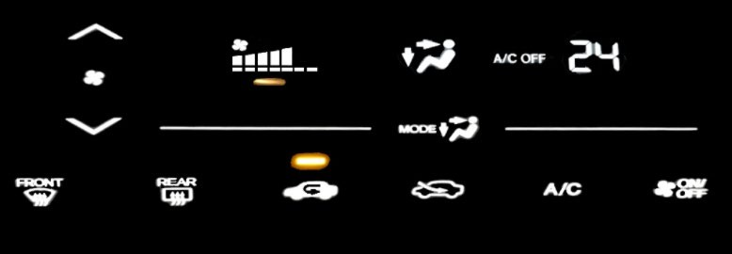
HVAC System for Cars and Automotive Vehicles
The climate control system displays every parameter and function on a LED screen as below.
How does Climate Control Work?
This system is a combination of electronic and mechanical devices that maintain a microclimate in a car without the need for constant monitoring by humans. It consists of two nodes:
The mechanical part. It includes air duct flaps, a heating fan, and air conditioning. All these nodes are combined into a single system, so that individual elements work synchronously, depending on the settings.
The electronic part. It is equipped with temperature sensors that monitor the climate in the cabin. Based on these parameters, the control unit either turns on cooling or activates heating.
The climate control system uses state of art electronic controllers and sensors that allows you to automatically adjust the heating or cooling of the air in the car. Obviously, it cannot work without a standard air conditioning system, but the mere presence of air conditioning does not mean that the car has climate control.
www.mitsde.com

Slide 73
HVAC System for Cars and Automotive Vehicles
Here are some key steps for temperature control of the Climate Control System.
The required temperature level is set on the control module and the AUTO button is pressed.
Sensors located around the cabin measures air temperature.
If the sensors and the system settings do not match, the air conditioner turns on (or turns off).
While the air conditioner is on, the supply air fan delivers fresh air through the ventilation ducts.
With the help of deflectors located at the end of the ducts, the flow of cool air can be directed not to the person, but to the side.
If the temperature drops, the electronics activate the heater damper actuator and it opens. The air conditioner is off.
Now the flow goes through the radiator of the heating system. Due to the high temperature of the heat exchanger, the flow heats up quickly, and heating starts to work in the cabin.
4.3 Mechanics of Automated Climate Control
The mechanics of automated climate control require temperature and humidity sensors to be placed in the cabin. These sensors continuously read the temperature and humidity values of the area and feed it to the microcontroller unit (MCU). These readings are then compared by the MCU to the setting defined by the occupants and the heating/cooling is adjusted appropriately.
www.mitsde.com

Slide 74
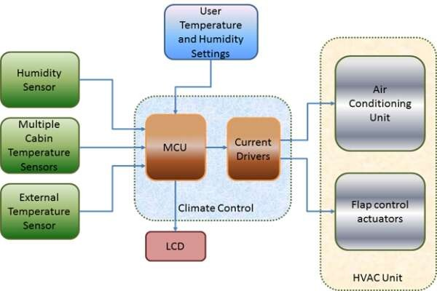
HVAC System for Cars and Automotive Vehicles
4.3.1. Recirculation and Defrosting
Recirculation helps retain the air inside your car, with only minimal quantity escaping out of the cabin. It is useful, especially when you need to cool down your vehicle quickly as it circulates air that is already fresh or when you are driving through an environment with an undesired smell.
For defrost, a blast of dried conditioned air is directed towards the windshield. Back when not all cars had air conditioning, people used the heater to defrost the windshield. Know that defrosting your windshield is not just a job for the heater. It involves both the heater and air conditioner to create a mix of air that is both warm and dry to get the job done faster.
Some advanced systems have permanent defroster nozzles to deal with the fogging effect in the windscreen and side windows based on the dew point sensor. It always keeps the front windscreen clear.
4.4 Zone Control
By default, the car climate control is a single-zone system. That means the entire cabin is set to a single temperature setting. This may cause different comfort levels to individuals riding the vehicle - some would feel it was freezing cool while others may feel sweating.
www.mitsde.com

Slide 75
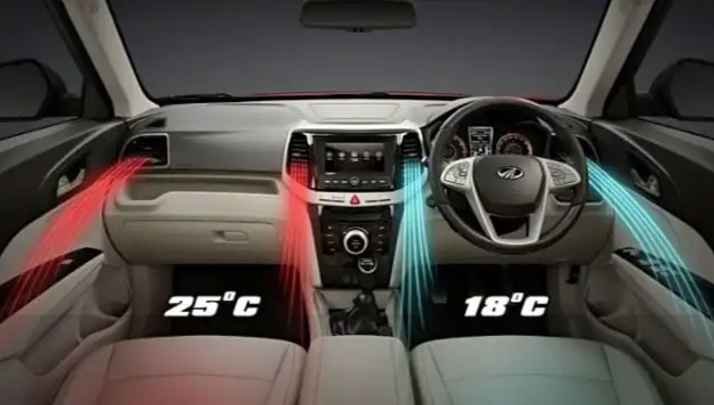
HVAC System for Cars and Automotive Vehicles
Advances in automatic climate control have evolved into zoned climate control, which provides an individual feel-good climate for the occupants. In this type of implementation, each occupant can adjust the temperature of the seating area in which he or she is seated. Each area in the specific zones has a separate sensor that detects the current temperature of only that area. The climate control system will then read the inputs and regulate the fan speed, engage/disengage the compressor; ensures proper hot and cold air mix and controls the intensity of the airflow.
The luxury variants of many models feature ‘Zoned’ climate control which may be dual, triple, or even four-zone controls.
4.4.1. Dual-Zone Climate Control
This features two temperature controls, so that the left-side and right-side of the car can have different temperature settings. There will be two controllers as well on either side of the dashboard that allows different temperatures settings.
In some cars, the system will limit the temperature on one side relative to the other. This option allows you to ensure a comfortable stay not only according to the needs of the owner or the driver of the car.
4.4.2. Three-Zone Climate Control
A three-zone climate control has three zones, each with an independent temperature controller. Two of the zones are in the front (left and right), while the third zone is in the rear seating area. Back seat occupants can choose the best option for them and have control over the air vents and temperature settings.
www.mitsde.com

Slide 76
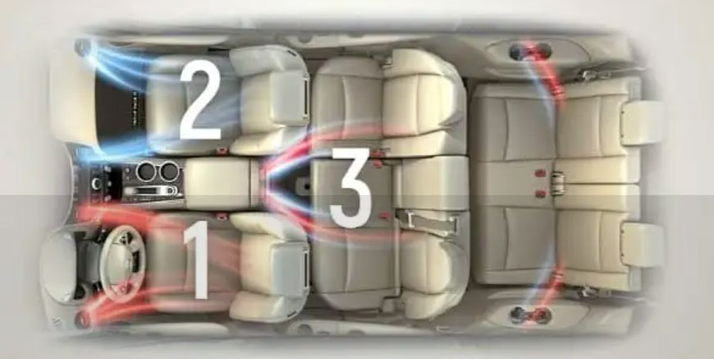
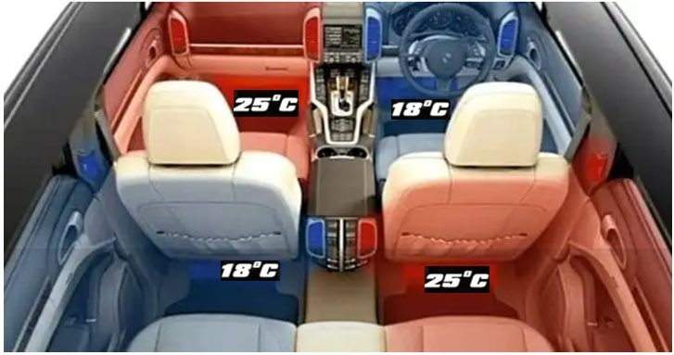
HVAC System for Cars and Automotive Vehicles
In this case, the driver will not suffer because of the preferences of those with whom he is travelling. It can optimize heating or cooling separately for the area near the steering wheel.
4.4.3. Four-Zone Climate Control
The four-zone climate control splits the temperature of the cabin into four areas for each of the four main seats in a car. This type of climate control can be found on high-end luxury cars, mainly limos like the Mercedes S-Class and the other expensive SUVs. However, four-zone climate control - like three-zone systems - will also give the driver the ability to control the rear cabin temperatures. These systems additionally have a 'SYNC' button which allows you to set a uniform temperature throughout the car.
Smooth blowing is also provided through the ducts on the door pillars and on the ceiling.
www.mitsde.com

Slide 77
HVAC System for Cars and Automotive Vehicles
A car equipped in 4-zone system would obviously be expensive because of the presence of additional sensors and a complex electronic control unit.
www.mitsde.com

Slide 78
HVAC System for Cars and Automotive Vehicles
5.0. CHAPTER 5: REFRIGERANTS AND ENVIRONMENTAL REGULATIONS
We have learned that how the state of refrigerant changes from liquid to vapour, and back to liquid during the course of the refrigeration cycle. The refrigerant is a chemical that must have certain properties, including a very low boiling point, in order to be efficient and safe.
R-12, or "Freon", was earlier used for many years, and was efficient and inexpensive, but due to environmental concerns, it is being phased out. Vehicles made in 1995 and later use R134a. During the transition years, both of the systems were used.
The two refrigerants (R-12 and R-134a) are not interchangeable. An identification label can be found on the compressor or elsewhere under the hood. To prevent contamination of systems and service equipment, the service valve design was changed for the R-134a systems. R-134a system service valves are either quick-connect fittings or metric-threaded. Most R-12 systems can be retrofitted for R-134a. If an R-12 system has suffered a significant component failure, it may be a good candidate for retrofitting. R-12 is becoming prohibitively expensive as available quantities dwindle.
Since the two types of refrigerants do not mix and are not interchangeable, each type requires dedicated equipment. This chapter provides some information for identification and comparison purposes; however, we will primarily be discussing the R-134a systems. If you will be servicing R-12 systems, be sure to refer to the R-12 service equipment manual and vehicle manufacturer service materials.
R-12234yf is the NEWEST refrigerant now being used in the newer generation automobiles.
Refrigerants
Refrigerant-12
R-12 has been used in refrigeration systems since its introduction in 1930. However, R-12 is a chlorofluorocarbon (CFC), and due to environmental concerns, countries around the world have agreed to end its production. It is estimated that 30% of released CFCs are from mobile air- conditioning sources mostly from repair and service. These are now banned.
5.1.2. Refrigerant-134a
Vehicles today use R-134a refrigerant, which is the only OEM approved replacement for R-12. It is an HFC and it does not deplete the ozone layer of the atmosphere. In many ways, it works and acts the same as R-12. Harmless to refrigeration system materials, it is non-flammable and it absorbs, transfers and releases heat efficiently. However, it does not mix well with mineral oil for
www.mitsde.com

Slide 79
HVAC System for Cars and Automotive Vehicles
system lubrication; synthetic oils must be used with R-134a refrigerant. Check the manufacturer's specs, under-hood labels, or compressor tags for the correct oil.
R-134a has a smaller-sized molecule than R-12, and so it has a higher potential for leakage than R-12; however, improvements in the design of fittings, and the use of barrier-type hoses offset this difference. There are numerous other differences between R-12 and R-134a refrigeration systems, as shown in the chart.
CAUTION: Beware of refrigerant blends and hydrocarbon-based refrigerants! These blends, besides causing possible damage to system components and service equipment, can be highly flammable! Only R-12 and R-134a are approved by automakers for use in their respective systems.
Refrigerant Leaks
The most common problem encountered with vehicle air conditioning systems is the refrigerant leak. Any loss of refrigerant doesn't just reduce the system's cooling capacity; it can cause numerous other problems:
The system pressure is reduced which prevents the clutch from triggering the compressor to begin its cycle.
A low refrigerant charge will not cool the compressor adequately and may cause system damage. Also, the compressor lubrication depends on the refrigerant circulation.
Air and moisture can enter a system at the leak point and cause internal components to clog or corrode. Moisture is the greatest enemy of a refrigeration system.
Modern A/C systems have R-134a refrigerant capacities as low as one pound (450 grams). As a result, even a small loss of charge can have a big effect on passenger comfort.
Common Leak Areas
A leak can occur at any point in the air conditioning system but the most common places, where leaks are found, include:
Connections: Check around connections between components, lines, and hoses. Connections can become loose, or O-rings can fail. Torque threaded connections carefully to prevent leaks or damage to aluminum parts.
Service ports: Very important! To begin with, the service port caps must be securely in place. While the Schrader valves are the primary seals for the ports, the caps serve as
secondary seals in the case of leakage. The caps also keep the valves clean and
www.mitsde.com

Slide 80
HVAC System for Cars and Automotive Vehicles
protected. Up to a pound of refrigerant per year can escape from a service port if the cap is missing.
Pressure switches: These switches are susceptible to leaks. Check the fitting and unplug the switch to check around the electrical connections.
Evaporators will sometimes develop leaks due to corrosion. Look for evidence of oil at the
bottom of the evaporator housing and at the drain hole or tube. Small evaporator leaks will require the use of a leak detector.
Solution: It’s sometimes possible to see an oily substance accumulating around these connections, which is likely the source of the leak. You or a technician can use a sealant (specifically designed for air conditioning units) found at most auto parts stores to close the leak. Most leak repairs involve replacing O-rings, seals, or hoses. But if the evaporator or condenser is leaking, repairs can be expensive. Replacing a leaky evaporator core usually involves tearing apart the dash and disassembling the HVAC housing, a job that can take 8 to 12 hours depending on the application.
How to tell if your A/C system needs refrigerant
Look at the Low-pressure gauge reading when the engine is OFF. On an 80-degree day, the LOW gauge should read about 56 psi or higher if the A/C system contains an adequate charge of refrigerant. On a 90-degree day, the LOW side reading should be about 70 psi or higher. If the LOW gauge reading is less than this, the A/C system probably needs some additional refrigerant. The actual pressure readings will vary depending on the type of refrigerant (R-134a or R-1234yf) that is in your A/C system.
Most new passenger car A/C systems do not hold much refrigerant (14 to 28 oz.), so you don't want to add too much if the system is low. Overcharging your A/C system with refrigerant will actually DECREASE cooling performance, not improve it.
To find small leaks, you will need to use an electronic or ultraviolet leak detector.
Electronic Leak Detection
Electronic Leak Detectors (ELD) operates in various ways. The most common being that when the unit is turned on, a low beeping sound can be heard, and once the probe locates a leak, the ticking sound increases to a high-pitched noise. This can be achieved by moving the sensing tip slowly around the underside of components and fittings at approximately 5 mm distance. DO NOT allow the sensing tip to contact components or fittings as false readings and tip damage will occur.
www.mitsde.com

Slide 81
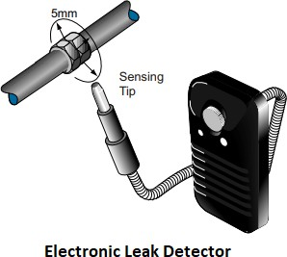
HVAC System for Cars and Automotive Vehicles
When set at its highest sensitivity, it can detect a leak of 1/10 ounce per year.
When the ELD detects refrigerant at the sensor tip, it responds according to the concentration of refrigerant present, through up to 15 gradient levels. Detection begins at the lowest level with one red LED illuminated, and then an increasing number of red LEDs will light as the level increases. As the level continues to rise, the LEDs go through yellow and finally green at the highest levels of concentration. The beep alarm increases in speed, accordingly. The detection level displayed is dependent on the sensitivity setting. In other words, the same size leak will display higher detection levels at higher sensitivity settings.
5.2.4. UV Leak Detection
Another way to find leaks is by using ultraviolet light to illuminate dye that has been injected into the system. This may be the best way to find some small leaks that occur only during special circumstances, such as driving vibrations, road shock, or flexing of components and lines.
A fluorescent-coloured dye is injected into the A/C system and allowed to circulate, and then a specially designed ultraviolet lamp is passed over each component in the A/C system. If a leak is evident, the coloured dye glows brightly. This method is exceptionally good for pinpointing a small leak. A standard dye application is ¼ fluid ounces.
www.mitsde.com

Slide 82
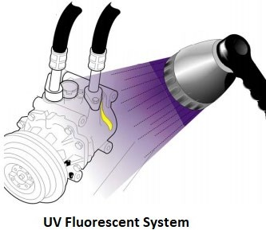
HVAC System for Cars and Automotive Vehicles
Environmental Regulations
The US Environmental Protection Agency (EPA) has issued regulations regarding the sale and service of refrigerants used in A/C systems, including R-12 and R-134a, as well as recovery and recycling equipment.
Under Section 609 of the 1990 Clean Air Act, it is illegal to vent any refrigerant (either R-12 or R- 134a) to the atmosphere during A/C system service. Furthermore, technicians who repair or service A/C systems must be trained and certified on the regulations, refrigerant handling, and environmental issues by an EPA-approved organization. Many such organizations are listed on the EPA website, and some of them offer refrigerant recovery and recycling information and an open-book certification test online. ASE and MACS are two popular sites that offer this service.
The EPA website offers many free fact sheets about refrigerants and the regulations that govern motor vehicle air conditioning in the US.
Ozone Layer
The ozone layer acts as a blanket in the stratosphere that protects us from harmful ultraviolet (UV) radiation. Scientists worldwide believe that man-made chemicals such as CFC-12 (also known by the trade name Freon) are rapidly destroying this layer of gas 10 to 30 miles above the earth's surface. Strong UV radiation breaks the CFC-12 molecules apart, releasing chlorine. A single chlorine atom can destroy over one hundred thousand ozone molecules. Ozone loss in the atmosphere is likely to lead to an increase in cataracts and skin cancer, which is now one of the fastest-growing forms of cancer and could weaken the human immune system. In the U.S., one person dies of skin cancer every hour. Agriculture, as well as plant and animal life, may also be dramatically affected.
www.mitsde.com

Slide 83
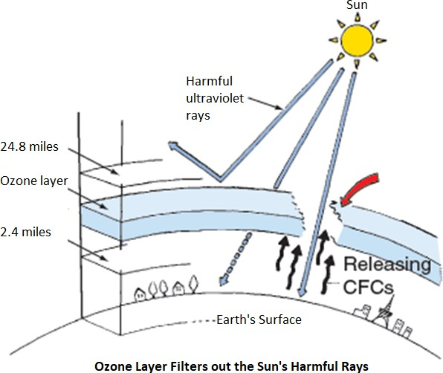
HVAC System for Cars and Automotive Vehicles
Remember that ozone is "good up high, bad nearby": even though it protects us when it is in the stratosphere, ozone at ground level can be harmful to breathe and is a prime ingredient in smog. Many man-made sources such as tailpipe emissions from cars contribute to ground-level ozone.
5.4.1. Global Action to Protect the Ozone Layer
The United States has joined over 160 countries as a Party to the international treaty known as the Montreal Protocol. All developed countries agreed to phase out the production of most ozone- depleting substances, including CFCs, by the end of 1995. The 1990 Clean Air Act Amendments (the Act) incorporated this production ban date and directed EPA to develop regulations to maximize recycling, ban nonessential uses, develop labelling requirements and examine safe alternatives for ozone-depleting substances.
5.5 Impact of Motor Vehicle Air Conditioners
One of the largest uses of CFC-12 in the U.S. is as a refrigerant in motor vehicle air conditioners (MVACs). Section 609 of the Act gives EPA the authority to establish requirements to prevent the release of refrigerants during the servicing of MVACs and to require recycling of refrigerants. Widespread refrigerant recycling reduces the demand for virgin CFC-12 and thus extends the time that it will be available. The following sections describe the requirements of the law and its potential impact on the service industry.
www.mitsde.com

Slide 84
HVAC System for Cars and Automotive Vehicles
Recycling vs. Reclamation
Recycling means the use of a machine to remove impurities and oil and then recharge the refrigerant into either the same car or a different car. Recycled refrigerant is not as pure as a reclaimed refrigerant. Recycling occurs in a service shop.
Reclamation means the removal of all oil and impurities beyond that provided by on-site recycling equipment and the reclaimed refrigerant are essentially identical to the new, unused refrigerant. Reclamation cannot be performed in the service shop. Rather, the shop generally sends refrigerant either back to the manufacturer or directly to a reclamation facility.
Refrigerant Recovery
Section 608 of the Clean Air Act prohibits releasing HFC-134a into the atmosphere. The prohibition on venting HFC-134a has been in effect since November 1995. Technicians who repair or service HFC-134a MVACs must recover the refrigerant and either recycle it onsite or send it off-site to a reclamation facility so that it may be purified according to ARI Standard 700. Technicians must use EPA-approved equipment to perform the refrigerant recovery and recycling. Recover/ recycle equipment cleans the refrigerant so that oil, air and moisture contaminants reach acceptably low levels. Listed below are some key guidelines:
The recovery/recycling equipment must indicate UL approval and must indicate SAE J1991 approval.
R-12 and R-134a refrigerants or refrigerant oils must not be mixed in the recovery/recycling process.
Not any type or size of container can be used with recovery/recycling equipment. The
refrigerant container specified by the recovery/recycling equipment manufacturer must be used to ensure that the container has proper capacity and valving. An HFC-134a container has a Blue color.
When recovering refrigerant in a recovery container, it must be filled not more than 60 percent of their gross weight rating.
When recovering refrigerant from an AC system, the technician should wait for at least 5
minutes and watch the gauges to check for residual pressure. If the low-side gauge rises above 0 psi, there is still some refrigerant remaining in the system. The system should be evacuated until there is no pressure left in the system.
www.mitsde.com

Slide 85
HVAC System for Cars and Automotive Vehicles
f. If the moisture warning light is yellow during the recycling process, the refrigerant contains excessive moisture and the filter/dryer cartridge in the recovery/recycling equipment must be changed.
Section 609 Regulatory History
In March 1996, EPA proposed a rule to require the recycling of HFC-134a. The rule proposed standards for recover-only and recover/recycle equipment and rules for training and testing technicians to handle this equipment. EPA requested comments from the public about this proposed rule, and, after reviewing the comments, published a final rule on December 30, 1997. This final rule will become effective on January 29, 1998. For more information about this rule, see the fact sheet "Summary of Final Rule Governing Substitutes for CFC-12 Refrigerant in Motor Vehicle Air Conditioners" available through the Hotline and the web site.
Converting CFC-12 Equipment for Use with HFC-134a
EPA regulations specify that when equipment is converted for use with a new refrigerant, the converted unit must be able to meet the applicable equipment standard set forth in the regulations.
R-12 equipment may be permanently converted for use with R-134a under certain conditions. The retrofitted unit must meet the technical specifications of SAE standard J2210 and must have the capacity to purify used refrigerant to SAE standard J2099 for safe and direct return to the air conditioner following repairs. Also, the unit may only be retrofitted if retrofit procedures have been certified by an independent testing laboratory such as Underwriters Laboratories (UL), and that an appropriate label is affixed to the unit.
When converting an R-12 system to R-134a, you must:
Install conversion labels and remove the R-12 label.
Recharge the system with R-134a to approximately 90% of the original R-12 charge minus 113grams (4 oz).
Change the accumulator or receiver dryer.
Change the service fittings and flexible hoses. If the R-12 fittings are not converted, they must be permanently capped.
www.mitsde.com

Slide 86
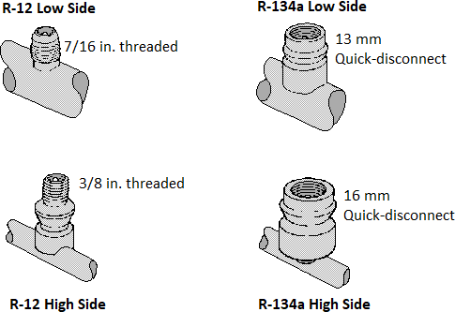
HVAC System for Cars and Automotive Vehicles
Currently, however, in the absence of any EPA regulations, a service facility may perform such a retrofit, or may have the equipment manufacturer's service representative perform the retrofit, as long as the fittings are changed in accordance with EPA's Significant New Alternative Policy (SNAP) program regulations. The Agency cautions technicians, however, that even though recovering a given refrigerant using permanently converted equipment is legal, it may not be technically desirable. The equipment is designed to be compatible with specific refrigerants, and incompatible materials may cause short circuits, damage to seals, and compressor failure. Technicians should check with the recovery equipment manufacturer for recommendations about the recovery of refrigerants other than the refrigerant the equipment was originally intended to recover. Conversion of recovery equipment for use with other refrigerants may also invalidate any warranties offered by the equipment manufacturer.
5.5.5. Restriction for Selling R-134a
There are restrictions for selling or distributing refrigerants and other substitutes for use in motor vehicles since Jan. 1, 2018. The rule establishes certification requirements for buying large containers of refrigerant and mandates that small containers include a self-sealing valve.
Under the new requirements, anyone purchasing a substitute refrigerant for R-12 in a greater- than-two-pound container must provide the seller with evidence that the technician has a Section 609 Technician Certification. If the purchaser is not certified and is buying the refrigerant on behalf of a service facility, the seller must be presented with evidence that one or more technicians at the facility are certified.
www.mitsde.com

Slide 87
HVAC System for Cars and Automotive Vehicles
Refrigerant wholesalers must retain an invoice listing the name of the purchaser, date of sale and quantity purchased. The wholesaler is not required to confirm any technician certification, but EPA is recommending that wholesalers obtain a statement certifying that the cylinders are to be resold to certified technicians.
Individuals do not need to have certification in order to purchase small cans (under two pounds) of R-134a. However, all cans produced after Jan. 1, 2018 must come equipped with a self-sealing valve capable of preventing the container from venting refrigerant after it is removed from the charging valves.
Technician Training and Certification
Technicians who repair or service HFC-134a MVACs must be trained and certified by an EPA- approved organization. If a technician is already trained and certified to handle CFC-12, he does not need to be recertified to handle HFC-134a.
Recordkeeping Requirements
Service shops must certify to EPA that they own approved HFC-134a equipment. Note that this certification is a one-time requirement, so that if a shop purchased a piece of CFC-12 recycling equipment in the past, and sent the certification to EPA, the shop does not need to send a second certification to EPA when it purchases the second piece of equipment, no matter what refrigerant that equipment is designed to handle. If the refrigerant is recovered and sent to a reclamation facility, the shop must retain the name and address of that re-claimer.
Sales Restrictions
Right now, there is no restriction on the sale of HFC-134a, so anyone may purchase it. This year, EPA will issue a proposed rule under section 608 of the Act that will include a proposal to restrict the sale of HFC-134a so that only technicians certified under sections 608 and 609 may purchase it. After the proposed rule is published, EPA will review comments from the public on the proposal and will then publish a final rule sometime in 1998 or 1999.
Retrofitting Vehicles to Alternative Refrigerants
Although section 609 of the Act does not govern retrofitting, section 612 of the Act, which describes the Agency's Significant New Alternatives Policy (SNAP) program, does require that when retrofitting a CFC-12 vehicle for use with another refrigerant, the technician must first extract the CFC-12, must cover the CFC-12 label with a label that indicates the new refrigerant in the system and other information, and must affix new fittings unique to that refrigerant. In addition, if
www.mitsde.com

Slide 88
HVAC System for Cars and Automotive Vehicles
a technician is retrofitting a vehicle to a refrigerant that contains R-22, the technician must ensure that only barrier hoses are used in the A/C system. Finally, if the system includes a pressure relief device, the technician must install a high-pressure compressor shutoff switch to prevent the compressor from increasing pressure until the refrigerant is vented. Much more information about the SNAP program and about retrofitting procedures is available in a fact sheet called Choosing and Using Alternative Refrigerants (EPA website).
5.5.10. EPA Latest Update on Venting and Recovery rules (March 2020)
The EPA published a new rule revising its previous rules that prohibited the venting of all refrigerants into the air when servicing a vehicle, whether or not they contain CFCs or global warming gases. R-12 still should NOT be vented and should be recovered, but now apparently it is okay to vent R-134a and R-1234yf during servicing procedures. No recovery is required.
The new rule also eliminates previous regulatory requirements regarding leak inspection and repair for R-134a and R-1234yf because both do not contain ozone depleting CFC chemicals.
The EPA also issued a proposed rule that would adopt three technical standards developed by the SAE International for A/C recovery and recycling equipment for R-1234yf. The new rule would require this equipment to meet the following updated SAE standards:
J2843 “Recovery/recycling/Recharging Equipment for Flammable Refrigerants for Mobile Air-Conditioning Systems”
J2851 “Recovery Equipment for Contaminated R-134a or R-1234yf Refrigerant from Mobile Air Conditioning Systems”
J3030 “Automotive refrigerant Recovery/Recycling/Recharging Equipment Intended for use with Both R-1234yf and R-134a”
www.mitsde.com

Slide 89
HVAC System for Cars and Automotive Vehicles
6.0. CHAPTER 6: EVALUATING AND DIAGNOSING CAR HVAC
Some A/C performance problems are caused by malfunctioning or broken components. Others, such as system leaks and improper service procedures can be the root causes of many customer performance complaints.
This chapter provides generic air conditioning problems faced by the users and the standard diagnosis techniques. There are several reasons why your car’s air conditioner may stop working, here are the most common problems and how they can be fixed.
Problem: Air conditioning not cooling enough
The most important complaint is the air conditioning system is not cooling enough. The lack of precious cold air could be caused by:
The refrigerant leak caused by a failed O-ring, seal, hose, or component
A clogged expansion tube or refrigerant charging hose
Failed compressor or compressor clutch
Failed blower motor or blower motor resistor
Damaged or failed condenser or evaporator
Vacuum leaks
Failed switch, fuse, relay, control module, blend door, or solenoid
Diagnosing an air conditioning cooling problem is best done by connecting a gauge set to the high and low-pressure service fitting on the system. Though poor cooling is often due to a low charge of refrigerant, it can also be caused by many other factors (see table below).
Air conditioning Troubleshooting & Diagnosis
Low Side | High Side | Cabin Temperature | Possible Cause
Low | Low | Warm | Low refrigerant charge
High | High | Warm | Overcharge of refrigerant
High | High | Some cool | Overcharge or air in the system
Normal | Normal | Warm | Too much oil/moisture in the system
Low | Low | Warm | Expansion valve stuck closed Orifice tube plugged
www.mitsde.com

Slide 90
HVAC System for Cars and Automotive Vehicles
 |  |  | High side restriction
High | Low | Warm | Compressor or control valve failed
The number 1 reason for inadequate cooling is caused by a low refrigerant charge and insufficient lubrication. Refrigerant charge level is critical to proper system performance.
The refrigerant oil required by the system depends on a number of things, but is primarily dictated by the refrigerant used in the system. R-12 systems use a mineral oil whereas R-134a uses PAG. The advantageous characteristic of PAG oil is that it absorbs moisture. Using the wrong lubricant in an A/C system can damage the compressor. Refer to the manufacture for the correct type and amount of oil to add.
The other reasons of inadequate cooling could be:
Blocked filter at the dryer or expansion valve.
Evaporator inlet solenoid closed.
Condenser fan motor issue, less heat transfer available for a given mass of refrigerant.
Defrosting element still operational.
Compressor capacity control faulty leading to less coolant effect across the thermostatic expansion valve.
Once you made these cursory checks, look at the refrigerant levels. Low levels will indicate leak, which must be found and repaired. We have learned about the refrigerant leakage in the previous chapter and we will discuss the refrigerant charging steps in section below.
Problem: Refrigerant Charging
Following these guidelines when recharging the system will ensure the system can operate efficiently.
Determine the Correct Refrigerant
First, make sure you have the correct refrigerant for your vehicle. Use R-134a in R-134a systems only and use R-1234yf in newer R-1234yf systems only. Do NOT inter-mix different types of refrigerant.
Determine Ambient Air Temperature
Different AC systems can have different recommended pressures, so it’s worth looking in a repair manual or online to determine the right pressure for your vehicle. In general, if the temperature of
www.mitsde.com

Slide 91
HVAC System for Cars and Automotive Vehicles
the air is 55°F or below, do not charge the vehicle. The reference table like the one below can be used to determine what pressure to charge the system depending on the ambient air temperature.
R-134a Temperature Pressure Chart
Ambient Temperature °F / °C | Low-Pressure Gauge | High-Pressure Gauge
65°F (18°C) | 25-35 psi / 172-241 kPa | 135-155 psi / 931-1069 kPa
70°F (21°C) | 35-40 psi / 241-276 kPa | 145-160 psi / 1000-1103 kPa
75°F (24°C) | 35-40 psi / 241-310 kPa | 150-170 psi / 1034-1172 kPa
80°F (27°C) | 40-50 psi / 276-345 kPa | 175-210 psi / 1207-1448 kPa
85°F (29°C) | 45-55 psi / 310-379 kPa | 225-250 psi / 1551-1724 kPa
90°F (32°C) | 45-55 psi / 310-379 kPa | 250-270 psi / 1724-1862 kPa
95°F (35°C) | 50-55 psi / 345-379 kPa | 275-300 psi / 1896-2068 kPa
100°F (38°C) | 50-55 psi / 345-379 kPa | 315-325 psi / 2172-2241 kPa
105°F (41°C) | 50-55 psi / 345-379 kPa | 330-335 psi / 2275-2310 kPa
110°F (43°C) | 50-55 psi / 345-379 kPa | 340-345 psi / 2344-2379 kPa
Optional but Highly Recommended
You should use a gauge to monitor the recharging process. Though not absolutely necessary, a gauge will help you recharge your A/C system more accurately and reduce the chance of undercharging or overcharging (either of which will reduce cooling performance).
It is important to note, charging an AC system with just a single gauge attached to the refrigerant is possible, but it is always recommended to use a complete set of manifold gauges, which monitor both the high and low side pressures.
Attach the Charging Hose to Low Pressure Port
Find the low-pressure line port, which will have thicker tubing. There are two ports on your air conditioner. You will add the refrigerant to the low-pressure line port, not the high-pressure line port. The low-pressure line has larger tubing than the high-pressure line, making it easy to
www.mitsde.com

Slide 92
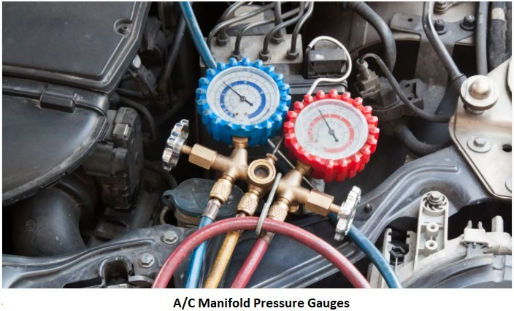
HVAC System for Cars and Automotive Vehicles
distinguish between the two. Consult the service manual to verify the exact location of the low- side service port.
The low side port is typically found on the line connecting the accumulator and compressor. The high side fitting is located between the AC compressor and condenser and is the larger of the two fittings. Sometimes the ports are labelled with “H” for high and “L” for low. Most kits have a hook- up that only fits onto the low-pressure port, making it easier to choose the right port.
Attach the charging hose to the low-side service port and ensure that you have a secure connection. If the hose does not attach easily you may be using the wrong port. Attach both connections if using a set of gauges.
CAUTION:
Do NOT connect a can of refrigerant to the HIGH side service fitting. The operating pressure inside the A/C system when it is running may exceed the burst strength of the can, causing the can to explode! This should be impossible to do because the service hose for recharging the A/C system will only fit the smaller Low-pressure service fitting. Even so, you should be aware of the danger.
Hold the can UPRIGHT so no refrigerant liquid enters the service hose. You only want VAPOR to be pulled into the A/C system (the compressor may be damaged if it sucks in a big dose of liquid!).
6.2.5. Attach the Charging Hose to Refrigerant Can
Connect the recharge service hose and valve to a CAN of refrigerant. Slowly open the valve on the service hose so refrigerant vapour will release a small amount of refrigerant into the hose. This will blow air out of the hose (which you do not want in your A/C system). Close the valve so
www.mitsde.com

Slide 93
HVAC System for Cars and Automotive Vehicles
no more refrigerant escapes, then quickly connect the other end of the service hose to the Low- pressure service fitting on the A/C system.
Start the Engine
Start the engine and turn the A/C on MAX/HIGH. The compressor may not engage if the system is too low on refrigerant. The low-pressure cut-out switch will prevent the compressor from running if the system is too low on refrigerant (this is done to protect the compressor from damage due to a lack of proper lubrication). The compressor must be running to suck refrigerant through the service hose into the system. So, if it is not engaging when you turn the A/C on, you may have to supply battery voltage directly to the compressor clutch using a fused jumper wire. Look for a single wire connector near the front of the compressor, unplug it and hook up a jumper wire to the battery POSITIVE terminal. This should cause the clutch to engage and the compressor to run.
Charging the System
Once the system connections are set, turn on the hose valve. It may take up to 10 minutes or more to suck the entire refrigerant volume out of the CAN into the A/C system. Recharging will go more quickly during hot weather than cooler weather.
Monitor the refrigerant charging with aid of high or low-pressure gauge (or both the gauges).
Low pressure gauge: Stop charging when the reading is between 25 and 40 psi with the A/C running. The system is fully charged and should be cooling normally. DO NOT add any more refrigerant. If the gauge is over 50 psi, you have overcharged the system with too much refrigerant. If your gauge has different color-coded zones for R-12, R-134a and/or R-1234yf, make sure you are within the correct range for your type of refrigerant.
High pressure gauge: Stop charging when the reading gets up around 200 to 225 psi (R- 12), or 225 to 250 psi (R-134a). The system is fully charged and should be cooling normally. DO NOT add any more refrigerant.
NOTE: The high- and low-pressure readings will vary depending on the system and ambient temperatures (higher temperatures cause higher system pressure readings).
Refer to the vehicle manufacturer specifications for normal system operating pressures, and the total refrigerant capacity of the system. Most new passenger car A/C systems do not hold much refrigerant (only 14 to 28 oz.), so you don't want to add too much if the system is low. One can of R-134a typically holds 12 oz. of refrigerant.
www.mitsde.com

Slide 94
HVAC System for Cars and Automotive Vehicles
If the system needs more refrigerant after adding one can, you can add a second can. CLOSE the valve on the service hose, then disconnect the hose from the empty can, screw a new can onto the service hose valve, turn the valve to puncture the new can, then turn the valve all the way back out again so refrigerant can flow through the hose into the A/C system.
Switch off the Engine/Air conditioning System
After the air conditioning system is charged to the proper pressure, close the valve on the hose can and turn off the engine. You will notice that with the gauges hooked up to the air conditioning system and the engine shut off, both the high side and the low side pressures should be equal in a short amount of time.
Disconnect the Refrigerant Charging Kit
Disconnect the charging hose from the low-side service port (in case there is any refrigerant left in the can). Don't vent any leftover refrigerant from the can. Leave the service hose attached to the can with the valve closed so you can save the refrigerant for a future recharge.
Remember to replace the plastic caps over the service fittings and remove the jumper wire from the compressor if you had to jump it to make it run.
Problem: Low Refrigerant Charge
Undercharge symptoms:
Low discharge and suction pressure.
Compressor motor getting tripped by low pressure cut out trip.
Large bubbles in the liquid sight glass.
Compressor discharge temperature high.
The compressor runs longer period between the start and stop.
Remedy:
Check for leaky points by halide torch or soap solution or electronic leak detectors.
Charge the system.
Achieve the correct pressure gauge reading.
6.4 Problem: Refrigerant Overcharge
Refrigerating plants should not be charged with excess refrigerant, as this may overload or damage the compressor. To ensure refrigerant charged correctly, weigh the refrigerant before charging. Overcharge symptoms are:
www.mitsde.com

Slide 95
HVAC System for Cars and Automotive Vehicles
High compressor discharge pressure.
Full level clear sight glass.
The compressor is running cold.
Excess frost on the compressor suction.
Unusually large compressor noise while running due to liquid refrigerant entering into the compressor suction.
Remedy:
Release the refrigerant into a recovery bottle and avoid any leaks directly into the atmosphere.
Problem: Air in the Refrigerant Circuit
As the air is non-condensable, it could cause:
Compressor overheating with high discharge pressure and normal condensing temperature.
The appearance of small bubbles in the sight glass.
Condensing pressure high.
Cooling capacity reduced.
Pressure gauge of the condenser jumps indefinitely.
Reason:
Air may enter while charging of the refrigerant.
Air may enter while carrying out routine maintenance.
If the suction pressure goes below atmospheric pressure, during system evacuation, then air may enter from leaky gaskets or loose connections.
Remedy:
Vacuum Purging an air conditioning system prior to recharging an empty system is required to remove air and moisture. To properly evacuate an AC system the vacuum pump should run for 30 min. To charge a system with the engine running, the refrigerant should be added to the low side of the system. Low side charging is also referred to as vapor charging, which means ONLY refrigerant vapor or gas enters the system. With the gauges hooked up to the air conditioning system and the engine shut off, both the high side and the low side pressures should be equal in a short amount of time.
www.mitsde.com

Slide 96
HVAC System for Cars and Automotive Vehicles
b. Air in the system gets removed by collecting the system gas into the condenser by closing the condenser outlet valve while the compressor is running. Vent the collected air from the venting valve using a thermometer, as the temperature drops, immediately shut the vent valve.
Problem: Moisture in the Refrigeration Circuit
The moisture in the refrigeration system could lead to:
Evaporator starving of refrigerant and rapid rise in condenser pressure causes a compressor to short cycle.
Icing at the expansion valve filter. When the expansion valve freezes, refrigerant flow is reduced, and cooling is also reduced.
Moisture can cause corrosion and damage to the motor windings.
Remedy:
Clean expansion valve filter.
Renew drying agent or the dryer unit.
Problem: Insufficient Air from the Vents
The main causes of weak airflow:
A customer complains of low air flow through the instrument panel duct outlets. Which of the following could be the cause?
Clogged passenger compartment air filter.
Mold or mildew may have accumulated in the evaporator core from residual moisture. When this happens, air will have trouble reaching your air vents.
The hose has come loose. This usually happens with the blower hose that supplies air to the blower unit.
Ventilation fan is not blowing; air won’t be flowing very well.
Core case seals, blower house seals, or evaporator core case seals open up over time
and diminish airflow. A/C ventilation systems are very sensitive and must remain sealed. Once they’re opened, the whole system is compromised.
Faulty blower motor and/or electrical faults
Remedy:
The technician may begin checking for:
www.mitsde.com

Slide 97
HVAC System for Cars and Automotive Vehicles
Blocked air intake – Vehicles have two areas where air enters the vehicle. One is where air enters your vehicle through vents by the lower half of the windshield and the other is the air that is recirculated from inside the cabin. If either of the air intake areas are blocked from a clogged filter or other debris, your vents may blow little to no air.
Damaged belts and hoses – The air conditioning system is equipped with many hoses and belts that operate the system. Any sort of leak, detachment, or blockages will prevent proper airflow from the vents.
A blown fuse or bad relay – If the ventilation fuse blows there will be no power to the blower motor preventing air from blowing through the vents. Likewise, a bad relay can also be the culprit since the relay takes the small electrical current and uses it to regulate the larger current needed for ventilation.
Damage to the blower motor or blower resistor – The blower motor is what pushes the air
through the vents in the car, like a fan in your home. Blower motors that have malfunctioned due to wear or age will prevent air from coming through the vents. Similarly, the blower resistor works with the blower motor to control the level of how much air is produced to flow through the vents (low, medium, high) based on your preference.
6.8 Problem: Smell and Odors
You may smell strong odours emanating from your vehicle vents, dashboard, or floor carpets particularly when the A/C is on. It’s mainly because of the growth of bacteria, mould, fungi and other micro-organisms build up on the evaporator coil, filters, and in the A/C heater box located under your dashboard.
Air filters and evaporator coils can collect dirt, water, dust, and other pollutants and after some time producing an odor. The contaminated airflow mixes with the condensation from the coils, creating a slimy film on the A/C fins and producing a mouldy smell. After a time, the film builds up and can clog the drain line. The drain line is a rubber hose that begins in the evaporator heater box goes through the floor, and to the undercarriage to remove excess moisture. Once plugged, water from the condensation fills up the heater box and begins dripping out and onto the floor of the vehicle, wetting the carpets.
Remedy:
Replacing your air filter will help combat this issue. If replacing the filter does not eradicate the stench, add an anti-bacterial solution into the evaporator area to kill mould and other contaminants from the system.
www.mitsde.com

Slide 98
HVAC System for Cars and Automotive Vehicles
6.9 Problem: AC Makes Noise
Air conditioning systems are relatively quiet when in use. When you hear rattling, banging, or other unusual sounds, it’s normal to feel a bit nervous about what is causing the issue. It could be as simple as leaves or other road debris blocking the unit and producing all sorts of unusual noises. Other sources include:
Cross-contaminated refrigerant (operating pressure too high), the air in the system, or the wrong type of compressor lubricant.
Hoses or other parts rattling against other components in the engine compartment. Check the routing of the hoses, support brackets, etc., to pinpoint the noise.
Major component could be in failure. If a bearing is worn out the air conditioning will produce a grinding or squealing sound. A rattling sound could indicate the compressor’s clutch has failed. Noise from the compressor usually means the compressor is on its way
out.
Continuing to use your A/C may only make things worse. A thorough inspection will be able to determine if a major component is in failure and whether it will need to be replaced.
6.10 Problem: Air Conditioning Goes from Cold to Hot
When you’re driving and the air suddenly goes from comfortably cool to horribly hot, you know there’s a problem. This may be due to:
Moisture in the refrigeration system could block/freeze the expansion valve. A blocked expansion valve prevents the refrigerant from reaching the evaporator. As the expansion valve thaws, the refrigerant flow is restored, and cooling is also restored until the expansion valve freezes again.
The compressor cycles quickly on and off several times per minute and air coming from the vents is only slightly cool. The reasons may be that the defective thermostatic switch may not be engaging the compressor long enough and also, if the refrigerant level is low,
it will cause the clutch to cycle quickly.
Remedy:
Properly test the system’s pressure and inspect components for blockages or malfunctions.
6.11 Common Problems with Compressors and Clutches
Malfunctions in the refrigeration system can occur with the compressor, condenser, evaporator, orifice tube or thermostatic expansion valve, receiver/dryer or accumulator/dryer, and the
www.mitsde.com

Slide 99
HVAC System for Cars and Automotive Vehicles
compressor controls. Restrictions in lines and hoses reduce refrigerant flow and cooling capacity, as does an inadequate or lost charge of refrigerant.
Compressor Suction Pressure High
Fractured compressor valves, causing the compressor capacity to fall.
Evaporator load too high, caused by high heat or car window left open.
Excess refrigerant charge. This fault is combined with a low compressor superheat and indicates liquid in the suction line. The solenoid valve should be closed quickly to prevent
liquid damage to the compressor.
Expansion valve stuck in a fully open position, caused by dirt in the expansion valve.
Low Suction and Discharge Pressure
Low compressor discharge pressure may be caused by a faulty internal seal or even a restriction inside the compressor. Restrictions elsewhere in the system or simply a too-low charge of refrigerant may cause low refrigerant pressures on both the low and high-pressure sides of the system. The reasons could be:
Blocked filter or closed valve in the system. In this mode, the compressor is extracting more from the evaporator than the expansion valve is supplying leading to low suction pressure and possibly compressor to short cycle.
Refrigerant charge too low. There is not enough refrigerant within the system to allow the compressor to operate at the present capacity setting. Increased compressor run time.
The liquid refrigerant flow may be disturbed: Fully open the valves in the liquid refrigerant line if not fully open. Check that line filters not chocked.
Thermostatic expansion valve clogged with ice or oil dust mixture: Dissemble expansion valve and clean the ice with dry compressed air. Activate the desiccant of dryer filter by the heater. Take off oil mixture dirt.
Less opening for the expansion valve or superheat very low: Adjust the expansion valve opening and ensure temperature sensor attached properly to the evaporator outlet.
Evaporator cooling capacity lowered by dust and frost: Check fan operation working
normal. Remove dust by soft brush and carry out defrosting.
Compressor Discharge Pressure High
This condition causes the compressor to overload the prime mover and expose the high-pressure side of the system to overpressure. The system overpressure is avoided by fitting a compressor motor trip and relief valve at the compressor outlet.
www.mitsde.com

Slide 100
HVAC System for Cars and Automotive Vehicles
Causes for discharge high pressure:
Too much refrigerant in the system
A blockage in the condenser
Low coolant or air flow to the condenser. The temperature of the condensing refrigerant gas rises as the coolant or ambient air temperature rises. This causes the condensing pressure to rise and a high-pressure trip.
Air in the refrigeration system prevents the condenser to operate at its full capacity and
partly insulate the condenser. This symptom would cause the superheat temperature of the compressor outlet to rise.
Condenser outlet valve closed, causing liquid level in the condenser to rise and producing a similar fault as above.
6.11.4. Abnormal Noise during Operation
The possible causes could be:
Anchor bolts or clamp bolts loosened. Tighten up anchor and clamp bolts.
The liquid is going to the compressor suction line. Adjust the expansion valve and check temperature sensor adhered firmly to the evaporator.
Foamed oil compressed. Adjust the quantity of oil in the compressor crankcase.
Suction valve plate, the delivery valve plate, piston pin, bearing, connecting rod are damaged or worn. Check for noise location and repair it.
Refrigerant inlet valve throttled and refrigerant velocity high, causing vibration in valve plates. Fully open refrigerant inlet valve.
Irregular noises or rattles, however, are likely indications of broken internal compressor parts. The compressor bearing may be defective, if it is making a growling noise whenever the clutch is engaged. The compressor clutch bearing allows the rotor/pulley assembly to spin independently of the compressor shaft when the AC is off. When the AC is on, the rotor/pulley assembly and the armature are locked together by the magnetic action of the compressor clutch coil.
Remedy:
Some compressor noises during A/C operation are normal. A/C systems sometimes use a muffler assembly to dampen compressor vibrations.
www.mitsde.com

Slide 101
HVAC System for Cars and Automotive Vehicles
b. Always check compressor mounting brackets and hardware for missing or broken pieces when evaluating a compressor noise complaint. In some cases, loosening and retorquing compressor mounting hardware to factory specifications can cure a noise problem.
6.11.5. Compressor Clutch Not Engaging
Reason:
Refrigerant charge is too low. When the low side pressure is less than 25 psi, the clutch won’t engage.
Electrical problem. Pressure cycling switch could be defective
Remedy:
Pressure test and add more refrigerant charge if required.
The compressor in an AC system does not run. When a jumper wire is used to connect the battery positive terminal to the power connector the clutch engages.
6.11.6. Short Cycling of Refrigeration Compressor
Short cycling means the compressor is repeatedly running for a few seconds and then cutting off. Reasons may be:
Refrigerant charge is too low.
Low pressure cut out is not properly adjusted.
Frosting or clogging of the evaporator.
Filter / Dryer chocked.
Moisture in the system.
Expansion valve not adjusted correctly leading to excess superheat.
Liquid line solenoid valve malfunctioning.
6.11.7. Frosting at the Suction of the Compressor
It means the liquid is reaching suction of the compressor and is absorbing heat from the surroundings resulting in ice formation. Reasons may be:
Thermostatic expansion valve stuck in open position.
Superheat setting is low and not proper.
The thermostatic bulb not touching the evaporator outlet pipe, or capillary tube damaged.
Refrigerant overcharged.
Fan tripped or damaged.
www.mitsde.com

Slide 102
HVAC System for Cars and Automotive Vehicles
f. Liquid entering inside the crankcase boils off taking away heat from lube oil which may cause foaming.
6.11.8. Compressor Seizure
Compressor seizure may be caused by:
Insufficient lubrication
Inadequate condenser airflow or by system contaminants.
A burnt or broken drive belt or a burnt drive plate can be another sign of compressor seizure.
Remedy:
The root cause of the failure must be found and corrected. Simply replacing the seized compressor and hoping for the best will likely result in a comeback.
If a compressor clutch is inoperative, but the compressor itself not seized, verify that
system voltage is present at the clutch terminals or compressor control relay when A/C is requested. You can also try using fused jumper leads to energizing the compressor clutch directly from the vehicle battery. Excessive resistance in the compressor clutch control circuit can reduce the strength of the clutch magnet and cause slippage.
6.11.9. Operation with Outside Air Sensor
In an automatic climate control system, the compressor operation is generally interlocked with the outside air temperature. When the outdoor air temperature is very low, the compressor will not operate.
6.12 Common Problems with Condensers
Condenser problems fall into three categories:
Leaks
Refrigerant flow restrictions
Airflow restrictions
Leaks
Condenser leaks may develop from internal or external corrosion, vibrations or as a result of roadside objects damaging the tubes, or fins.
Obviously, a leaking condenser will fail to perform properly and may shut down the system as the refrigerant is lost. If the leak is slow, oil starvation may seize the compressor first.
www.mitsde.com

Slide 103
HVAC System for Cars and Automotive Vehicles
Flow Restrictions
Refrigerant flow restrictions are usually caused by excessive corrosion or contaminants in the system. Debris from a failed compressor can block or restrict the flow of refrigerant.
Keep in mind that excessive compressor discharge pressures can only be seen on the high side gauge if the high side service port is located on the compressor discharge line between the compressor and the condenser. If the high side service port is located on the liquid line between the condenser and the orifice tube or expansion valve, the high side gauge will read low when refrigerant flow through the condenser is restricted.
Airflow Restrictions
Inadequate condenser airflow will cause excessive compressor discharge temperatures and pressures.
Cooling fans that are inoperative, or that do not work properly will reduce heat transfer from the condenser.
Obstructions, missing seals or damaged air intake shrouds will also reduce airflow.
Without sufficient cooling air for refrigerant condensation and heat transfer, refrigerant temperatures and pressures will stay high. This may overwork the compressor and generally reduce refrigeration system performance.
Common Problems with Evaporators
Like the condenser, the evaporator is also a heat exchanger. Potential evaporator problems fall into two categories:
Leaks
Airflow restrictions
Evaporators, unlike condensers, rarely have problems with refrigerant flow restriction. Their passages are generally larger in diameter than condenser passages. Evaporators are not subject to the same pressure and temperature extremes as condensers, plus they are downstream from the TXV or orifice tube. TXV and orifice tube screens will, in most cases, keep trash out of the evaporator passages.
6.13.1. Leaks
Refrigerant leaks may develop from internal or external corrosion. Many times, the evaporator case will collect leaves and trash which hold moisture and accelerate a corrosion failure. Because
www.mitsde.com

Slide 104
HVAC System for Cars and Automotive Vehicles
of the evaporator’s location, leaks caused by physical damage are rare unless the vehicle has been involved in a collision.
6.13.2. Airflow Restrictions
This problem shows up as an inadequate supply of cooled and dehumidified air in the passenger cabin. The reason could be:
A dirt-plugged core, a cracked evaporator case, or a leaking seal.
Electrical fault or malfunctioning blower motor. The blower speed directly affects the evaporator heat exchange rate.
Evaporator freeze-up. Condensed moisture that collects on the evaporator surface can
freeze the core and restrict both airflow and heat absorption. Freeze-ups can be caused by compressor clutch control circuit problems.
6.14 Common Problems with Metering Devices
6.14.1. Orifice Tubes
Orifice tube restriction is often indicated by low gauge pressures and insufficient evaporator cooling. The section of the line where the orifice tube is installed may frost as well. The usual cause of the restriction is a clogged orifice tube screen. It is recommended that the orifice tube be examined for any pieces of foreign material stuck on the screen.
If the blockage looks like grey or brown powdery material, the cause is probably a ruptured desiccant bag in the receiver/dryer or accumulator/dryer.
If the screen blockage looks like shiny metal chips, the compressor may be failing.
Hose residue in the form of black granular material can also clog the screen. This is usually
caused by moisture in the system, which reacts with the refrigerant to form acid. The acid in turn breaks down hoses and seals.
Previous A/C system service records can be very important.
If an orifice tube has been installed that is too small for the system, high side pressures will increase, and the compressor may be cycled on and off too quickly for efficient cooling.
If the orifice is too large, or if the orifice tube O-Rings do not seal the tube tightly against the inside of the line, the compressor may never cycle off.
6.14.2. Thermostatic Expansion Valves
TXV restrictions are usually indicated by the same symptoms as those for a restricted orifice tube
- low gauge pressures and insufficient evaporator cooling.
www.mitsde.com

Slide 105
HVAC System for Cars and Automotive Vehicles
Like the orifice tube, TXV inlet, and outlet screens can also become plugged due to system contaminants. A plugged TXV must be cleaned or replaced.
Some TXV designs use an external temperature sensing bulb to regulate refrigerant flow. This bulb is normally clamped to the evaporator outlet line and wrapped with insulating tape. If the bulb is not firmly clamped in place or properly insulated, the TXV can open too far. A TXV that opens too far or is stuck open will cause cycling clutch compressors to never cycle off. Low side pressures and vent temperatures will also be higher than normal.
An expansion valve can be tested using a CO2 fire extinguisher to cool the valve while the air conditioning system is operating. This will result in the low side pressure dropping to 0 or a vacuum.
6.15 Common Problems with Receiver/dryer or Accumulator/dryer
Both dryers perform similar functions, as previously described.
The most common dryer failure is a ruptured desiccant bag. The main cause of desiccant bag rupture is moisture contamination of the system. As we noted earlier, moisture in an A/C system forms acid, which can destroy the desiccant bag and cause loose desiccant to circulate through the system. If the orifice tube or TXV clogging indicates loose desiccant in the system, the dryer should be replaced. Note that the desiccant can become saturated with moisture over time. Once saturation is reached, no more moisture can be absorbed. Refrigerant leaks can also occur because of perforations, damaged O-ring seats, or damaged fitting threads.
Summarizing….
This was a brief overview of servicing and troubleshooting. The intent is not to give the service instruction as this depends on numerous factors importantly the vehicle models, technology used, and type of compressors, control system, and proprietary features. Each vehicle manufacturer provides specific A/C system diagnostic charts and procedures for their products. Only the authorized O&M manuals must be referred to during system diagnosis and repair.
www.mitsde.com

Slide 106
HVAC System for Cars and Automotive Vehicles
References:
The History of Automotive Air Conditioning System https://www.indusmotor.com/blog/automotive-air-conditioning-system
Air conditioning for passenger cars
https://www.mahle.com/en/products-and-services/passenger-cars/air-conditioning/
Fundamentals of the automotive cabin climate control system https://www.edn.com/fundamentals-of-the-automotive-cabin-climate-control-system/
Automotive Air Conditioning https://gomechanic.in/blog/car-ac-working/
How a Car Air Conditioning System Works? https://www.mechanicalbooster.com/2017/12/car-air-conditioning-system.html
The Five Major Parts of Your Car’s A/C System
https://www.cbac.com/buda/media-center/blog/2016/march/the-five-major-parts-of-your-car-s-a- c-system/
Car Air-Conditioning Mechanisms and the Role of Compressors
https://www.toyota-industries.com/company/business/automobile/compressor/mechanism/
www.mitsde.com

