Slide 1
Public Awareness

Slide 2
Newspaper Advertisements (Print Media)

Slide 5
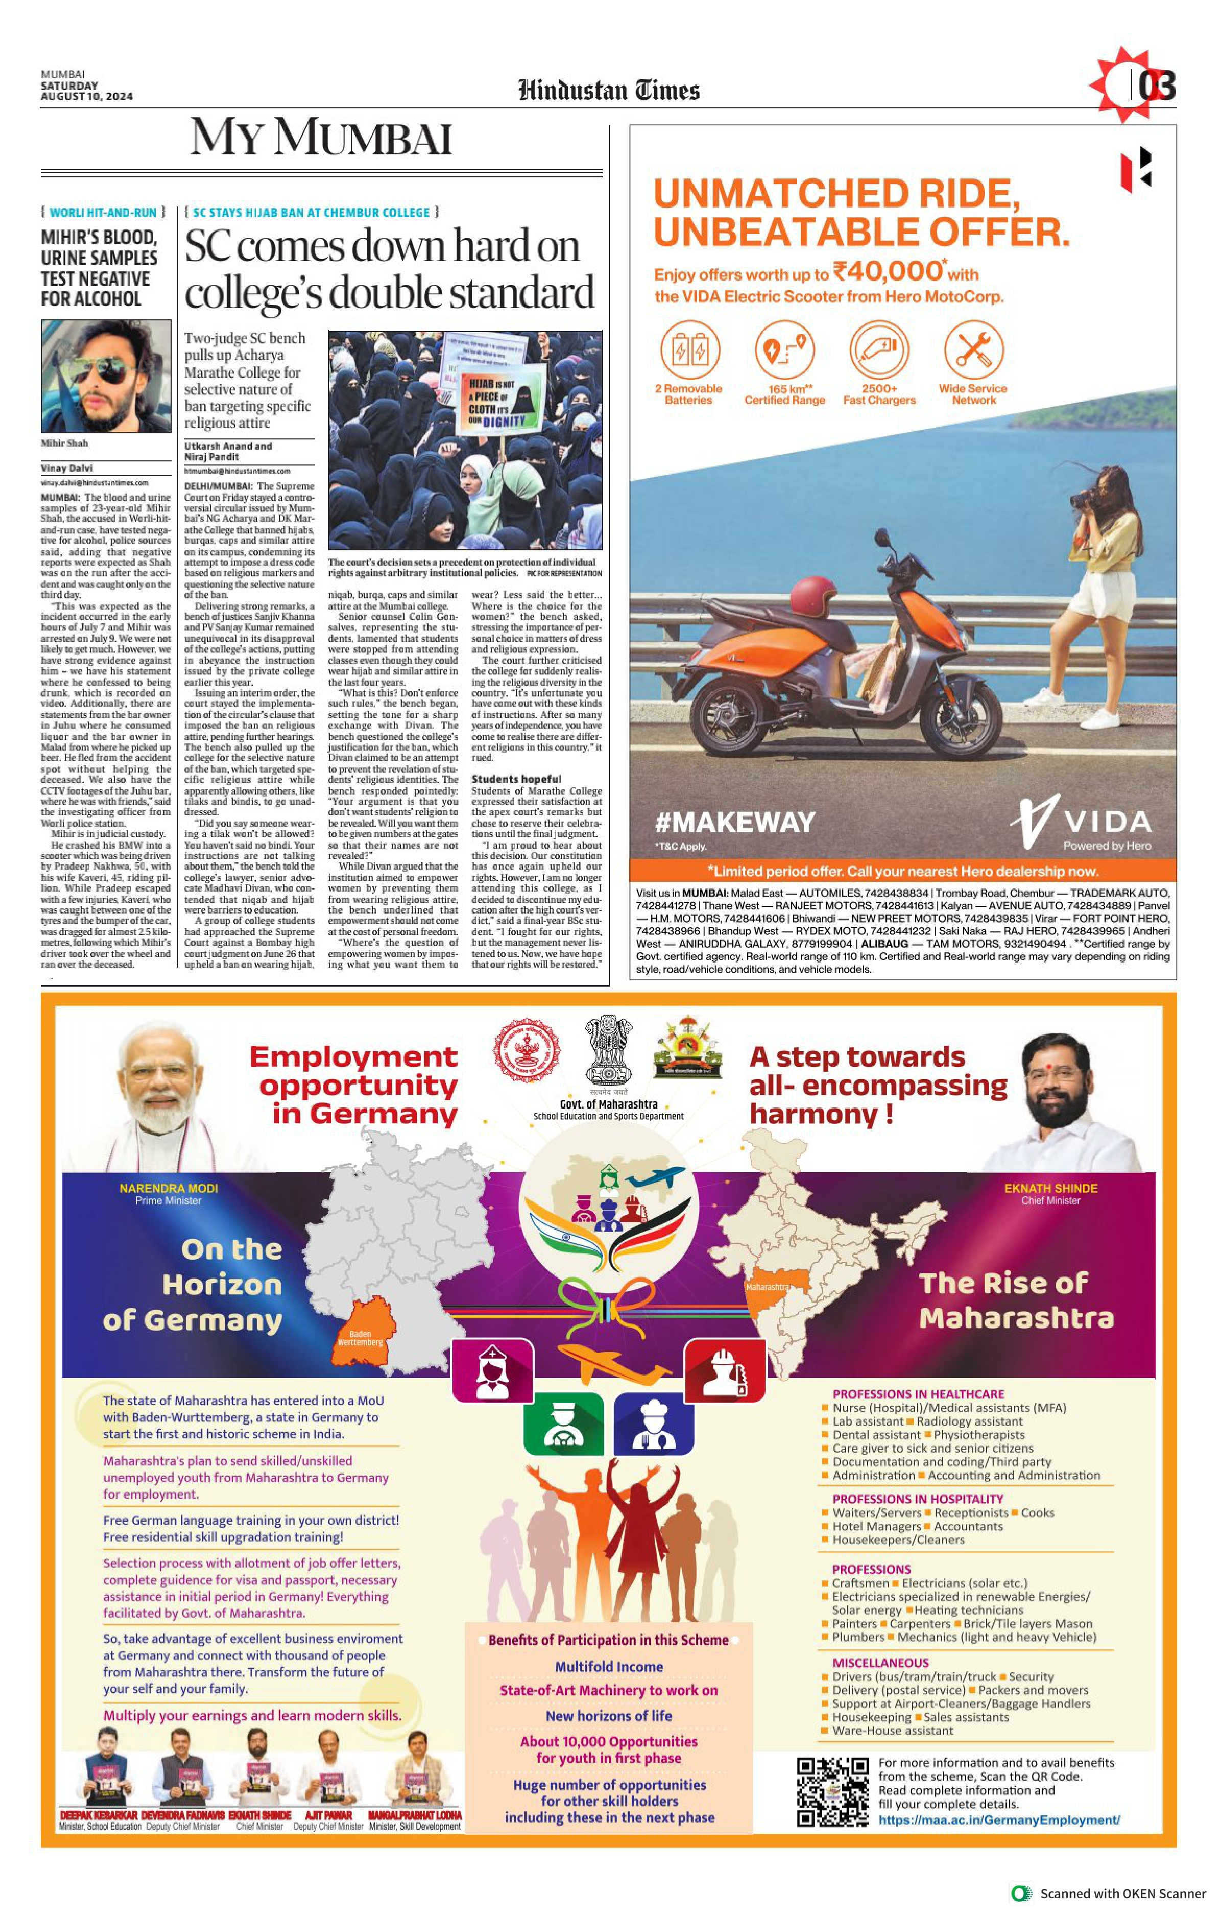
Hindustan Times My Mumbai Saturday August 10,2024

Slide 6
Social Media Advertisements (Instagram, Facebook etc.)

Slide 17
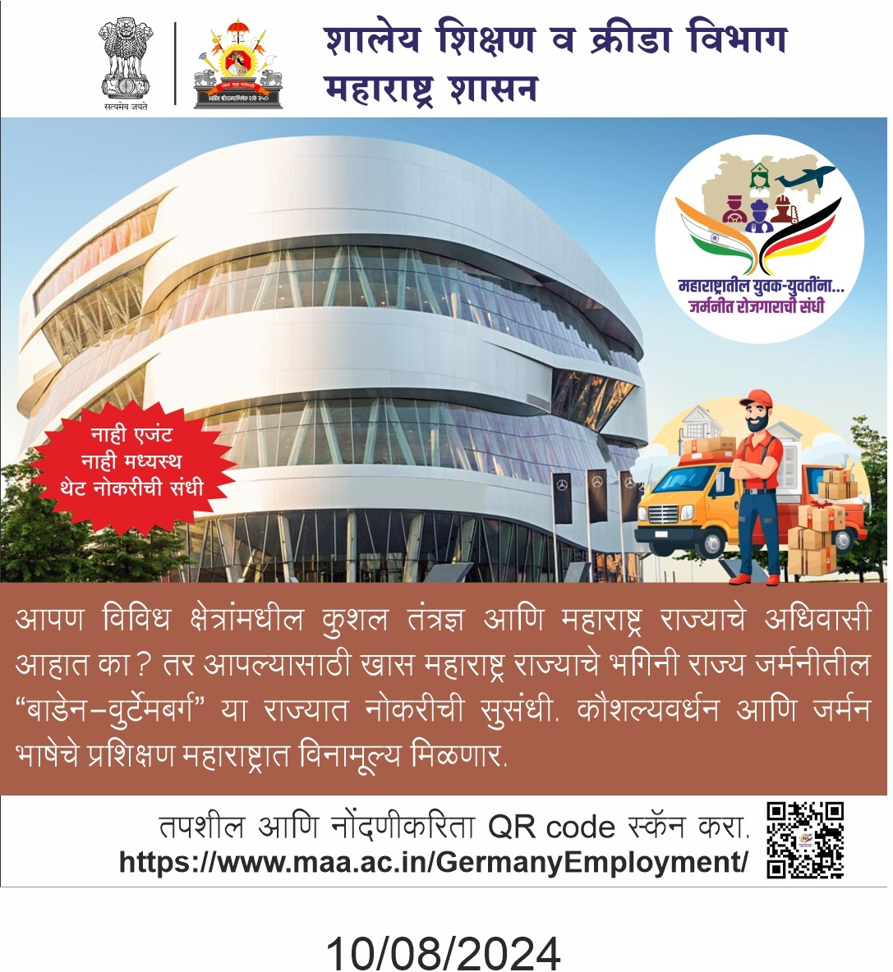

Slide 18
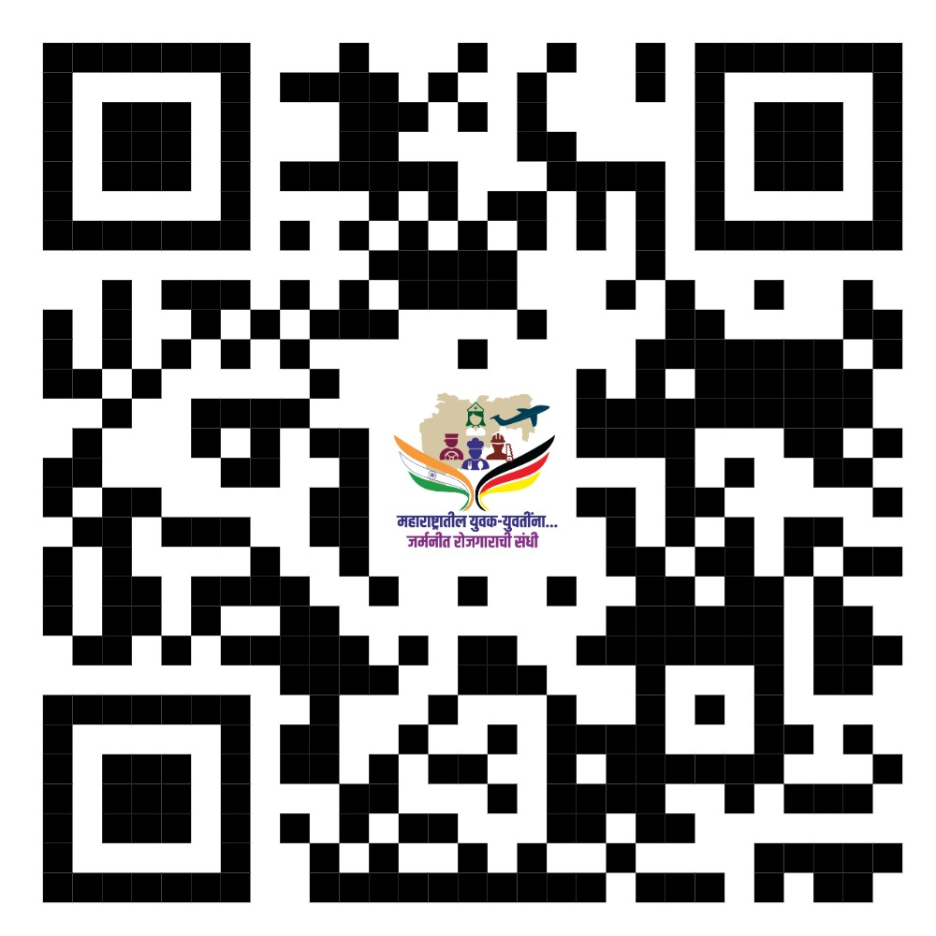

Slide 19
Audio-Visual Advertisements (Television, You-Tube etc.)

Slide 20
Advertisement 1-
maa.ac.in/GermanyEmployment/documents/Germany-Employement-Video-1.mp4
Advertisement 2-
https://www.maa.ac.in/GermanyEmployment/documents/Germany-Employement-Video-3.mp4
Advertisement 3-
https://www.maa.ac.in/GermanyEmployment/documents/Germany-Employement-Video-2.mp4

Slide 21
Link For Registration https://www.maa.ac.in/GermanyEmployment

Slide 22
Registration Process

Slide 23
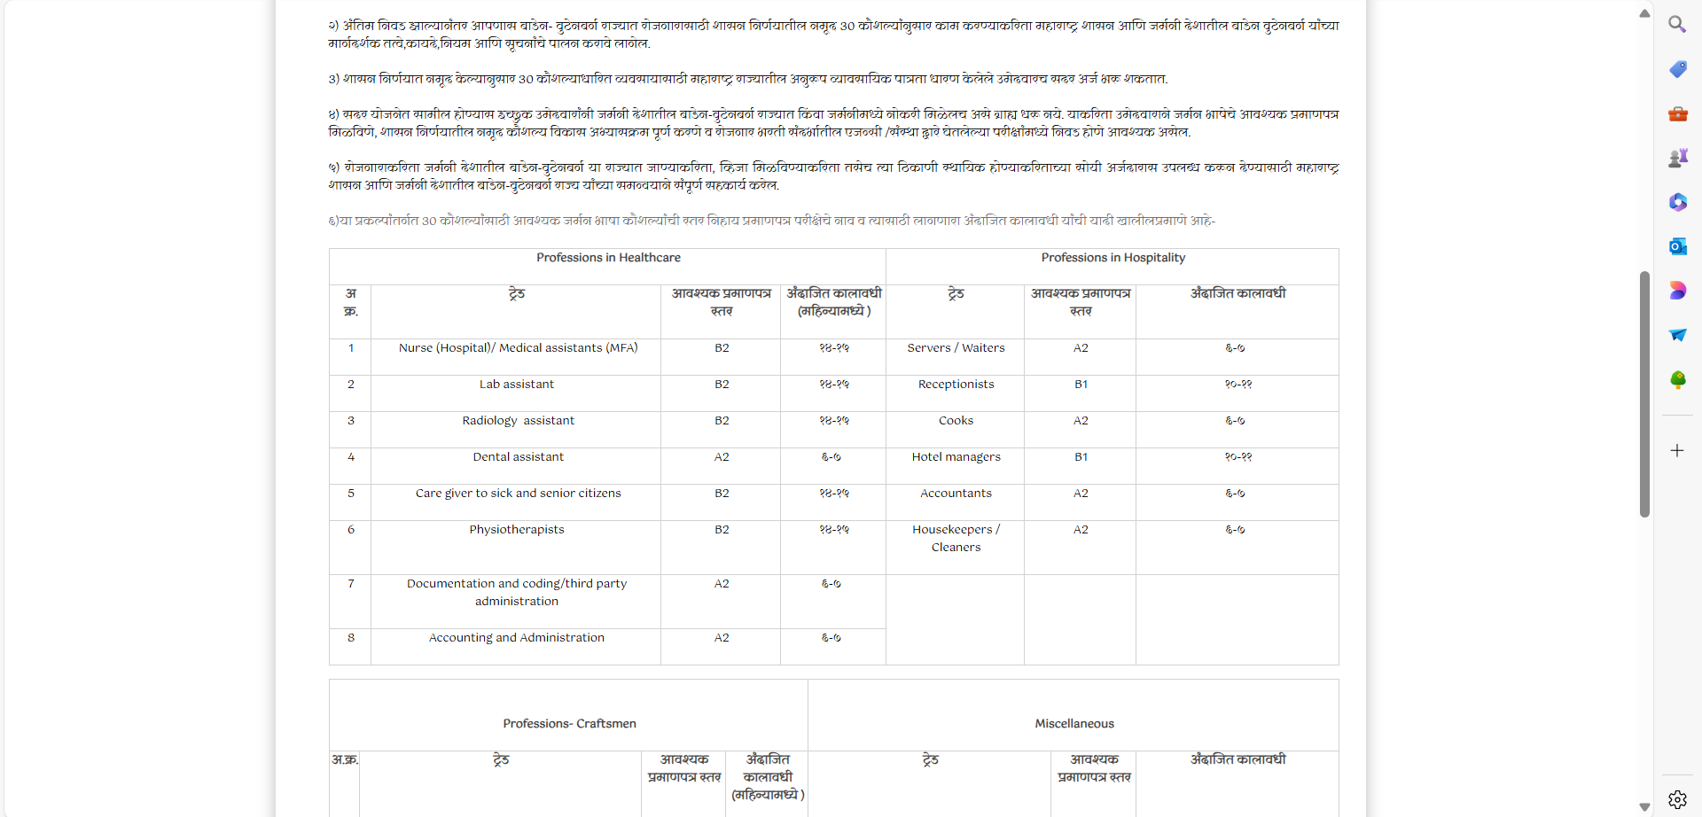

Slide 24
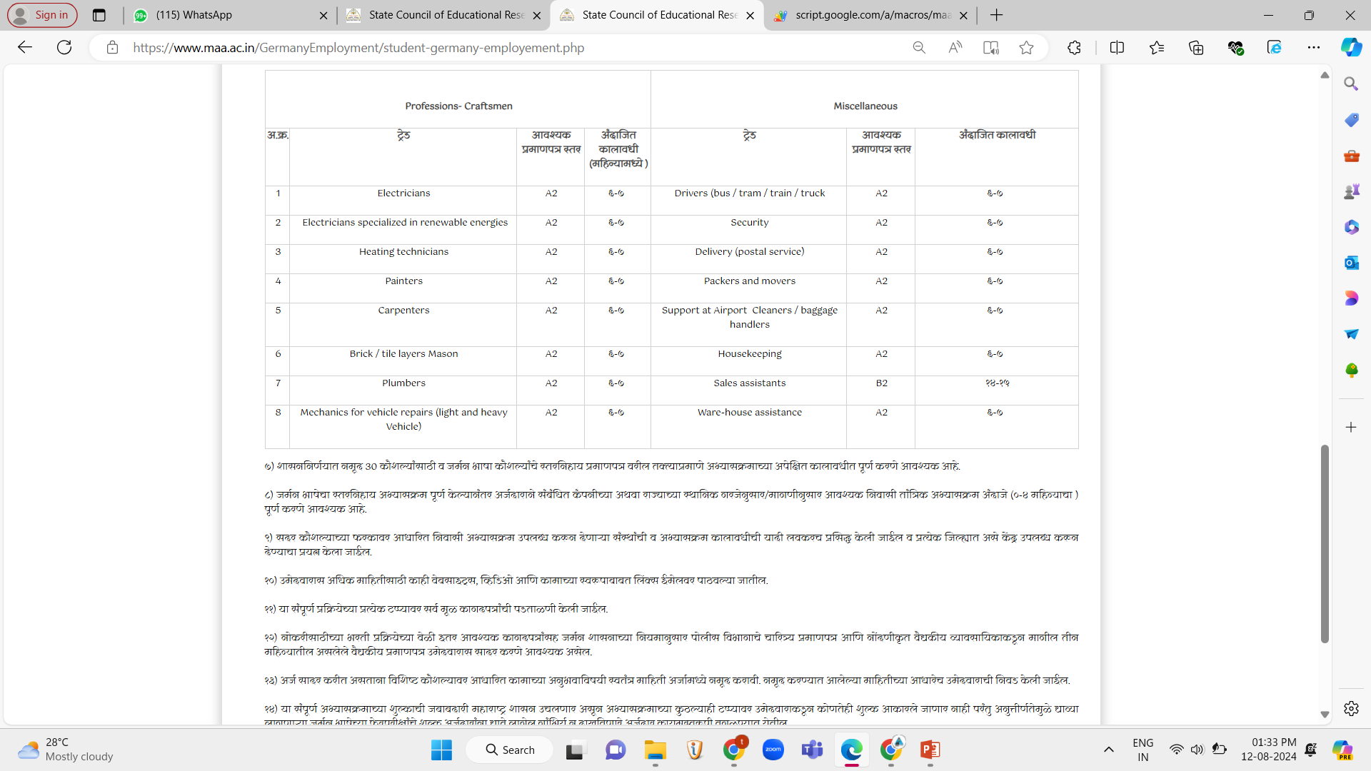
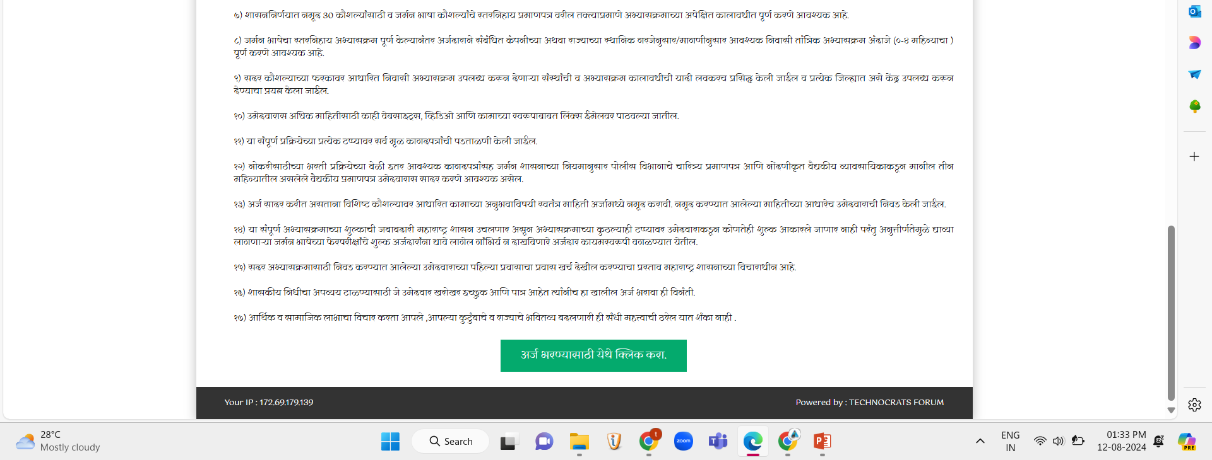

Slide 25
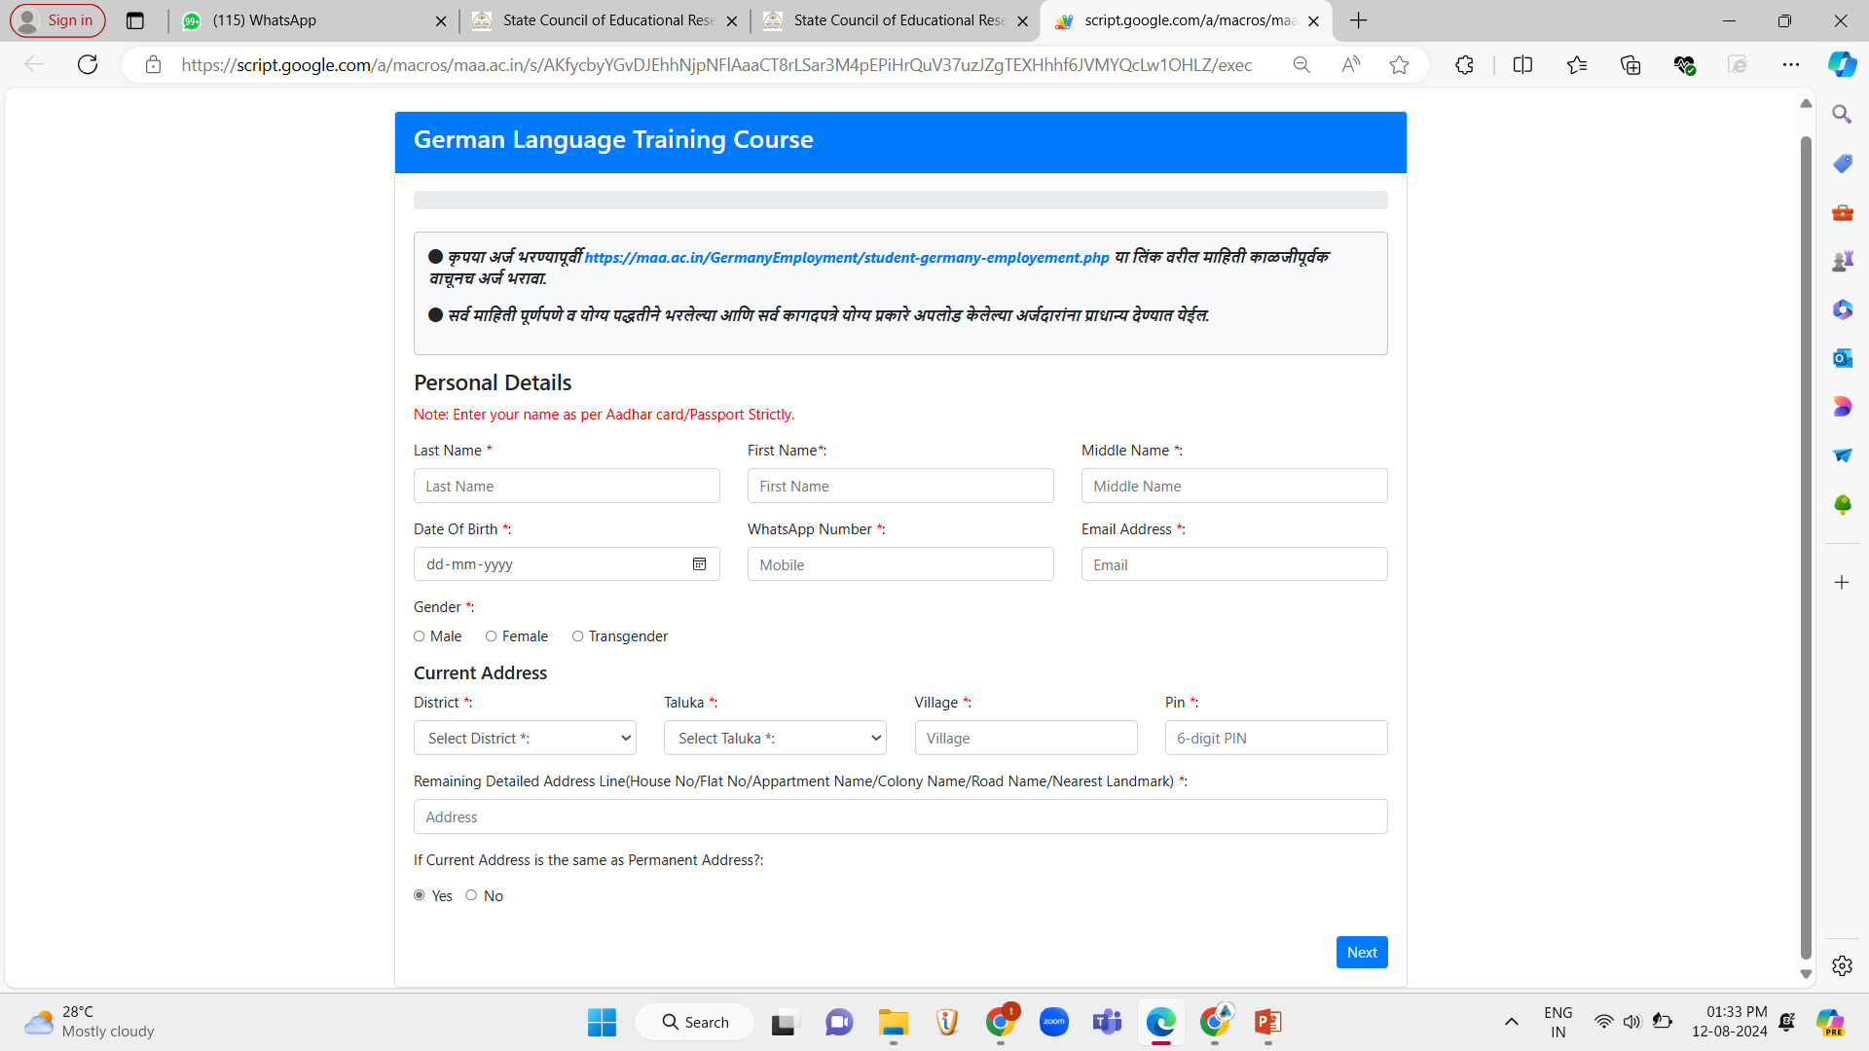

Slide 26
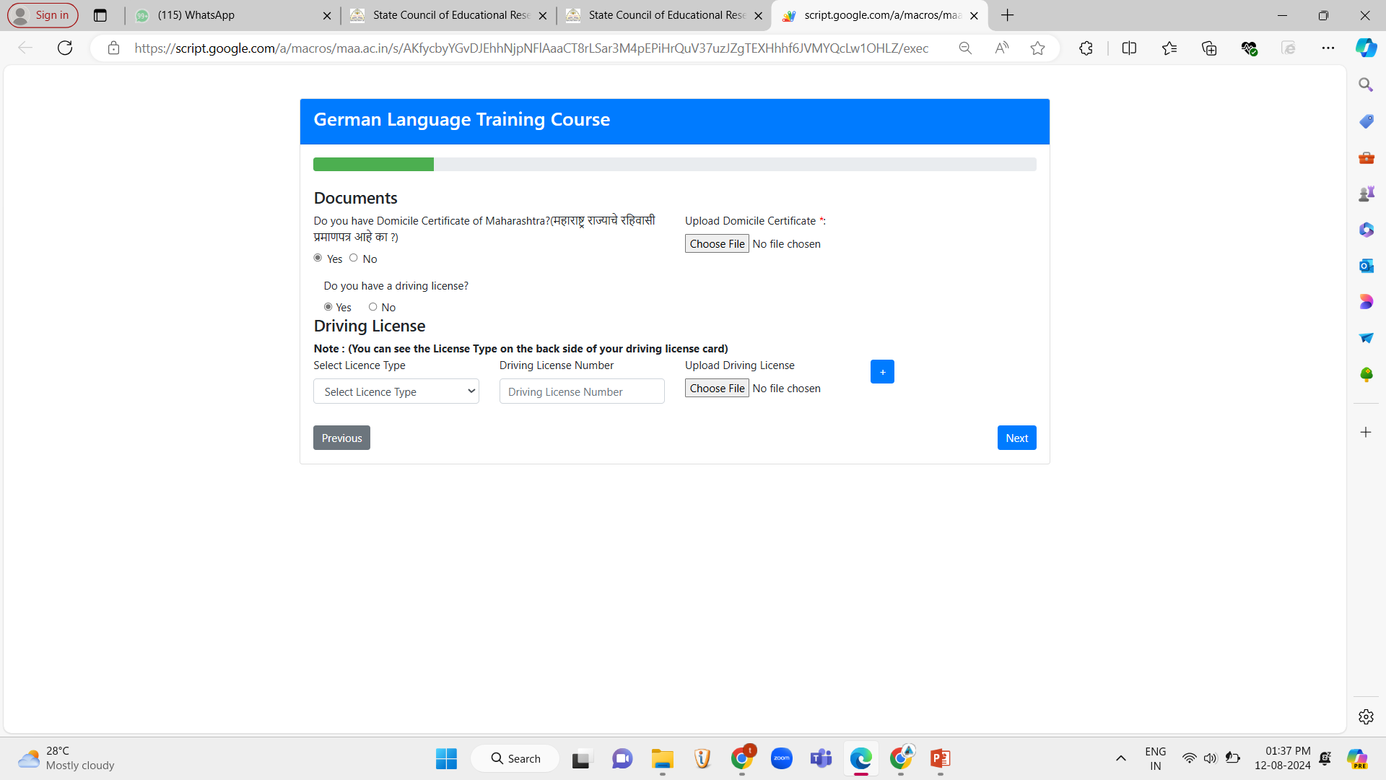

Slide 27
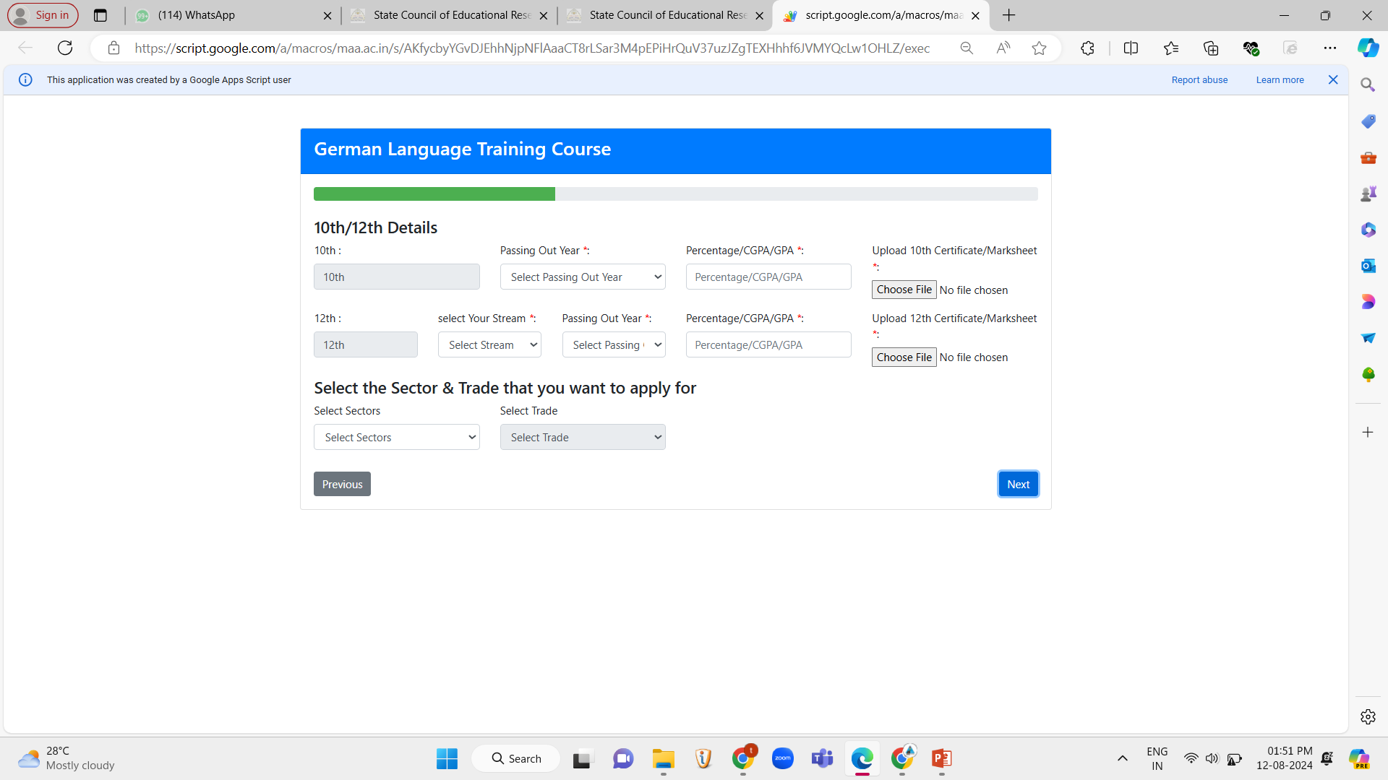
Drivers (bus/train/tram/truck)
Miscellaneous

Slide 28
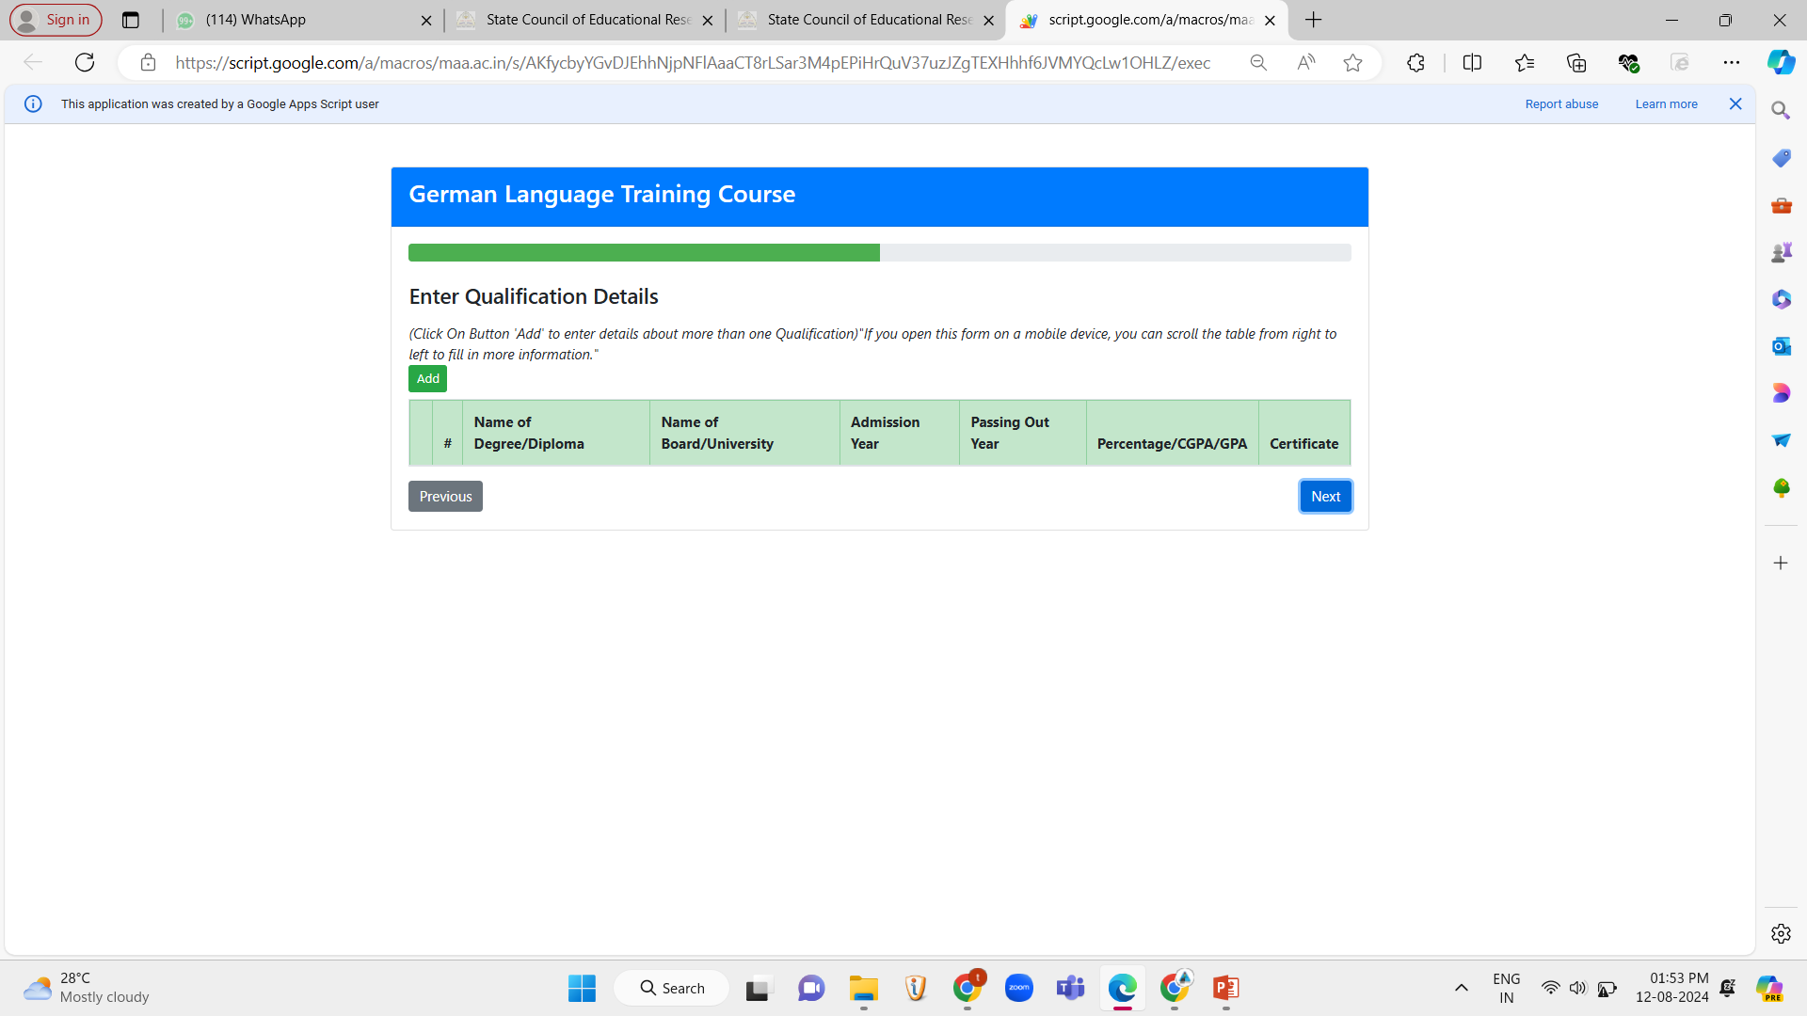

Slide 29
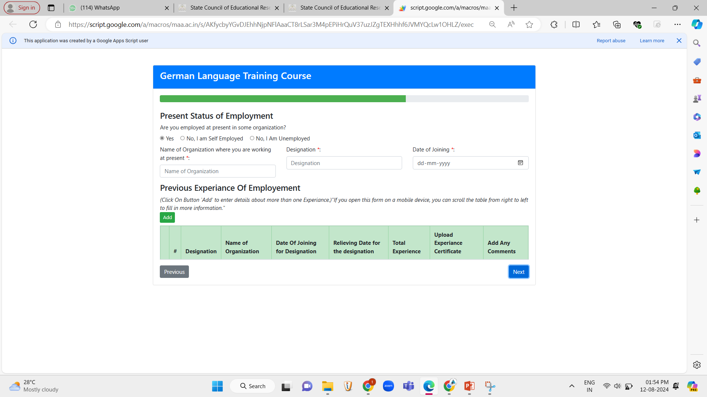

Slide 30
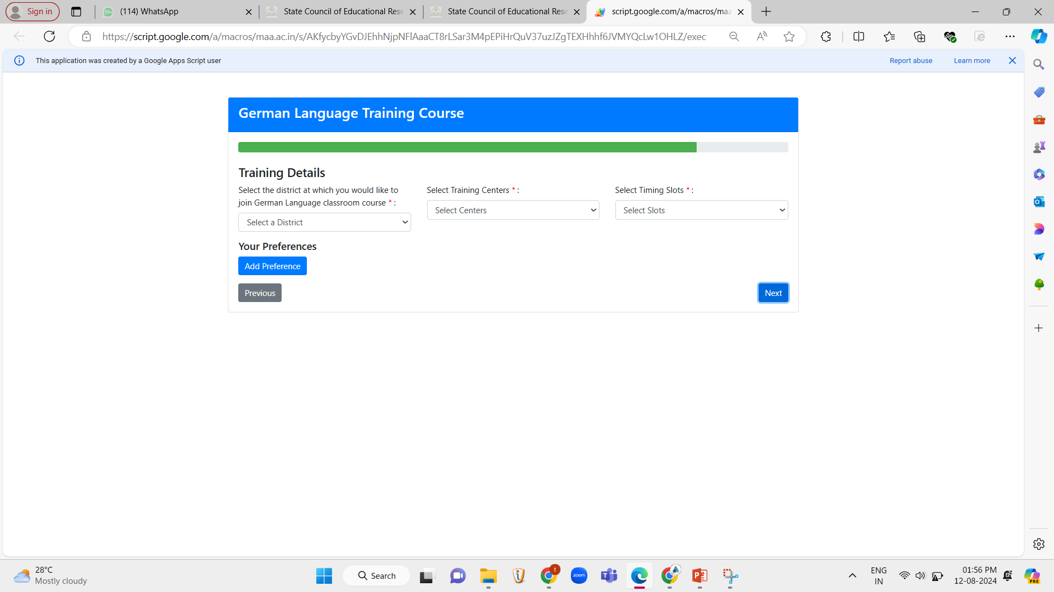

Slide 31
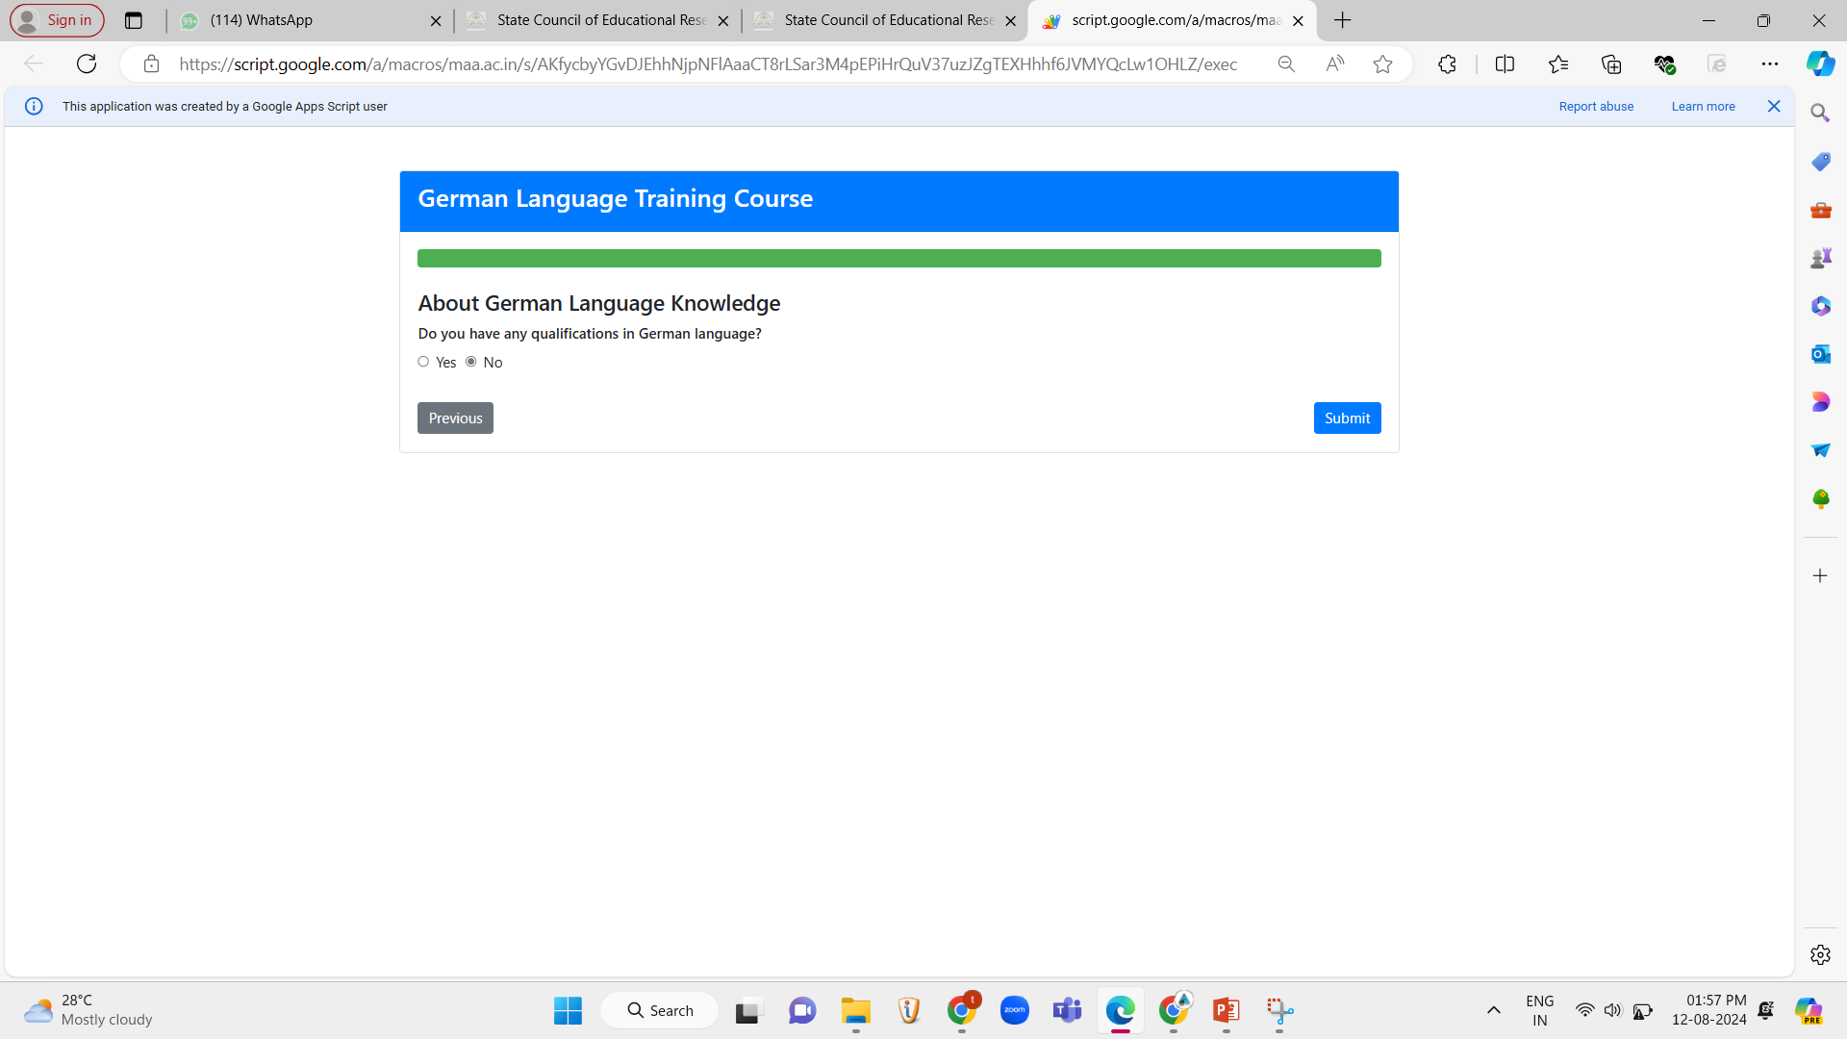

Slide 32
THANK YOU For any queries kindly contact – 8956663065

