Slide 1
Business Operations – A Walk Through
Amit Singh
19 Jun 24

Slide 2
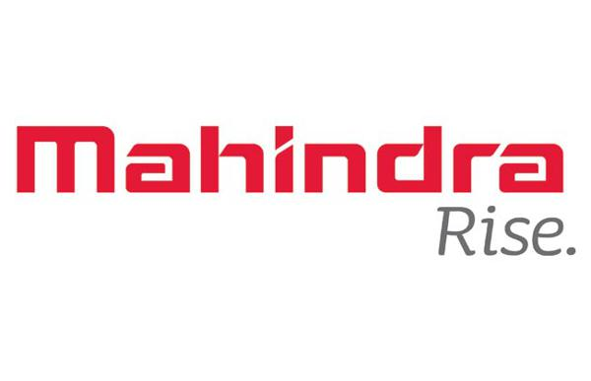
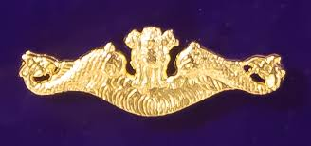

Slide 3
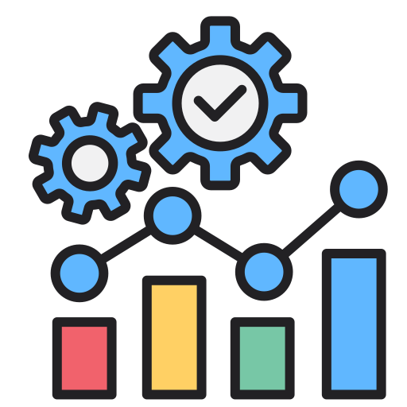
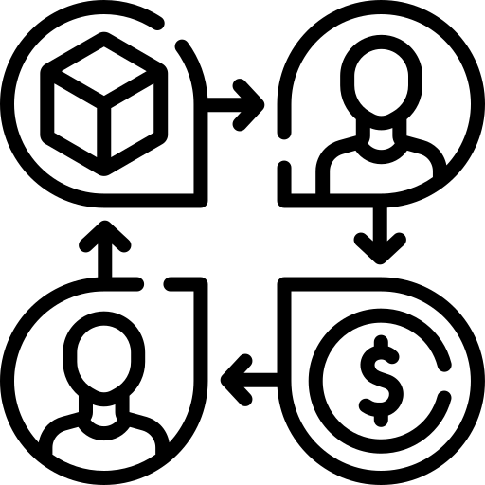
“Refer to activities that businesses engage in on a daily basis to increase the value of the enterprise and earn a profit”
Business Operations
People
Process
Capital
Data
Property
Machinery

Slide 4
Is operations a cost center or a profit center?
Cost center definition
A department or function within an organization that does not directly add to profit but still costs the organization money to operate.
Profit Center Definition
A department or function of a company that directly adds or is expected to add to the entire organization's bottom line.

Slide 5
Operations – Value Chain
Raw Material Sourcing
Storing of Raw material
Processing of Raw Material to Finished Goods
Storing of Finished Goods
Distribution of finished goods
Manage
&
Control

Slide 6
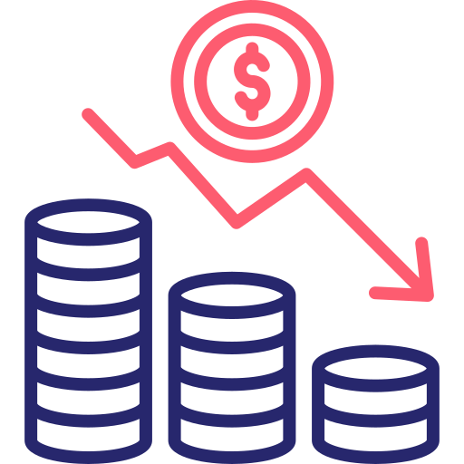
Operations – Goals
Cost Reduction
Quality Improvement
Speed of execution
Flexibility
Reliability
Note:- In line with your companies business
Gyan 1:- Success has many fathers, failure has only one- By Unknown

Slide 7
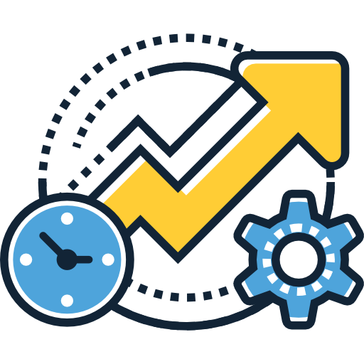
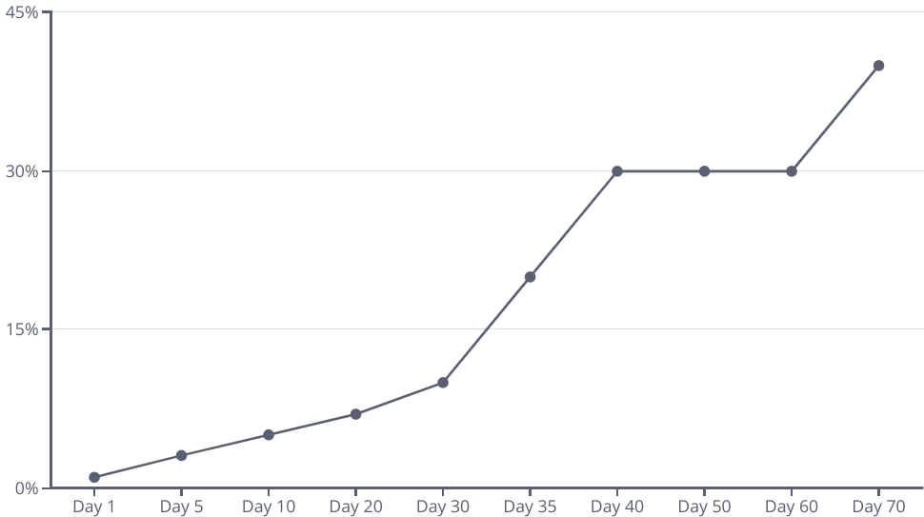
Productivity & Efficiency
Technology Upgrade
Productivity
= Output/Input
Efficiency
= Useful Output/
Input
Via process improvements
% Improvement
Time
Time Vs Improvement Graph
Gyan 2:- If there are nine rabbits on the ground, if you want to catch one, just focus on one- By Jack Ma
Notes:
While it’s important to be productive, it’s even more important to be efficient. Here are a few tips to help increase efficiency at your workplace:
1. Create a routine and stick to it. Having a set time management routine helps you focus on your tasks and eliminates distractions.
2. Organize your workspace. Keeping your workspace organized makes it easier to find what you need and eliminates distractions.
3. Taking breaks. Breaks help you to refresh and refocus, which can help you be more productive when you return to your tasks.

Slide 8
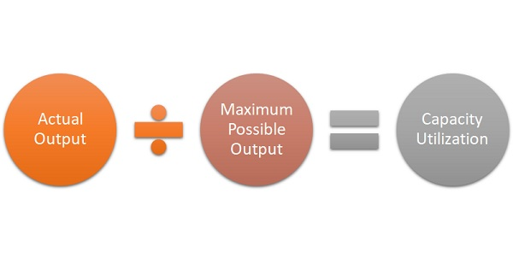
Capacity Utilization
A Higher Capacity Utilization >80% will give the following benefits :-
Improve resource allocation
Reduces cost
Improve Profits
Achieve break even point faster
Build Morale
Source:- www.mbaskool.com
Gyan -3:- Biggest cost is not power, or servers, or people. Its lack of utilization. It dominates all other costs- By Jeff Bezos

Slide 9
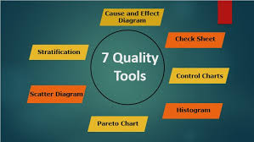
Quality
Definitions
“Conformance to Standards”
&
“Fitness for use—as defined by the customer”
Source:- www.educba.com
Gyan 4:- Quality is not an act, it’s a habit- By Aristotle

Slide 10
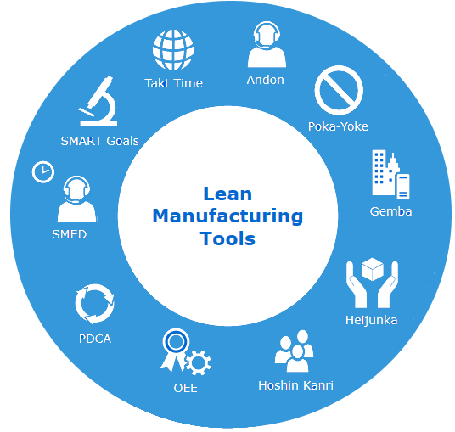
Lean and Continuous Improvement
Source:- https://softwareconnect.com/manufacturing/lean-tools/
Gyan -5 - The most dangerous kind of waste is the waste we do not recognize– by Toyota

Slide 11
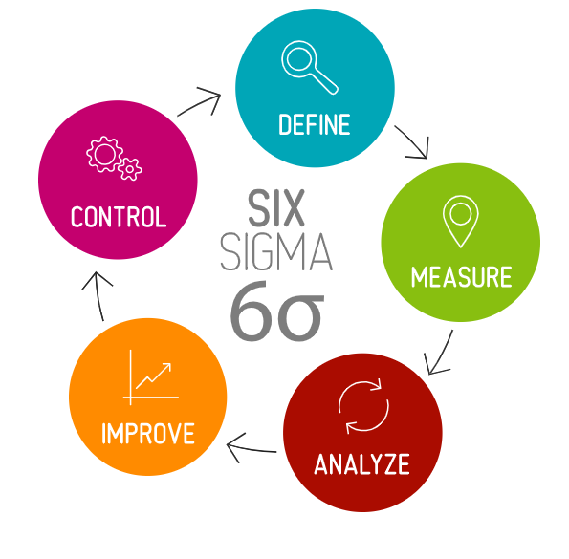
Six Sigma - PDCA- Cycle
Six Sigma- A method that provides organizations tools to improve the capability of their business processes
Define: Identify the problem
Measure: Measure the performance of the process
Analysis: Analyze it to find out.
Improvement: Figure out the best possible solutions for the issue.
Control: Start small when you implement each new process. Compare the results to the
Gyan -6 – If you cannot measure, you cannot improve- by H James Harrington

Slide 12
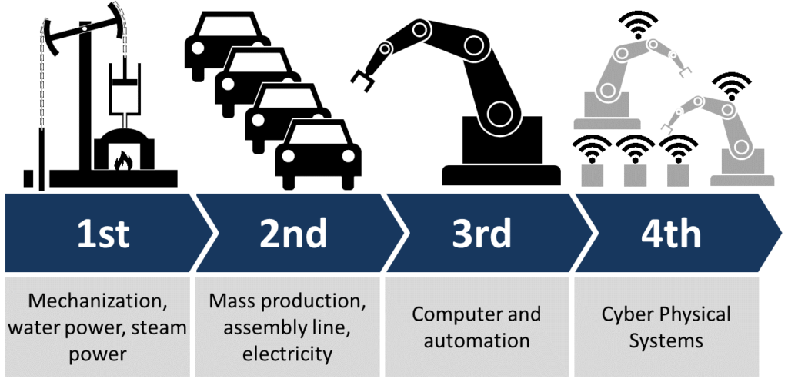
Technology- Industry 4.0
Automation
Deploying robotics and AI to streamline repetitive tasks and enhance productivity
IoT
Connected devices and real-time data analytics to optimize asset utilization and maintenance
Cloud Computing
Flexible, scalable, and cost-effective IT infrastructure to support operations
Supply Chain Tech
Source:- https://www.renaix.com/industry-4-0-the-fourth-industrial-revolution/
Advanced planning, visibility, and collaboration tools to enhance supply chain efficiency
Gyan -7 – Technology is an enabler and not the silver bullet - by Unknown

Slide 13
People – Behavioral Aspects
10 Things That Require ZERO Talent
Being on time
Work ethic
Effort
Body Language
Energy
Attitude
Passion
Being Coachable
Doing Extra
Being Prepared
Organization Culture + People
Behavior
Definition :- Culture is consistent, observable patterns of behavior in organizations
Gyan -7 – Great things are never done by one person, they are done by a team- By Steve Jobs

Slide 14
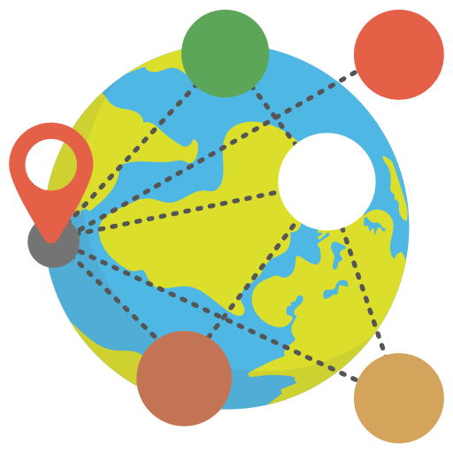
Challenges – In Operations
Globalization
Sustainability
Communication
Talent

Slide 15
Conclusion
Operations is the life blood of any organization
Mastering Operations is critical for competitive advantage
Embracing technology is key to future proof operations
Developing a strong operational mindset is critical

Slide 16
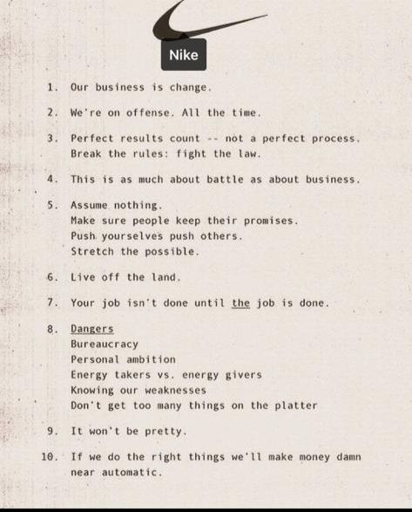
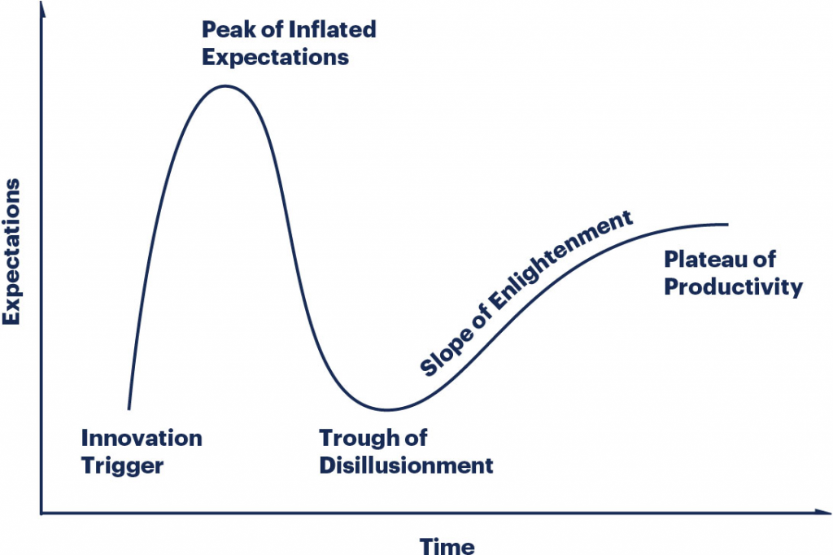
Last Gyan
Gartners Hype Curve

Slide 17
Thank you

